Slide 1
Module 2:
The Lotus Blossom
Notes:
In this module, we’re going to talk about one of the most popular and powerful tools in the innovation toolkit, the Lotus Blossom

Slide 2
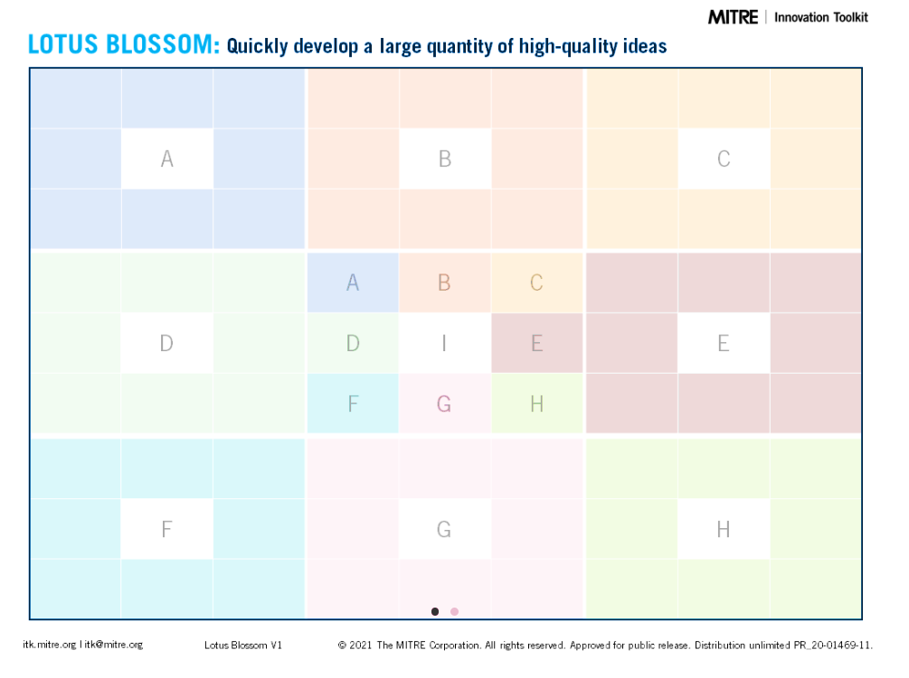
Notes:
The Lotus Blossom is an ideation tool that is designed to help teams quickly develop a larger quantity of higher quality ideas than traditional brainstorming.
Instead of sitting around trying to come up with ideas in an unstructured way, the Lotus Blossom uses this 9x9 grid of colored squares to document a brainstorming discussion and to assemble everyone’s ideas into a visual artifact that is organized, binned, and sorted.
As you can see, the grid is divided into 3x3 sub grids – we call those Blossoms and they each have their own color. The individual squares that make up each blossom are referred to as Petals.
So we might direct the group’s attention to the Blue blossom in the upper left corner, and ask about the middle petal on the left column

Slide 3
Notes:
We’re talking about this one – were you all able to follow along when I said blue blossom in the upper left corner, middle pedal on the left side?

Slide 4
 |  |  |  | TOPIC
Notes:
To use the Lotus Blossom, we begin in the very center, and we write the topic of our session here

Slide 5
 |  |  | Idea A | Idea B | Idea C
 |  |  | Idea D | TOPIC | idea E
 |  |  | idea F | idea G | idea H
Notes:
Then, in the eight petals that make up the central blossom, we write eight facets or ideas that are related to our central topic.

Slide 6
Idea A-1 | Idea A-2 | Idea A-3
Idea A-4 | A | Idea A-5 |  | B |  |  | C
Idea A-6 | Idea A-7 | Idea A-8
 |  |  | idea A | idea B | idea C
 | D |  | idea D | TOPIC | idea E |  | D
 |  |  | idea F | idea G | idea H
 | F |  |  | G |  |  | H
Notes:
Each petal from the central blossom then becomes the central petal for the blossoms around the edge, and the group then comes up with eight ideas related to that thing.
We find that the first two or three ideas are the obvious things, while ideas 6, 7, and 8 tend to be more creative and imaginative. We also find that having these blank spaces creates a type of creative pressure – we want to fill in those boxes, and so we stretch ourselves and think of things we wouldn’t have thought of otherwise, because we keep going rather than stopping at 3…

Slide 7
 |  |  |  | Healthier
Notes:
So let’s do a quick example, let’s say we want to explore ideas around helping people get healthier.
We might use a Lotus Blossom to scope out the problem, to understand and define it and narrow it, because “helping people get healthier” is super broad.

Slide 8
 |  |  | Aging | Poverty | Military
 |  |  | Idea D | Healthier | idea E
 |  |  | idea F | idea G | idea H
Notes:
If we want to use a lotus blossom to brainstorm around the problem of “help people get healthier,” we might develop a list of possible groups to focus on – they all might need different solutions to help them be healthier. So before we get into solutions, let’s understand the problem. When we say we want to help people get healthier, which people are we talking about?
We might talk about helping people get healthier as they age, or improving health for communities with very limited resource, or military personnel recovering from injury… you get the picture. We could come up with 8 possible groups, then use the rest of the lotus blossom to look at different aspects of each

Slide 9
Expertise | Scope | Who else
Opp’ty | Aging
 |  |  | Aging | Poverty | Military
 |  |  | Idea D | Healthier | idea E
 |  |  | idea F | idea G | idea H
Notes:
We might brainstorm about our expertise on that topic – do we have experts on healthy aging? Or what about the scope and scale of it - how big is this community, where are they located? We might talk about the scope – how critical is the need? We might talk about who else is doing this work and might partner with us – and we keep exploring different facets of each potential problem area until we’ve got 8 for each one. Of course, we can add more and overflow beyond the 8 boxes
When it’s done, we’ll have a better understanding of the scope of the problem. This might help us prioritize our problem space, through whichever lens we pick. We might choose to focus on the community that has the greatest number of people, the biggest need, the closest alignment with our skills and knowledge, or whatever other criteria we decide matter most.

Slide 10
 |  |  | Diet | Exercise | Social
 |  |  | Meds | Healthier | idea E
 |  |  | idea F | idea G | idea H
Notes:
Or maybe we have the problem well framed already – let’s say we’re working to improve health in communities with very limited resources. In that case, we can use the Lotus Blossom to explore SOLUTIONS
In that case, we’d fill up the LB with things like Diet, exercise, or social support, medication or the social determinants of health.

Slide 11
Access | Education
 | DIET
 |  |  | Diet | Exercise | Social
 |  |  | Meds | Healthier | idea E
 |  |  | idea F | idea G | idea H
Notes:
And then we would copy diet into middle of the upper left blossom and explore 8 ideas related to diet.
Food deserts are a big problem, so maybe the solution includes increasing access to healthy foods.
And maybe people also need better education about how to eat healthy.
We’d then fill in the rest of the lotus blossom with solution-oriented ideas around diet, exercise, and whatever else we came up with in the central blossom.

Slide 12
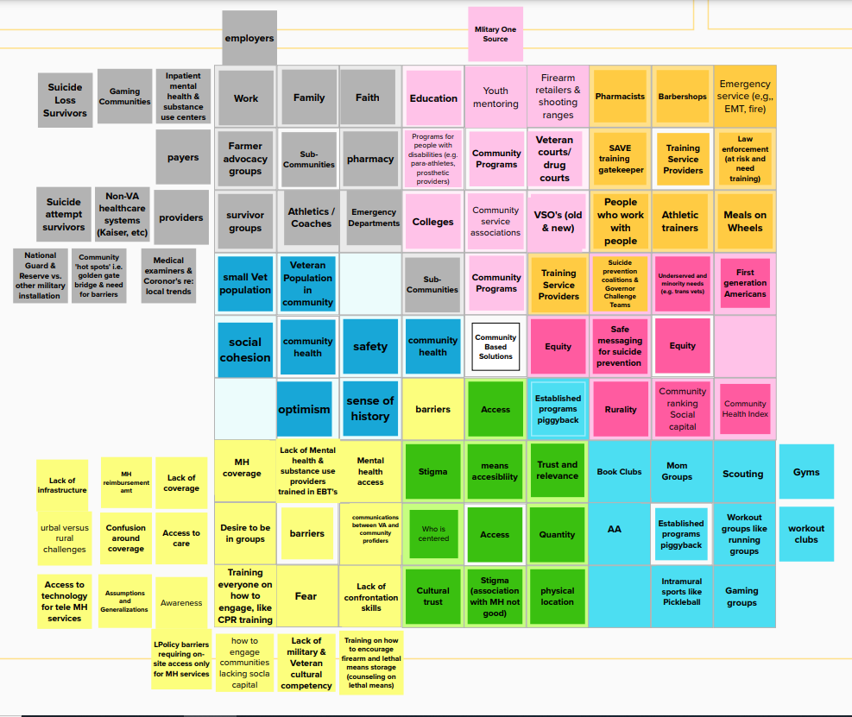
Notes:
When we’re done, it might look something like this. For this particular case, we used a virtual whiteboard called Mural.
We produced a colorful artifact that documented the discussion and captured everyone’s inputs in a way that is organized and sorted. As you can see, several of the blossoms went well beyond the usual 8 topics – that often happens with a big group – and a few blossoms have some empty petals. That’s ok too.
We might refer back to it as a way to remember what we discussed, or we might use it in a conversation with someone who wasn’t there, to get them up to speed on what we came up with.

Slide 13
 |  |  | Idea A | Idea B | Idea C
 |  |  | Idea D | TOPIC | idea E
 |  |  | Barriers | idea G | idea H
 | Barriers
Notes:
One technique I tend to use is the Barriers Blossom – I usually put it in the lower left corner, and it’s a place where people can put all the things that get in the way of whatever the topic is. Because regardless of our topic, there are always barriers… so here’s a place to write about those.

Slide 14
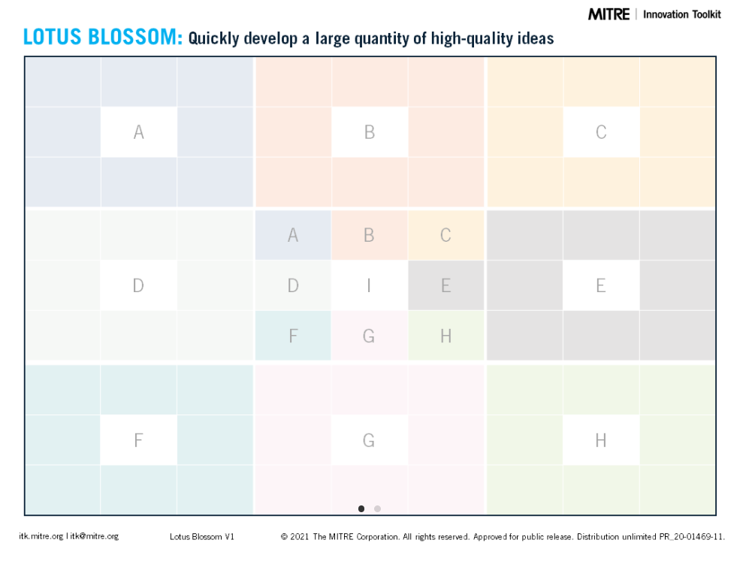
https://itk.mitre.org/
toolkit-tools/lotus-blossom/
Notes:
You can learn more about LB and download templates at the link on your screen!

