Slide 1
ITK
Certification
Jump Start!
Day 1
Accelerating your path towards ITK Certification
With Dan Ward and Lynne Cuppernull
©2024 The MITRE Corporation. ALL RIGHTS RESERVED Approved for public release. Distribution unlimited 24-02352-12
This work is licensed under CC BY-SA 4.0.
Notes:
Lynne
Intro selves, etc
Introduce each other at table groups – what did you want to be when you were 10 years old?
Participative – don’t hold questions to the end, talk with each other
We’ll take breaks regularly – feel free to step out as needed
Our goal with these 2 days is to give you a jump start towards certification -

Slide 2
Write a definition of innovation.
Notes:
Lynne
Let’s get right to it – in 60 seconds, write a definition of innovation on one of the 3x5 cards

Slide 3
A FEW PROCEDURAL
QUESTIONS!
Notes:
Lynne
Before we get to the definitions, I have a few procedure questions…
How many of you compared notes with a neighbor? Used Google? Asked me?
If not, why not?
Did anyone feel like this was supposed to be a competition?
Did anyone feel like that would have been cheating? If so, why?

Slide 4
A FEW PROCEDURAL
OBSERVATIONS!
The instruction did not put any limitations on you
There are a lot of resources around you
Something intended for 1 use might be useful in other ways
Notes:
Lynne
I didn’t put any limitations on you – one key innovation practice is to not self-impose restrictions on ourselves.
Another key practice is to make full use of the resources around you, find otherwise overlooked things
Finally, take something intended for 1 use and put it to some other use.

Slide 5
Share Your Answer!
“Innovation is…”
Photo by Kate Kalvach on Unsplash
Notes:
Lynne
As a general rule, in our time together if we ask you to write something down, we’ll also give you an opportunity to say it out loud.
So… does anyone want to share what you wrote down?
Did anyone write down the exact same thing as anyone else? What might that tell us…?

Slide 6
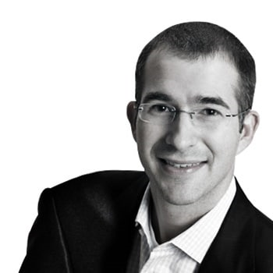
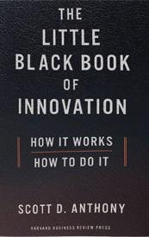
“I have written several books on innovation, totaling close a quarter million words. I went back and looked, and in not one of those books do I actually define what innovation is.
That’s a glaring oversight.”
- Scott Anthony, The Little Black Book of Innovation
Notes:
Dan
Here’s why we like to start with this activity - Innovation is one of those words we often use without defining it… even among people who do this sort of thing for a living.
This is from Scott Anthony’s “Little Black Book of Innovation” – and I wish I’d read his book before I wrote my first one, because I also overlooked that…

Slide 7
Novelty
Impact
Notes:
Dan
Here’s how we like to define innovation – Novelty with Impact.
We like it because it’s just 3 words, easy to remember
Novelty distinguishes innovative solutions from status quo solutions
Impact distinguishes innovative solutions from something that’s merely creative / different (but doesn’t make a difference)
Take a look at what you wrote: Does your definition address these 2 things? Circle ref’s to Novelty, Underline ref’s to Impact, got something circled & something underlined – you’re good to go! If not, you may want to add…

Slide 8
What NOVELTY do you want to introduce?
What IMPACT do you want to have?
Notes:
Dan
But the thing we like most about that def’n is that it puts two key questions on the table – so take a moment to write down some thoughts about your work.

Slide 9
Share Your Answer!
Describe your Novelty & Impact
Photo by Kate Kalvach on Unsplash
Notes:
Dan: Share with someone next to you. Then share a few out with the larger groups

Slide 10
EXPERIMENT
INTERVENTION + OBSERVATIONS
Notes:
Dan
One of the techniques we find useful for addressing a lot of those barriers is to do experiments.
I like to define and experiment as an intervention followed by observations.
Why do we do experiments? To learn…
An experiment is not a change or an improvement – it’s about gathering data.
The best experiments are reversable interventions.
Should be done “with, not to”

Slide 11
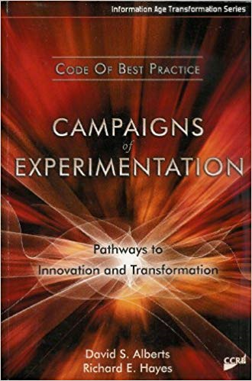
“Trying to do too much in a single experiment greatly increases the probability that the experiment will generate little in the way of useful information or experience, and therefore be of little value.
“Overly ambitious efforts are a waste of time, talent, and resources.”
Campaign of Experiments, pg 3
https://apps.dtic.mil/sti/pdfs/ADA457167.pdf
Notes:
Dan
The idea of launching a series of small, restrained, inexpensive experiments gets a pretty strong endorsement in the Campaigns of Experiments book (which is available as a free PDF if you want to get a copy – the URL is at the bottom of the screen).
What say you – they’re making a strong statement here, what do you think?

Slide 12
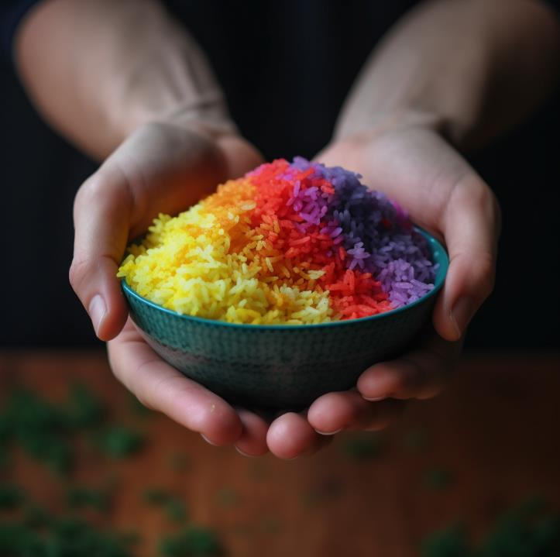
RAPID
ITERATIVE
COLLABORATIVE
EXPERIMENTS
Notes:
Dan
Lately I’ve been experimenting with the acronym RICE. We’ve already talked about E, let’s briefly talk about R & I & C.
Rapid – do it quickly, don’t delay
Iterative – do it repeatedly, build on previous experiments, etc
Collaborative – do it with, not to; include & invite; bring in stakeholders, etc.
When we pitch a RICE experiment, we’re more likely to be able to proceed – inviting people to contribute to a quick, inexpensive, reversible intervention that’s designed to provide some data…

Slide 13
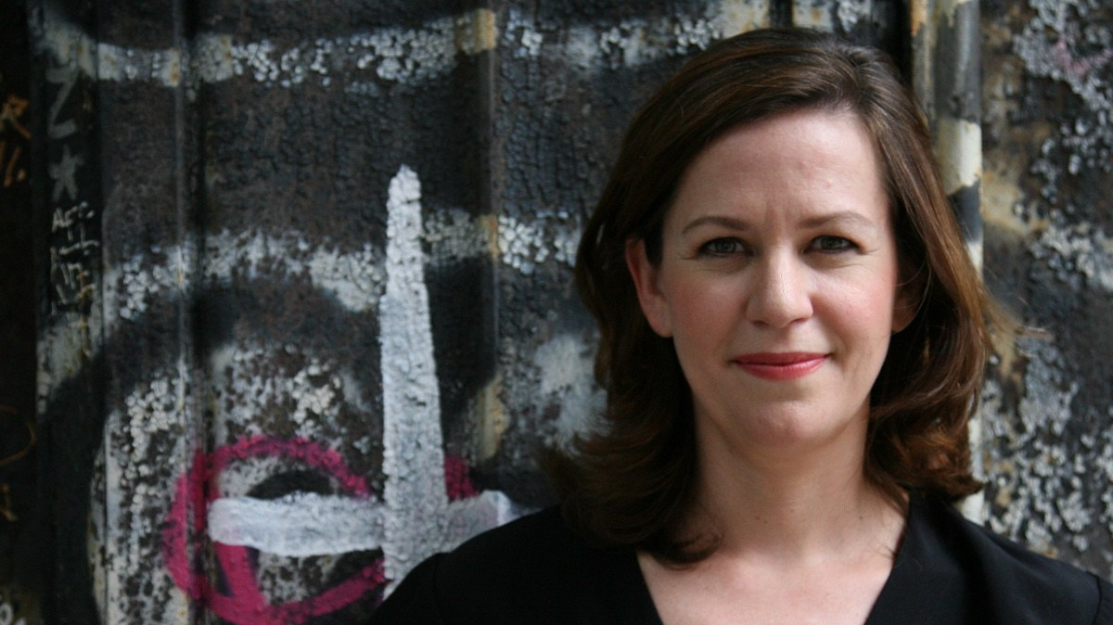
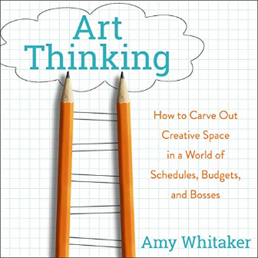
“… give yourself permission to
be more curious
than absolutely correct…”
Amy Whitaker
Art Thinking
Notes:
Dan
As you think about experiment, take some advice from Amy Whitaker – focus on curiosity, focus on trying stuff you haven’t tried before, stuff that might help you learn something new… and not just asking the obvious question, but asking the NEXT question…

Slide 14
What do you want to learn?
What kind of experiment could you do?
Notes:
Lynne
Let’s think about the impact you want to have (examples from previous discussion), or maybe some of the barriers that stand in the way.
What stuff do you want to learn? What kind of data would it be helpful to have? What are you curious about?
What sort of experiment might you do?
And our favorite type of experiment is “make a real thing, put it in front of a real person, see how they respond.” So what’s a real thing you could make? And who might you show it to?

Slide 15
Share Your Answer!
Describe your Experiment
Photo by Kate Kalvach on Unsplash
Notes:
Lynne
With a big group like this, it’s tricky to share a more nuanced and detailed answer to these questions – so we want you to write down someone’s name – you’re going to go find them later and talk with them about your experiment. Maybe even invite them to join you in the experiment – because remember, this is a team sport!

Slide 16
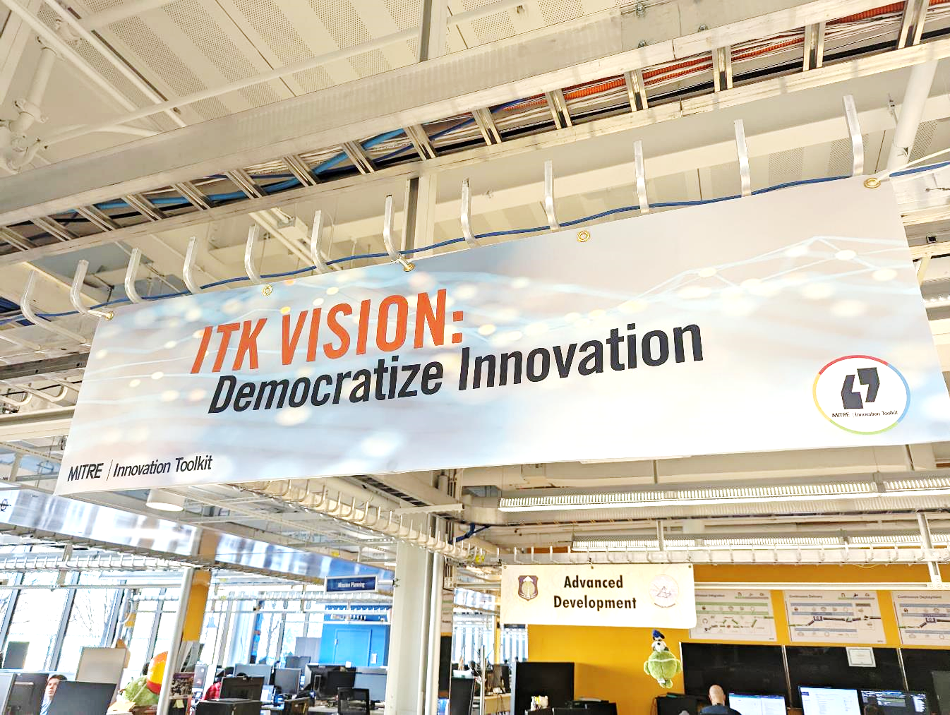
Tools
Techniques
Training
Teammates
Notes:
Lynne
Let’s talk briefly about ITK’s vision & mission.
A Vision is an aspirational description of the future. It should be clear, short, and inspiring.
ITK’s vision is to democratize innovation, to help create a world where everyone has access to the 4 T’s (tools, techniques, training, and teammates) that they need in order to be effective innovators.
Anything stand out in this vision statement for you?
Tools – simple and repeatable frameworks that push us to think differently
Techniques – practices that help us collaborate and invite all the knowledge and experience in the room
Training – teaching and sharing about approaches that work—and don’t work
Teammates – supporting and helping each other on our innovation journey

Slide 17
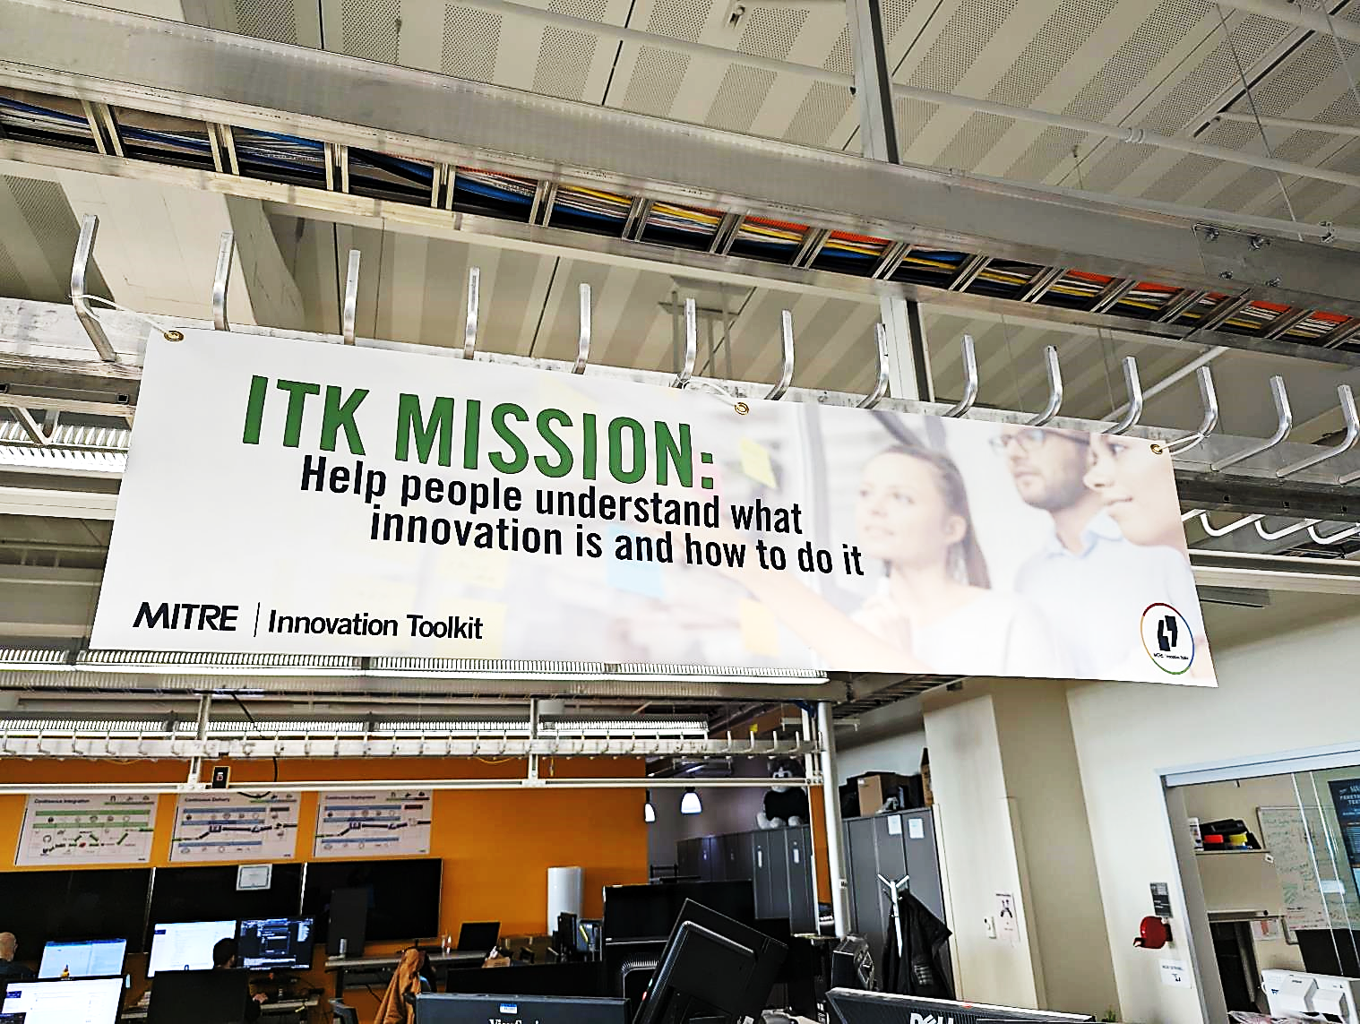
Notes:
Lynne
A Mission statement then is a concrete description of a group’s present activities.
I LOVE that the first two words of ITK’s mission are HELP PEOPLE… that’s where we really focus our work.
The next two parts are WHAT innovation is and HOW to do it.
Lots of different opinions about what innovation means – when we use the word, we mean “novelty with impact”
As for HOW – that’s where the tools come in…

Slide 18
Lightweight, domain agnostic & free!
Painstorming
Premortem
Personas
Prototyping
Service Blueprint
Stakeholder Map
Stakeholder Power
Mission & Vision
Problem Framing
Rose Bud Thorn
Stakeholder
Engagement
Simplicity Cycle
Stormdraining
System Map
Available at itk.mitre.org
Bodystorming
Mindmap
Journey Map
Lotus Blossom
Culture Building
Card Sorting
Trimming
Stakeholder Map
Stakeholder Power
Community Map
Stakeholder ID
Storyboarding
Value Prop Canvas
Triz Prism
Notes:
Lynne
MITRE’s innovation toolkit is a set of free tools & techniques designed to help teams work together and solve hard problems.​
Inspired largely by human-centered design, these field-tested tools spark insightful conversations, capture meaningful insights, and guide creative problem solving.
They are repeatable approaches to really understanding the problem, the users, and the context of the space they’re working in. They help you ideate creatively so that when you deliver a solution it really does hit the mark.
​​
These tools are delightfully low-tech and domain agnostic. We have used them with senior executives at NASA, with generals in the Pentagon, on our own projects, and with high school kids.

Slide 19
Notes:
Lynne
To help realize our Vision and accomplish our mission, we created a certification process for ITK facilitators. We thought this would be a good way to share the fun, spread the skills, increase our capacity, and maintain quality of our work.

Slide 20
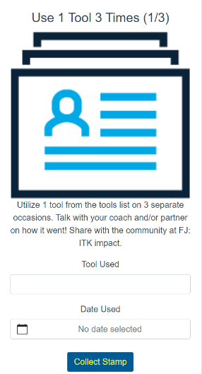
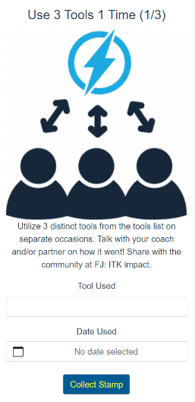
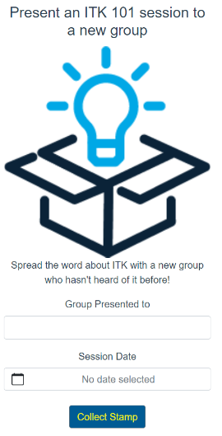
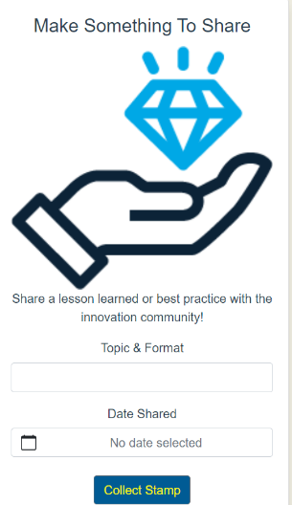
FJ: ITK Trail Map
https://itkcert.mitre.org/trailmap
Notes:
Lynne
It’s a pretty straightforward process, and you can track your progress using our online trail map.
The main requirements come down to Use 1 tool 3 times, use 3 tools 1 time, do an ITK 101 presentation, and make something to share. You’ll do all this with a coach and/or a partner – we’re big believers in the buddy system.
There’s a bit more to it than that, as you’ll see, but those are the highlights. Over the next two days, you’ll use 4 tools once (over-achievers!), you’ll hear the ITK story, we’ll talk about facilitation techniques, we hope you’ll make some connections, and you might even make something to share! My estimate is you’ll finish up about 40% of the requirements by tomorrow afternoon.

Slide 21
 |  |  |  | Topic/ Question
Lotus Blossom - Innovation Toolkit (mitre.org)
Notes:
Dan
So let’s get right to it – time to introduce you to your first ITK Tool, the Lotus Blossom!
First question – anyone ever use this one before? What do you know about it already?

Slide 22
 |  |  |  | Topic/ Question
Notes:
Dan
Focus the power of brainstorming using a structured, visual representation of ideas—pushing you to fill out every box with new ideas.
Use Lotus Blossom when you need to quickly produce a large quantity of ideas or are exploring a range of facets of a problem, solution, or topic.
Help develop many ideas with a focus on quantity. This structured ideation method helps accelerate the process of coming up with ideas, and also makes the next step (sorting, assessing, filtering, etc) faster because the Lotus Blossom is a structured artifact where the ideas are already binned and organized. This tool also helps unlock creativity by encouraging users to go beyond the obvious “first thought” ideas and to instead come up with eight items for each blossom. We find that the 6th, 7th, and 8th idea tend to be the most creative. As a collaboration tool, this helps ensure the entire group is able to contribute and participate, with no judgment or unnecessary barriers.
Eight 3-by-3-inch squares are arranged around a center blossom. The center square of each blossom contains a concept or problem related to the other squares of the blossom.
STEP 1: Enter a problem to be solved, an item to be improved, or a theme to be examined in the center box (Box I in the example).
STEP 2: Brainstorm related components, solutions, or themes and put them in the boxes immediately surrounding the center box (Boxes A-H).
STEP 3: Use the values from those boxes as the center of the eight lotus blossoms on the outer edges of the sheet. (You’re propagating ideas.)
STEP 4: Brainstorm related components, solutions, or themes, and enter these in the eight boxes surrounding each of the new center seeds for each outer lotus blossom. Try your best to complete all the blossoms to maximize ideas.
STEP 5: When the exercise is complete, you will have at least 64 new ideas to explore related to the original problem or theme.

Slide 23
 |  |  | idea A | idea B | idea C
 |  |  | idea D | Topic/ Question | idea E
 |  |  | idea F | idea G | Idea H
Notes:
Dan
Ideas A – H can reflect various facets or aspects of the topic you’re exploring or the question you’re aiming to answer.

Slide 24
Idea A-1 | Idea A-2 | Idea A-3
Idea A-4 | A | Idea A-5 |  | B |  |  | C
Idea A-6 | Idea A-7 | Idea A-8
 |  |  | idea A | idea B | idea C
 | D |  | idea D | Topic/ Question | idea E |  | D
 |  |  | idea F | idea G | Idea H
 | F |  |  | G |  |  | H
Notes:
One potential twist – you may occasionally find an idea in one of these blossoms that you want to expand on further…

Slide 25
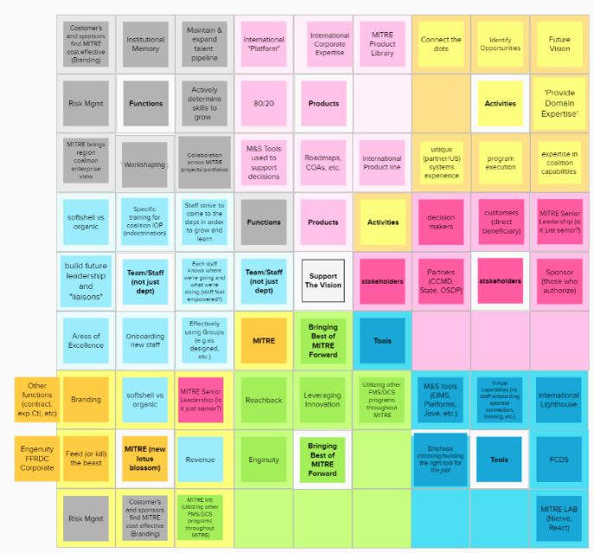
Notes:
Dan
When you’re finished, it might end up looking something like this… and you don’t need to read any of these words, just see that we’ve come up with a lot of ideas, they’re binned & categorized & organized.
In particular, notice the lower left corner – that blossom has lots of different colors in it, because we had ideas start in one blossomg (blue, green, grey, etc) and then moved them down to their own blossom

Slide 26
Exercise – Lotus Blossom Practice!
Let’s brainstorm a couple of topics!
Break into two groups
Notes:
Dan

Slide 27
Break Time!

Slide 28
(c) 2021 The MITRE Corporation. ALL RIGHTS RESERVED.
Approved for public release. Distribution unlimited PR_20-01469-9
Notes:
Dan
In 1985, Echo & The Bunnymen released one of my favorite albums, Songs to Learn and Sing.
I loved the music but I also liked the title and so I named this module…

Slide 29
PHRASES TO LEARN & USE
Notes:
Dan
Phrases to learn and use!!!
We’re going to take a few minutes to talk through a handful of phrases & questions you may want to use when you’re facilitating an ITK session.

Slide 30
If you think it, ink it.
Notes:
Dan
This is a great way to encourage participation by asking people to capture their own ideas, in their own words.
It makes each person’s contributions visible to the rest of the group and gives the facilitator something to point to if there’s a lull in the conversation.
This also contributes to the canvas or artifact the group is creating.
But most importantly, it helps people focus & clarify their thinking by putting their idea down in writing.

Slide 31
Say more about that…
Notes:
Lynne
Sometimes I’m not sure how to respond to someone’s comment. Maybe I didn’t quite follow what they said, or their idea was incomplete or confusing? Or sometimes the rest of the group responds with silence when someone says something.
In all these situations, you may want to go with “Can you say more about that?” This can be a very encouraging response and keeps the conversation moving. It’s also a great way to draw attention to a really good idea that the rest of the group might have overlooked.

Slide 32
I think what I’m hearing is…
Notes:
Lynne
Mirroring and summarizing the group’s comments is a powerful way for a facilitator to move the group towards clarity and consensus.
Here’s the good news - even if my summary is wrong, that’s still a useful input because it creates an opportunity for the rest of the group to clarify and correct previous statements, and gives the group something specific to respond to.

Slide 33
Who have we not heard from?
Notes:
Lynne
I love this question. I ask it in pretty much every session I facilitate.
Rather than calling out anyone by name or putting anyone on the spot, this phrase creates space for quieter participants to join the conversation and share their ideas.
It also provides a very gentle signal to dominant voices and over-sharers to step back for a moment and make room for others.

Slide 34
Great idea, can you write that down in your own words so we don’t lose it?
Notes:
Lynne
Asking someone to write down their idea is a great way to manage a dominant voice. It simultaneously expresses appreciation for their inputs, empowers them to keep contributing, and it shuts them up because they can’t talk and write at the same time.
This creates space for others to contribute and does so in a really positive way.

Slide 35
There’s a zero percent chance we got this 100% right on the first try.
Notes:
Dan
This phrase encourages participants to experiment and try things. It gives everyone permission to get it a little wrong at first… and that can be really freeing.
This phrase is particularly helpful for making perfectionists feel a little more comfortable taking a first step, because it points out two important things: First, getting it perfect from the start is not an option, and second, we’ll get more than one try.

Slide 36
This is the beginning of a conversation, not the end of one.
Notes:
Dan
This phrase helps set expectations for the session’s outcomes.
It encourages participants to keep doing the work after the session is over. I like to say this at the kick-off, to sort of set the stage, and then say it again towards the end as a reminder / send-off.
It’s an invitation to keep keep going…

Slide 37
Yes, and…
Notes:
Dan
We did a whole four-week training series on this topic a few years back, but the short version is that this improv technique can go a long way towards building a positive, creative environment for your session.
Don’t feel limited to those specific words. There are lots of ways to affirm and build on someone’s comment. One tip – saying “Yes” doesn’t necessarily mean you’re agreeing with someone. You’re simply acknowledging their contribution & affirming their participation, then adding to it. This is a great phrase to teach the rest of the group and invite them to use it too.

Slide 38
Distill
It
Down.
Notes:
Dan
When talking about simplifying something, we like to talk about “distilling” rather than “boiling.”
The difference is that distillation tends to concentrate and purify a substance, while boiling can sort of strip the flavor out of something.
I think distillation is a more apt metaphor.

Slide 39
Let’s
Discuss!
What might
you add?
Photo by Kate Kalvach on Unsplash
Notes:
Lynne
OK, let’s discuss these phrases – what might you add? Any you particularly like? Any you dislike?

Slide 40
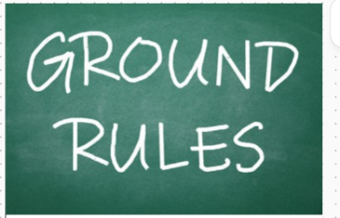
• "If you think it, ink it"
• Say “Yes, and...”
• Practice grace & respect
• Leave your rank at the door
• Have one conversation at a time
• Challenge cherished beliefs
• Articulate hidden assumptions
• Filter for intrigue, not feasibility
• Include everyone in the discussion
• Encourage wild, crazy ideas— don't censor your ideas
• Be present— Put distractions away
• Share all relevant information and give freely of your experience
• Use a “Parking Lot” space to capture important but off-track topics
Notes:
Lynne
OK, let’s talk about ground rules when facilitating a session. Here’s a notional list you might draw from – spoiler alert, putting this entire list up at the start of a meeting would be a bad idea…
Why? Why not just give everyone this whole list?
(My rule of thumb – 2 or 3 ground rules, carefully chosen for the particular group…)
How might you get buy-in from the group? Can the facilitator just tell everyone this is how we’ll operate?

Slide 41
Innovation Culture

Slide 42
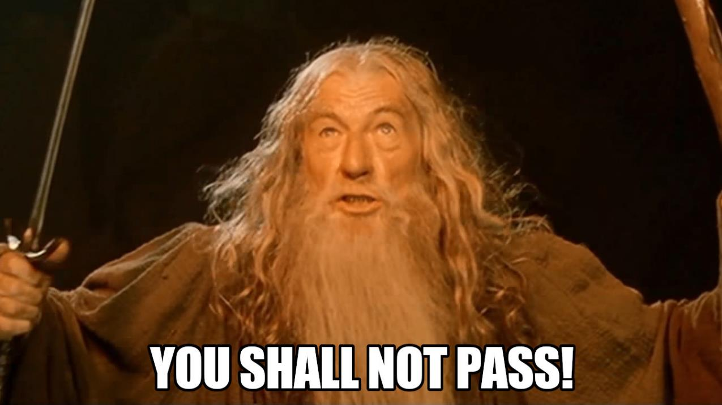
Notes:
Dan
OK, now that we’ve got a definition of innovation, let’s talk about what gets in the way & prevents it.
We’ll make a big list on the whiteboard of Barriers to Innovation. Specifically, what gets in the way of Novelty and what gets in the way of Impact?
Shout ‘em out…(lynne will capture on flip chart)
OK, now that we’ve got a big list, we’ll spend most of the rest of the class talking about how to knock those barriers down, go over / around / through them…

Slide 43
Creator: Nelosa | Credit: Getty Images/iStockphoto
Notes:
Lynne
Getting certified as an ITK Facilitator means you’re joining a community of other ITK’ers… and like any group of people, ITK has a distinct culture. So let’s talk about that a bit.
First, what does that word mean – anyone have a definition?

Slide 44
CULTURE
CULTURE
CULTURE
CULTURE
CULTURE
CULTURE
SHARED BELIEFS* AND BEHAVIORS
CULTURE
Notes:
Lynne
We like to define organizational culture as (mostly) the shared beliefs and behaviors within an organization. Other people might mean other things by that word – but this is what WE mean when we say it.
Beliefs come in two important flavors: things we believe are TRUE, and things we believe are IMPORTANT – we call that second category VALUES
It’s important to understand that culture is dynamic, not static. It’s always in flux, so these things we’re about to talk about simultaneously express culture and shape culture.
We’ve heard it said that culture is invisible – we disagree. Culture is actually FULLY visible, if we know where to look.
Let’s talk about MITRE’s culture. What are some beliefs and behaviors you might see around MITRE?

Slide 45
Culture
Culture, culture, culture
Culture, culture, culture
Culture, culture, culture
Culture, culture, culture
Culture, culture, culture
Culture, culture, culture
Culture, culture, culture
Notes:
Lynne
Some cultures believe that conformity, compliance, and bulleted lists are good.
They express this belief by making slides that look like this.

Slide 46
Culture
Culture, culture, culture
Culture, culture, culture
Culture, culture, culture
Culture, culture, culture
Culture, culture, culture
Culture, culture, culture
Culture, culture, culture
Notes:
Lynne
But the thing is, culture is never monolithic. An organization of just about any size will have sub-cultures and co-cultures and small pockets of people that do not exactly fit the larger pattern while still having a connection to the larger group.
So those bulleted lists… may be less uniform than you might expect.

Slide 47
Culture
Culture, culture, culture
Culture, culture, culture
Culture, culture, culture
Culture, culture, culture
Culture, culture, culture
Culture, culture, culture
Culture, culture, culture
Notes:
Lynne
Effective cultures don’t always spread – sometimes they remain isolated and insulated.
But with a little deliberate effort they can spread… and it’s much easier to spread an internal culture than to introduce an entirely alien culture.

Slide 48
Culture
Culture, culture, culture
Culture, culture, culture
Culture, culture, culture
Culture, culture, culture
Culture, culture, culture
Culture, culture, culture
Culture, culture, culture
Notes:
Lynne
That means it’s possible to shift the default by building on existing sub-cultures, without introducing an entirely foreign culture (which tend to trigger the corporate immune response and lots of resistance).
But again – culture is never monolithic, so we’re not aiming for complete conformity here.

Slide 49
LEADERSHIP
PEERS
PRACTITIONER
LITERATURE
TRAINING &
EDUCATION
Notes:
Dan
Where does culture come from? How do we build and maintain it?
I created this diagram a few years ago that shows some of the things that shape a culture.
We’re going to walk through the diagram a piece at a time and talk about how to use it to develop a culture change strategy.

Slide 50
LEADERSHIP
Make Decisions
Solve Problems
Take Action
PEERS
PRACTITIONER
LITERATURE
TRAINING &
EDUCATION
Notes:
Dan
We’ll start in the middle, with the box labeled Practitioner.
In our context, practitioners are the ITK facilitators and community members – the people whose beliefs and behaviors make up the culture.

Slide 51
LEADERSHIP
Metrics
Messages
Incentives
Investments
Enablers
PEERS
PRACTITIONER
LITERATURE
TRAINING &
EDUCATION
Notes:
Dan
One of the most obvious influences on a member of an organization is the organization’s leadership.
The Leadership channel represents senior decision-makers, the people who are in charge of an effort. This could be at the tactical / program manager level or at higher, strategic level (PEO and above).
This channel includes:
Metrics – what gets measured, reported, paid attention to, used, and acted upon?
Messages – what do leaders say (or not say)
Incentives – promotions, rewards, recognition, encouragements
Funding – where do leaders allocate financial resources
Enablers – other, non-financial resources, to include permissions and waivers as well as facilities and processes

Slide 52
LEADERSHIP
PEERS
PRACTITIONER
LITERATURE
Networking
Mentoring
Best Practices
Informal Links
Hallway Conversations
TRAINING &
EDUCATION
Notes:
Dan
The Peer channel represents the practitioner’s colleagues, collaborators, and competitors. The people who are working on the effort with the practitioner or are working on similar efforts, inside and outside the organization.
This channel includes:
Informal and formal networking and mentoring activities, the best practices that are actually shared, discussed, and adopted. It includes OJT and side conversations over coffee.

Slide 53
LEADERSHIP
Books
Papers
Articles
Videos
Comics
Blogs
Tweets
Memes
PEERS
PRACTITIONER
LITERATURE
TRAINING &
EDUCATION
Notes:
The Literature channel includes the various media that convey professionally-relevant information. It is generally self-directed and self-selected, and represents the things people actually read, watch, or engage with. I’ve never seen a significant culture build that wasn’t based on some sort of document – Declaration of Indep, Agile S/W Manifesto, every religion ever, Accelerate Change or Lose,
This channel includes:
formal academic studies and papers as well as informal blogs and social media streams.
Video and other graphics (comics, memes, etc)

Slide 54
LEADERSHIP
PEERS
PRACTITIONER
LITERATURE
Classes
Workshops
Presentations
Webinars
Lunch & Learn
TRAINING &
EDUCATION
Notes:
Dan
The Literature channel includes the various media that convey professionally-relevant information. It is generally self-directed and self-selected, and represents the things people actually read, watch, or engage with. I’ve never seen a significant culture build that wasn’t based on some sort of document – Declaration of Indep, Agile S/W Manifesto, every religion ever, Accelerate Change or Lose,
This channel includes:
formal academic studies and papers as well as informal blogs and social media streams.
Video and other graphics (comics, memes, etc)

Slide 55
LEADERSHIP
CHANNEL #5?
PEERS
PRACTITIONER
LITERATURE
TRAINING &
EDUCATION
Notes:
Dan
Is there a fifth influence channel? Sure. And maybe a 6th and a 7th.
The point of this model is not to definitively and comprehensively identify all the sources of influence. This is a deliberately and admittedly simplified sketch of some influence channels. The only thing we’re trying to do here is:
identify a representative sample of the most important and prominent channels,
to make people aware that such channels exist, and
to begin a discussion about how we can use these channels to define a specific, actionable strategy to shape and define culture.

Slide 56
LEADERSHIP
PEERS
PRACTITIONER
LITERATURE
TRAINING &
EDUCATION
Notes:
And of course, none of this is intended to downplay the role of individual character, personality, preference, experience, or opinion.
These external influence channels are sources of influence, not determinants.
The individual practitioner still has agency.

Slide 57
LEADERSHIP
PEERS
PRACTITIONER
LITERATURE
TRAINING &
EDUCATION
Notes:
Dan
In fact, we should also recognize that the arrows point both ways.
Good leaders listen to and are influenced by their people.
Peer relationships go in both directions.
Practitioners can & should contribute to the literature and to training & education.

Slide 58
LEADERSHIP
The Boss’s
Recommended
Reading List
PEERS
PRACTITIONER
LITERATURE
TRAINING &
EDUCATION
Notes:
Dan
To add a little more complexity, we can note the channels are not entirely distinct – for example, if the boss provides a recommended reading list to all employees, this would be a blend of the Leadership and Literature channels.

Slide 59
LEADERSHIP
PEERS
PRACTITIONER
LITERATURE
The people you meet in class
TRAINING &
EDUCATION
Notes:
Dan
And the people you meet in class contribute to both the Peer network and to the Training & Education experience.

Slide 60
LEADERSHIP
PEERS
LITERATURE
TRAINING &
EDUCATION
Notes:
Dan
Contradictory messages from different channels leads to confusion, friction and conflict, reducing the influence any one channel might have.

Slide 61
LEADERSHIP
PEERS
LITERATURE
TRAINING &
EDUCATION
Notes:
Dan
Note that Silence is a form of contradiction.

Slide 62
LEADERSHIP
PEERS
LITERATURE
TRAINING &
EDUCATION
Notes:
Dan
Similarly, conflicting messages within individual channels dilutes the overall message (recognizing that a certain amount of conflict is inevitable).
Consistent messages from multiple channels help reinforce each other and strengthen the overall influence.
So our opportunity is to use these channels strategically, to deliberately send a message that is consistent and clear.

Slide 63
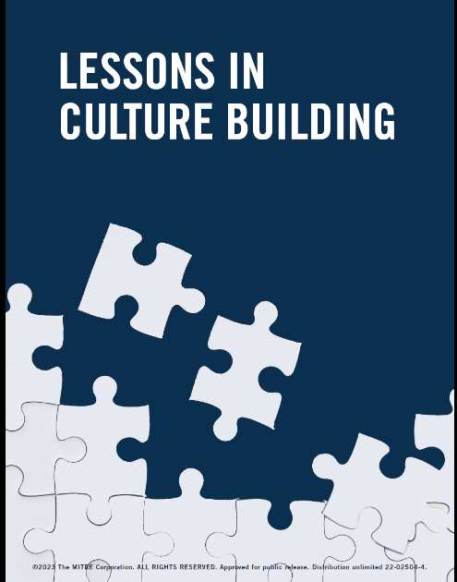
What BELIEFS and BEHAVIORS
characterize ITK’s culture?
Notes:
Lynne
We published a report about culture building a few years back, using ITK’s culture as an example.
So let’s talk about ITK culture a bit – what do you know? What do you suspect? What do you hope?

Slide 64
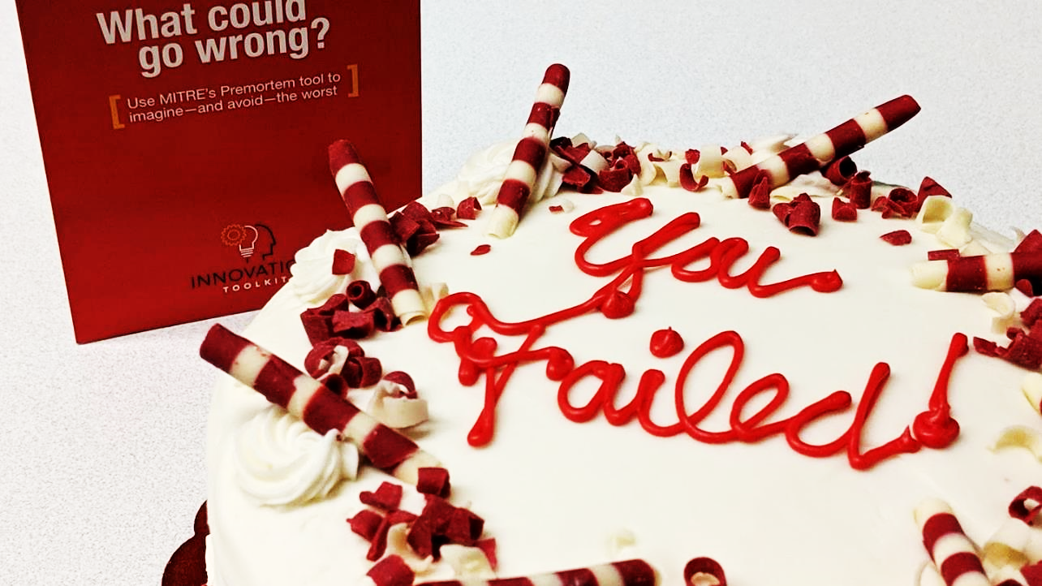
Notes:
Lynne
One of our team’s rituals – a repeated behavior – is around a thing we call Failure Cake…
Several years ago when the team was first getting started, we made a pitch for funding the ITK that was rejected. One of the team members brought in a cake the next day that said, “Can’t stop, won’t stop” and the team celebrated the failure with cake. What we were really celebrating was not the failure (cause failing sucks and isn’t fun) but the ATTEMPT to do something different that made a difference.
A key in all this talk about failure is learning. If we only acknowledge or celebrate the failure, but don’t talk about what we learned, well, then that’s a failure too.
Fast forward 6 years later…we didn’t stop, and now we have about 75 ITK trained facilitators and the ITK us being used across MITRE and with our sponsors

Slide 65
LUNCH

Slide 66
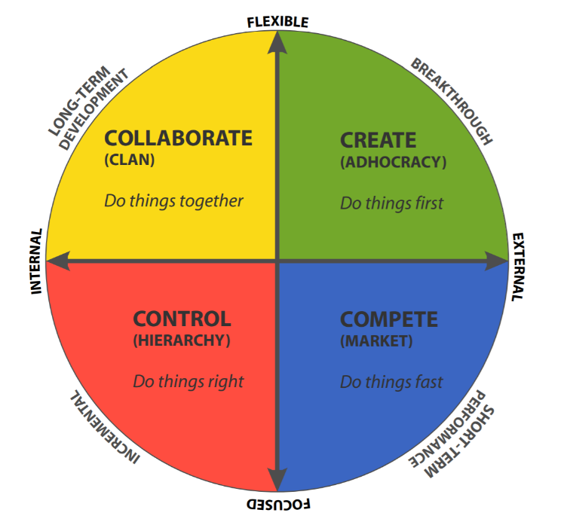
THE
COMPETING VALUES
FRAMEWORK
A Quick Intro
to
Robert Quinn’s CVF
Notes:
Dan
I was introduced to the CVF earlier this year, and have found it to be really interesting & helpful.

Slide 67
ASSESSING
EFFECTIVENESS?
Notes:
Dan
The basic question the CVF set out to explore was how to assess and define organizational effectiveness.
Surprise –their main finding is that there is NO SINGLE MEASURE of effectiveness that works for every organization or project, all the time.
Instead, they identified 4 distinct quadrants that a project or organization might move through.

Slide 68
internal
external
Notes:
Dan
The CVF is built on a pair of intersecting axes – this one shows Internally vs Externally focused org’s

Slide 69
flexible
internal
external
focused
Notes:
Dan
And org’s that value being flexible vs being focused.
Don’t worry about what these terms mean precisely yet – that’ll be clearer as we go along. Right now the point is just that these are COMPETING values –internal and external are opposites, and flexibility & focus (as they define them) are opposites

Slide 70
flexible
CREATE
GREEN
(Adhocracy)
DO THINGS FIRST
internal
external
focused
Notes:
Lynne
I think the easiest way to understand it is by looking at what happens in each quadrant.
Each one is assigned a color for easy reference, and the upper right is GREEN – in this quadrant, we value doing things FIRST. It’s all about ideas & energy & creative thinking. Classic Innovation activities, with a high emphasis on NOVELTY. The verb here is CREATE
This is typical Start Up values. It’s also common for artists and creatives and serial entrepreneurs, in MITRE this is where the MIP fans like to live. Anyone who likes to quickly move from idea to idea. Show of hands –anyone identify with that?
What might be the RISK of an all green team?
Here’s the warning: If a team is all green all the time, loads of ideas… but tends to be light on teamwork & implementation

Slide 71
flexible
COLLABORATE
YELLOW
(Clan)
DO THINGS TOGETHER
GREEN
(Adhocracy)
DO THINGS FIRST
internal
external
focused
Notes:
Lynne
So that brings us to the YELLOW quadrant. If Green is about doing things first, Yellow is about doing things TOGETHER.
bringing people together and establishing shared values & culture. Big emphasis on supporting, guiding, mentoring. The verb is Collaborate
Groups that skew yellow tend to use language like “we’re all a family here.” ITK leaned into this really hard early on (and still) – and for me personally, YELLOW is my happy place. I love bringing people together, building small teams where we can know each other. I love connecting & introducing people to each other, helping to support & advise…. Anyone else a Yellow like me?
Risk of lots of yellows?
If you have a team that’s all yellow all the time – excellent off-sites, everyone’s supported and loved, but can get stale & miss opportunities to actually do stuff that matters.

Slide 72
flexible
YELLOW
(Clan)
DO THINGS TOGETHER
GREEN
(Adhocracy)
DO THINGS FIRST
internal
external
RED
(Hierarchy)
DO THINGS RIGHT
CONTROL
focused
Notes:
Lynne
The next quadrand is RED – if Green is do things first, yellow is do things together, Red is about doing things RIGHT. We’ve shifted from valuing flexibility to valuing focus, so now there’s a big emphasis on nailing down our procedures and processes, examining our systems to make them better, getting things under engineering control so they’re repeatable, predictable, and efficient. The verb is Control.
This is classic ENGINEERING values. MITRE skews Red. So does the Pentagon. So any RED’s in this group?
Risks of lots of Reds?
What is missing?
But if it’s all red all the time, can be boring, stale, sterile, bureaucratic – while also being super efficient

Slide 73
flexible
YELLOW
(Clan)
DO THINGS TOGETHER
GREEN
(Adhocracy)
DO THINGS FIRST
internal
external
RED
(Hierarchy)
DO THINGS RIGHT
BLUE
(Market)
DO THINGS FAST
COMPETE
focused
Notes:
Lynne
Our last quadrant is Blue, and this one is about doing things FAST – again, Competing Values, and here we value speed.
In the Blue quadrant, we focus on winning – and that means identifying & understanding the market, pursuing the metrics of competition, thrilling your customers and crushing the competition. So the verb here is COMPETE
This is classic industry values (and Special Forces and athletes) – gotta maximize profit, gotta dominate the environment, gotta beat all competitors. Show of hands – who feels the need for speed?
Risk of lots of blues?
But all blue all the time – you’ll crush it, then flame out spectacularly, burn out the team, and if someone comes along with a new idea (GREEN), they just might eat your lunch.

Slide 74
Notes:
Lynne
So Dan likes to avoid sports examples, but I love them. Dan happened to find this one, which I love extra.
What color is Deion Sanders being here? (blue) What color is he disparaging? (yellow).
See the friction across the diagonals, the “conflict” in Conflicting Values Framework.
And also see the (begrudging) acknowledgement of the value of that Harmon – classic Yellow value – even in a strong Blue situation.
And the “I don’t care about culture” line is funny – because this sort of thing VERY MUCH is about team culture.

Slide 75
flexible
How can we support each other?
What haven’t
we tried yet?
internal
external
How can we be
more efficient?
How can we outperform the rest?
focused
Notes:
Lynne
Based on the primary values & verbs, here are the key questions we ask in each quadrant.
If you’re not sure which quadrant you’re most aligned with / comfortable in – which one is your happy place – ask yourself which of these questions do you find most interesting?
Which one would you most want to answer?
You might be interested in several, but does one stand out?
Does this question set help? Any thoughts here?

Slide 76
flexible
YELLOW
(Clan)
DO THINGS TOGETHER
GREEN
(Adhocracy)
DO THINGS FIRST
FRICTION
internal
external
RED
(Hierarchy)
DO THINGS RIGHT
BLUE
(Market)
DO THINGS FAST
focused
Notes:
Dan
Here’s where things get interesting – and this is really the reason I like the framework & wanted to share it - we tend to see antagonism & friction across the diagonals.
If Greens are constantly asking “What have we not tried yet?” and the Reds are asking “How can we get things under control?” – what are those two groups going to think of each other?
Similarly, if Yellows are asking “How can we support each other?” and the Blues are asking “How can we outperform the competition?” – what does that do to the team’s effectiveness?

Slide 77
flexible
YELLOW
(Clan)
DO THINGS TOGETHER
GREEN
(Adhocracy)
DO THINGS FIRST
partnership
internal
external
RED
(Hierarchy)
DO THINGS RIGHT
BLUE
(Market)
DO THINGS FAST
focused
Notes:
Dan
This might be my Yellow tendencies speaking, but the research shows effective teams learn to blend & cooperate.
The ideal team has a full rainbow, but here’s the twist…

Slide 78
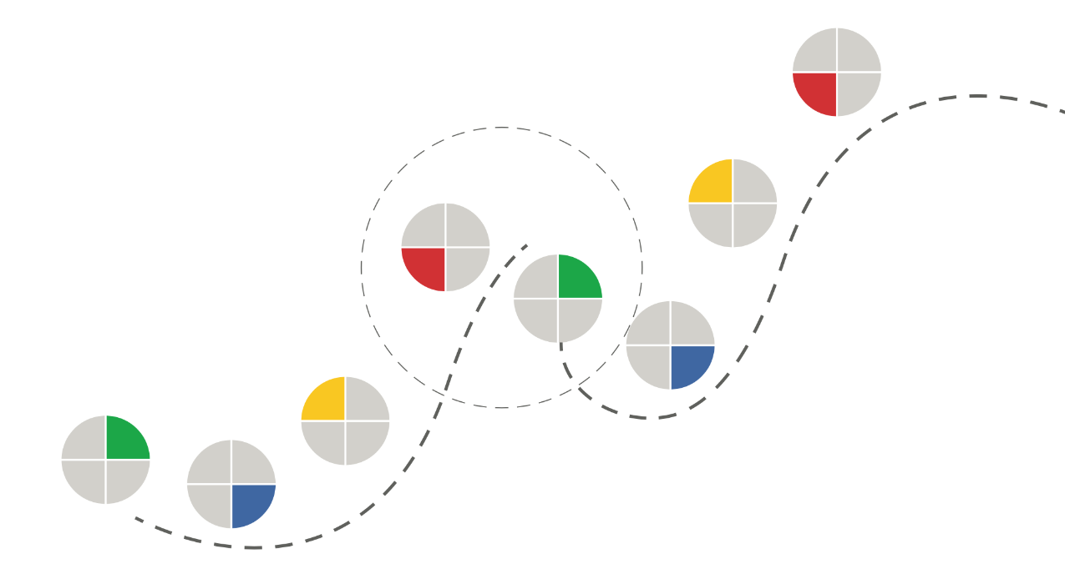
Notes:
Dan
We need to shift from one dominant color to another several times over the life of a project… or the life of an organization. Failure to make these transitions is one of the big reasons organizations fail.
For example, the circled peak is where RED’s focus on scaling and standardization make the organization addicted to their present success and lead them to avoid or resist exploring new areas (which is what Green does). So that’s Blockbuster, Kodak, or Blackberry… any organization that fell to the innovator’s dilemma.
This isn’t the only way to proceed from color to color – the point is the transitions, not the pattern. I could imagine doing these colors in different orders – starting with yellow then going to blue and so on. What’s harder to imagine is an effective organization that stays effective by staying in a single color for the long haul.
Have you ever seen a team get stuck in one area? And yes, the GREEN can be just as resistant to change as the RED… maybe even more so.

Slide 79
I’LL DECLINE AN
INVITATION IF:
flexible
It looks
LONELY
It looks
BORING
internal
external
I can’t see the
GUARDRAILS
I can’t see the
SCOREBOARD
focused
Notes:
Dan
One more little insight to help you understand each color – let’s look at what makes each color decline an invitation.
For GREEN – they’ll tend to decline if the thing looks boring, predictable, or obvious. If it’s repetitive, old fashioned, already been done, or if there’s no room to explore and experiment. Greens want to make sure we’re exploring new ground, otherwise why bother?
For YELLOW – they’ll decline if the thing looks lonely. If there’s no opportunity to bring people together or if there’s not a consensus that it’s something people want to do. Yellows want to make sure they’re not leaving anyone behind, otherwise they’re out.
For RED – they’ll decline if they can’t see the guardrails and instructions. If it’s not clear what right looks like (‘cause then we might be wrong!) or if the outcome is not predictable. Like playing pool, Reds want to call their shot before taking it (otherwise they won’t take it).
For BLUE – they’ll decline if they can’t see the scoreboard or the finish line. If there’s no way to earn points or there’s no way to win. Reds want to be able to keep score, otherwise why bother?

Slide 80
CVF
USE CASE
Notes:
Dan
OK, so how do you use this?
First – as a vocabulary. It gives us a way to describe & understand our own preferences & tendencies & tastes, as well as the preferences of the people around us.
As a Green I can say “Oh, Bob’s not an idiot or a soul-sucking bureaucrat. He’s a Red and he’s trying to make sure we do things right, and Red is an important contributor to the team and helps balance out some of the tendencies I bring as a Green…” And there are times when RED should be in the driver’s seat…

Slide 81
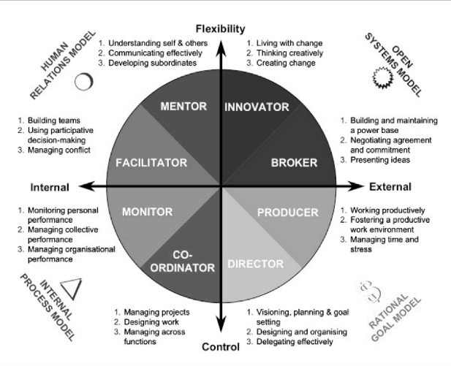
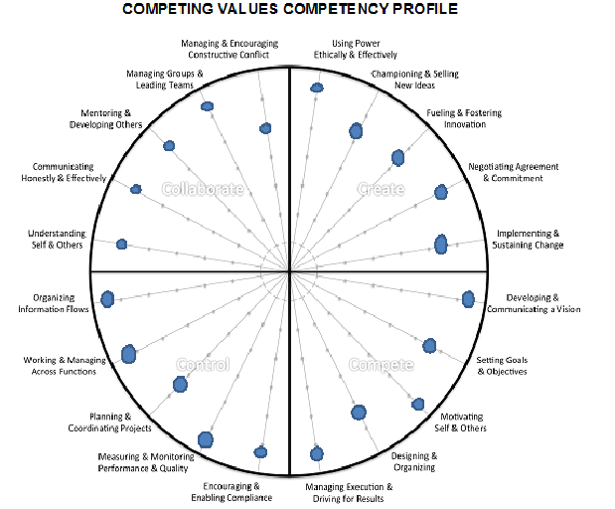
Notes:
Dan
If you’re interested, you can go MUCH deeper into all this – the four quadrants each get divided into sub-quadrants, there’s a whole set of competencies in each quadrant… we’re not going to go that deep in the 30 minutes we have today, but I want you to know it exists.

Slide 82
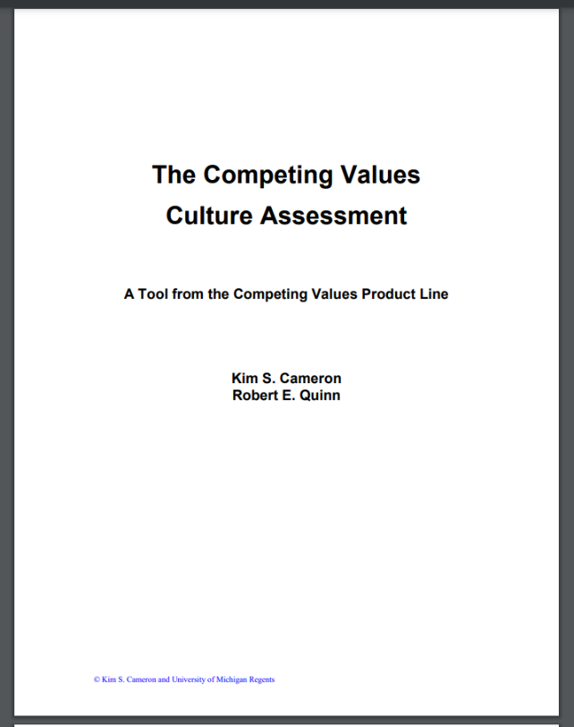
https://www.boomhogeronderwijs.nl/media/8/download_pdf_culture_assessment_workbook.pdf
Notes:
Dan
If you want to learn more, download this PDF guide by Robert Quinn and Kim Cameron, Quinn is the one who created the framework in the first place. It includes an assessment you can use to “diagnose your organization” and I’ll put the link in the chat.
https://www.boomhogeronderwijs.nl/media/8/download_pdf_culture_assessment_workbook.pdf
Hope it’s been helpful. Questions & thoughts & discussion?

Slide 83
Break Time??

Slide 84
Problem Framing 101
Get clarity and consensus about the problem to be solved
Notes:
Lynne

Slide 85
“If you can’t define the problem…
you shouldn’t design the solution.”
- Sarah Doody
Notes:
Lynne
If we skip this first step (defining the problem), we may end up building something that does NOT solve the problem, or solves the wrong problem…
And we’re likely to have a difficult time coordinating our efforts within the team.
Can you think of a time when you have done or seen this done? What is the outcome?

Slide 86
Add text here…
Add text here…
Problem Framing - Innovation Toolkit (mitre.org)
Add text here…
Notes:
Lynne
Problem Framing - Innovation Toolkit (mitre.org)

Slide 87
Notes:
Dan

Slide 88
Notes:
Dan

Slide 89
Notes:
Dan

Slide 90
Notes:
Dan

Slide 91
Exercise: Problem Framing Practice!
Think of a current situation where you have a problem that needs defining
Using the canvas on the table, answer as many questions as you can (try not to overthink!)
Go back to your novelty with impact card for inspiration!
Notes:
Lynne

Slide 92
Positives, Strengths, Good
Potentials, Opportunities
Weakness, Negatives, Bad
itk.mitre.org | itk@mitre.org
Rose, bud, thorn V1
© 2021 The MITRE Corporation. All rights reserved. Approved for public release. Distribution unlimited PR_20-01469-11.

Slide 93
Rose Bud Thorn
Analyze the good, the bad and the promising aspects of a thing
Notes:
Lynne

Slide 94
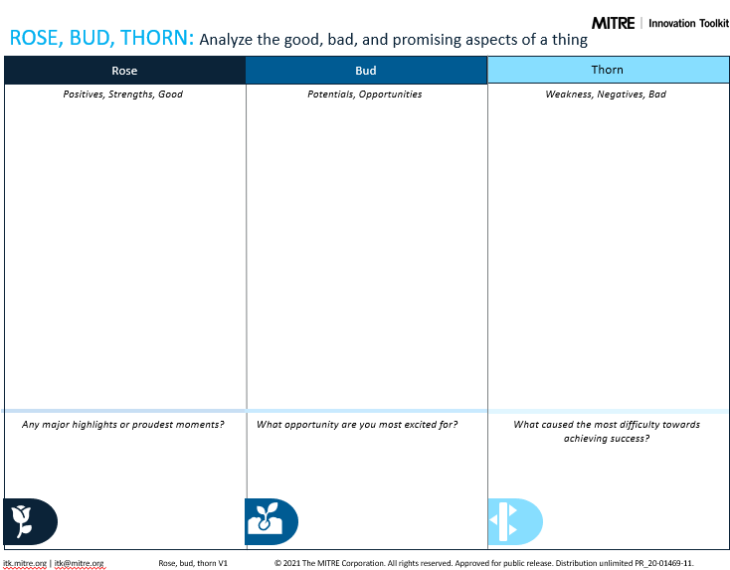
Notes:
Lynne
Who here has used Rose, Bud, Thorn? What did you use it for? What did you learn?

Slide 95
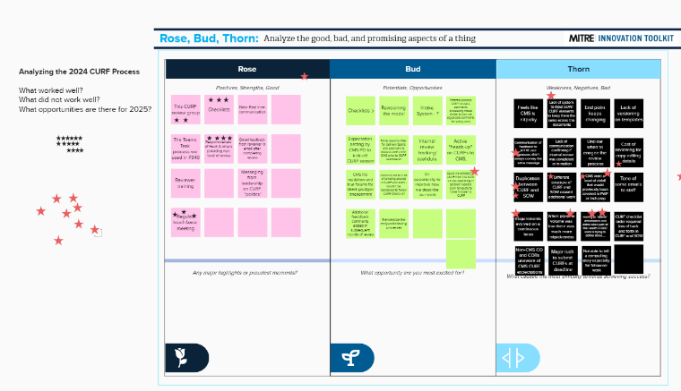
Let’s Try One!
What do we want to assess?
Notes:
Lynne

Slide 96
What was AWESOME about today?
What would make it MORE AWESOME?

