Slide 1
ITK
Certification
Jump Start
Day 2
Accelerating your path towards ITK Certification
With Dan Ward and Lynne Cuppernull
©2024 The MITRE Corporation. ALL RIGHTS RESERVED Approved for public release. Distribution unlimited 24-02352-13
This work is licensed under CC BY-SA 4.0.
Notes:
Welcome back!
Maybe do a Yes-And ice breaker to get things started

Slide 2
Notes:
Lynne
What do you remember from yesterday’s session? Any overnight reflections, ah-ha moments, new questions, etc?

Slide 3
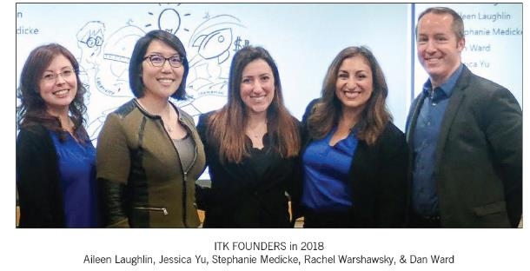
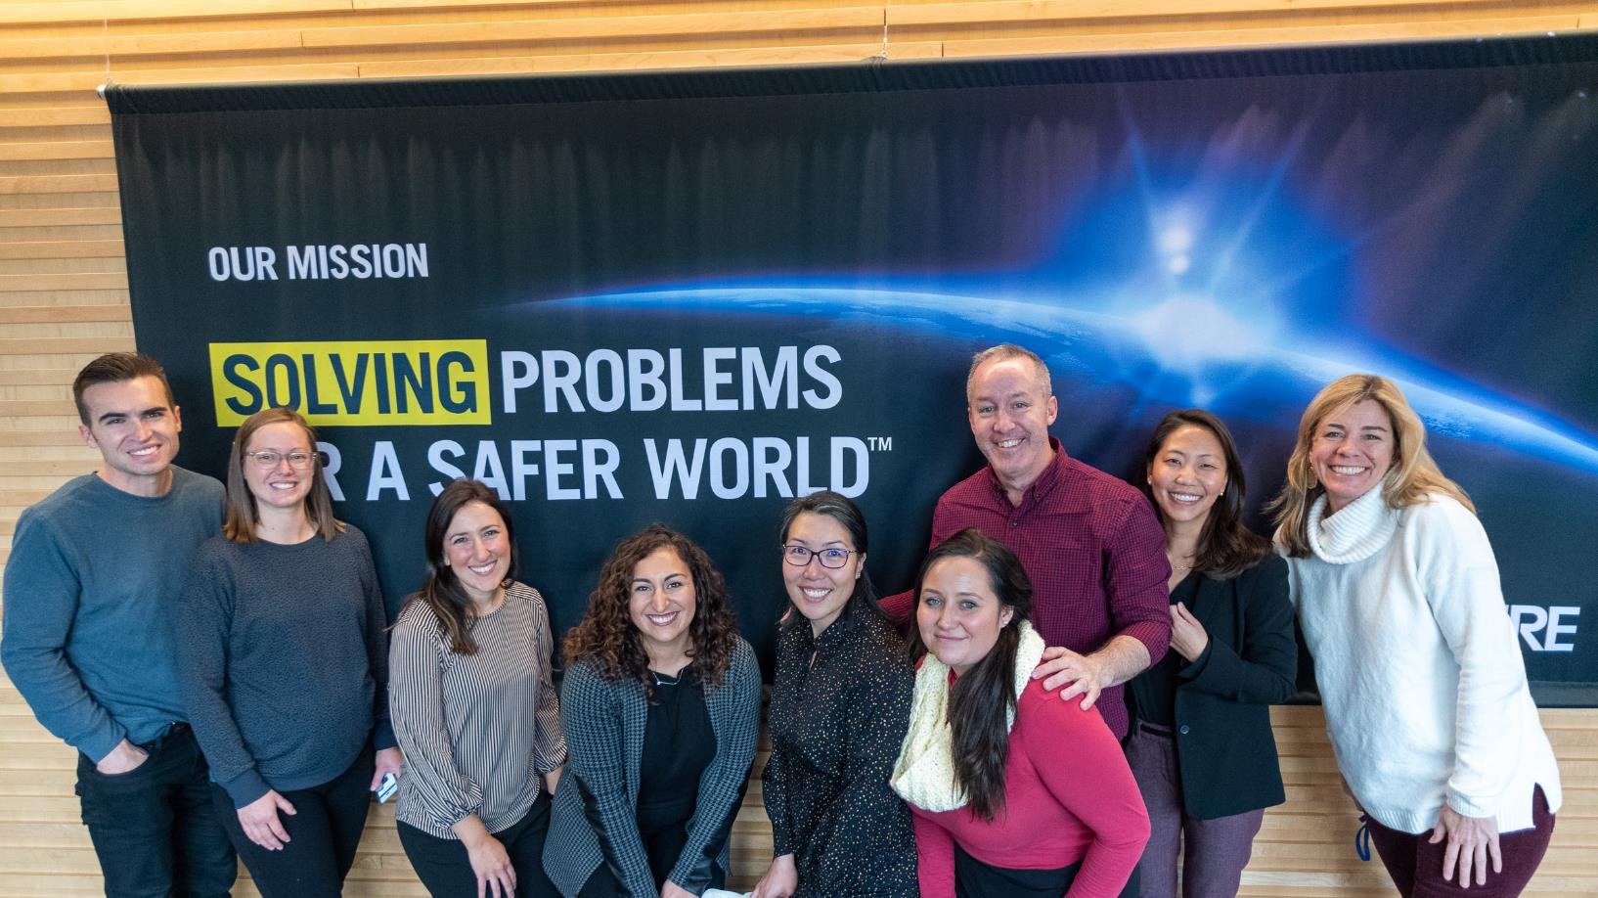
Notes:
Dan
We want to talk a little about our history – Team Toolkit started in 2017 as a side-hustle for a couple of us here at MITE’s Bedford location – that’s the photo in the upper left of the screen.
The team grew to 6, then 9… and now we’ve got somewhere between 60 and 100 people, at 14 different locations across the country.
ITK’s still a side hustle, but for many of us it can take up a significant part of our work week for several of us!

Slide 4
Notes:
Dan
ITK funding overview –
We get a little funding from corp to keep the lights on, etc
Fee-for-service for delivering workshops (i.e. charge codes)
External funding – Sandia paid us to deliver 8 weeks of ITK-based training
Future… who knows?

Slide 5
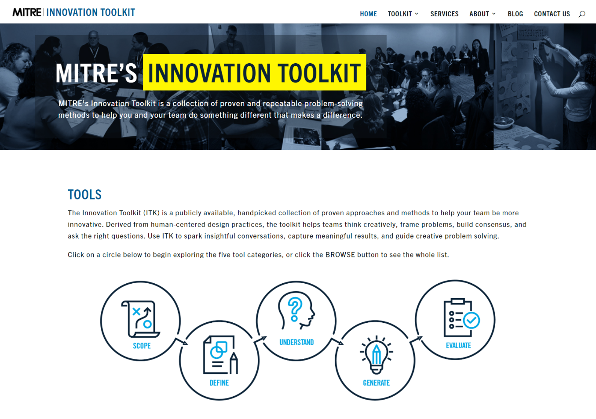
itk.mitre.org
A multi-disciplinary team of MITRE engineers curated the MITRE Innovation Toolkit to help our colleagues, teams and sponsors jump start the innovation process.
Notes:
Lynne
OK, we’ve used two tools so far – and we’ll use two more today – but there are 22 other tools in the kit so we wanted to give you a quick look through them all.
Our website is public-facing and freely accessible, etc…
These tools are delightfully low-tech and domain agnostic. We have used them with the most senior executives at NASA, with generals in the Pentagon, on our own projects, and with high school kids.

Slide 6
itk.mitre.org
All contain helpful links!
Notes:
Lynne

Slide 7
Painstorming
Premortem
Personas
Prototyping
Service Blueprint
Stakeholder Map
Stakeholder Power
Mission & Vision
Problem Framing
Rose Bud Thorn
Stakeholder
Engagement
Simplicity Cycle
Stormdraining
System Map
Bodystorming
Mindmap
Journey Map
Lotus Blossom
Culture Building
Card Sorting
Trimming
Stakeholder Map
Stakeholder Power
Community Map
Stakeholder ID
Storyboarding
Value Prop Canvas
Triz Prism
Notes:
Lynne
It’s a CURATED list…we didn’t create them all from scratch. Some we did, some we adopted, and some we just used as is.
Which of these tools have you used before?

Slide 8
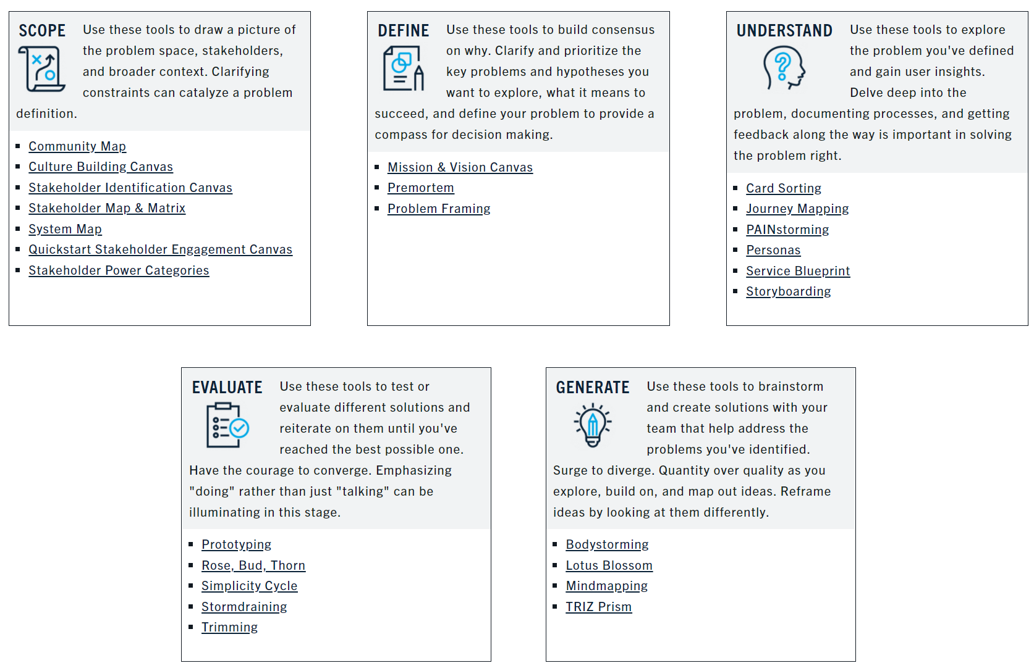
Notes:
Lynne
We put the tools into 6 categories – ideation, strategy, understand users, reduce complexity…

Slide 9
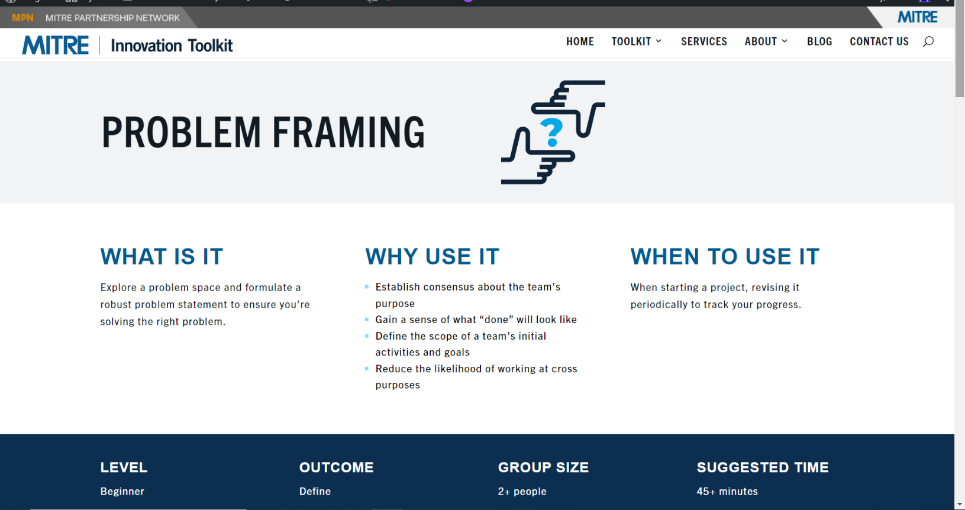
Notes:
Lynne
For each tool, there’s a page that looks like this, with a description of What, Why, When…

Slide 10
Premortem
Building clarity and consensus around what success looks like
Notes:
Dan

Slide 11
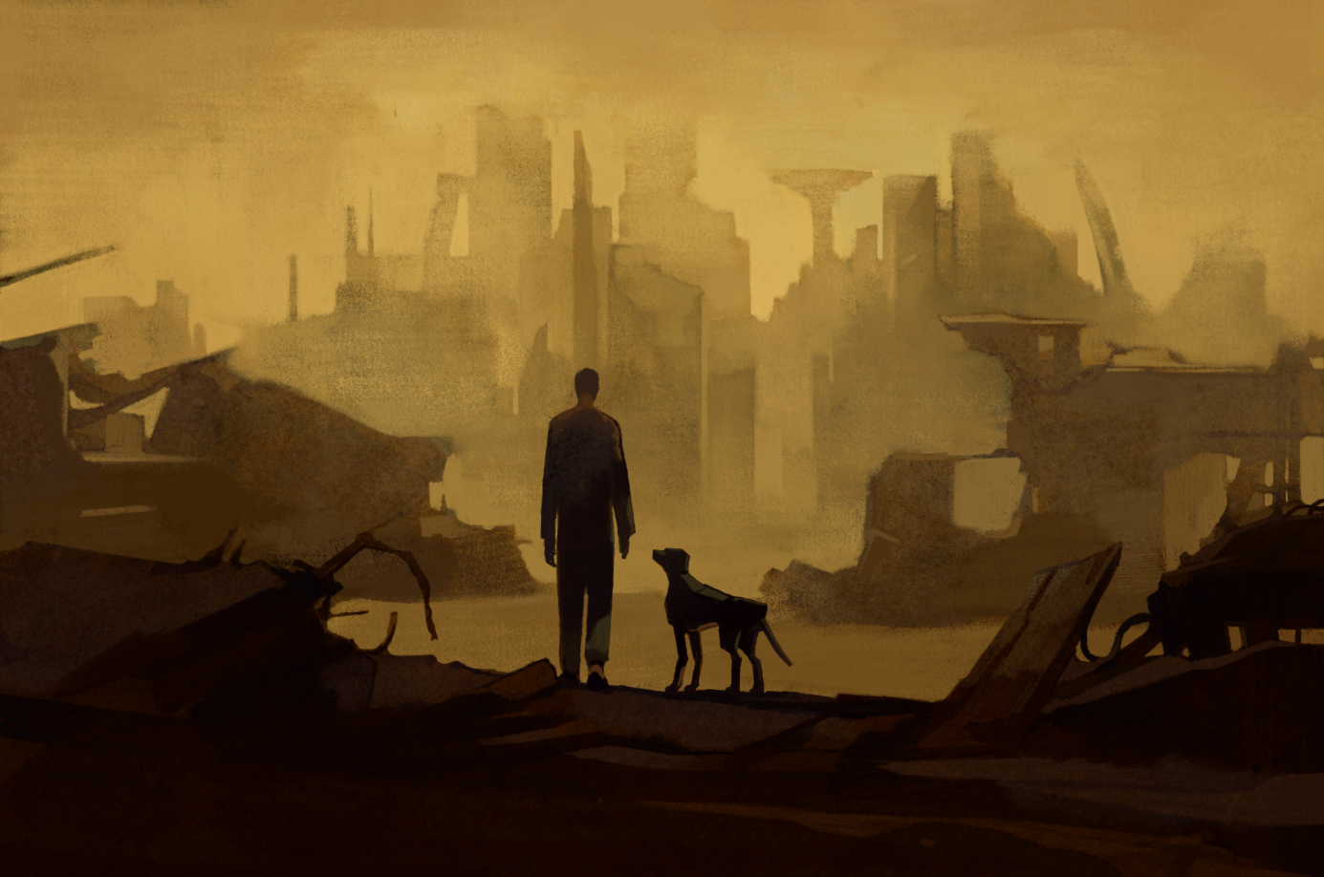
Imagine a dystopian future…
© 2022 THE MITRE CORPORATION. ALL RIGHTS RESERVED. Limited Distribution.
Notes:
Dan
From title slide: The first tool we are going to talk about today is the Premortem. The pre-mortem is an excellent tool for identifying potential problems before they actually become problems and defining solutions so you aren't caught off-guard
Everyone -- think of a project you are working on right now in your own area [pause]. Now, picture this--it’s 2 years in the future and a project you are starting today has failed spectacularly.
We’ll use the pre-mortem tool to describe the failure as vividly as possible, imagining of the worst possible outcome (think sci-fi).

Slide 12
Do you ever think...
“I’m not sure I should say this one…”
Or
“This would never happen…”
Photo Credit: http://www.ashevilledental.com/blog/2017/09/07/mouth-say-youre-not-talking/
Notes:
Dan
No one wants to fail and we are programmed to avoid talking about it. When you are a group and you are talking about failure and you find yourself thinking these things…I’m not sure I should this…or this will never happen, then that’s precisely the sort of thing you SHOULD say.
It’s not about accurately predicting the way we’ll fail, it’s not about identifying the most likely negative outcomes.
It’s about imagining the worst case scenario.

Slide 13
PREMORTEM: Build a shared understanding of what success looks like
Describe the Failure
Symptoms
List the Causes
Describe the failure:
How will we know we failed?
When did we realize we’d failed?
Why do these outcomes
constitute failure?
If we don’t do
______________________________
it’s a fail.
If the only thing we do is
_____________________________ It’s a win
.
What did we do to cause us to fail?
What did we not do to cause us to fail?
What did others do that caused failure?
What did others not do that caused failure?
What incorrect assumptions did we make?
What important stuff did we not do?
What unimportant stuff did we do?
What current problems remain?
What new problems emerged?
Project X
RIP
Who knew we’d fail?
Who is surprised we failed?
Who is glad we failed?
Who is sad we failed?
Was it not well coordinated?
Communicated? Supported?
What got in the way? Was there something we lacked?
Update Goals
Risk Mitigation
itk.mitre.org | itk@mitre.org
Premortem V1
© 2021 The MITRE Corporation. All rights reserved. Approved for public release. Distribution unlimited PR_20-01469-11.
Notes:
Dan
And now we’re going to try Tool #3 – the Premortem!
What do you already know about a premortem?

Slide 14
Break Time!

Slide 15
Notes:
Lynne
While the tools are cool, and we love the website, the real secret sauce for ITK is the people. We’re not just collecting methods and tips, we’re building a connected community of tool users.
So we spend a lot of time bringing people together. We are big fans of the buddy system… and one of the main things we hope you get out of these two days is a connection with at least one other person who might do this ITK stuff with you!
And when we say “buddy system,” that means nobody has to do anything alone. It happens, but we strongly prefer partnering up on everything we do.

Slide 16
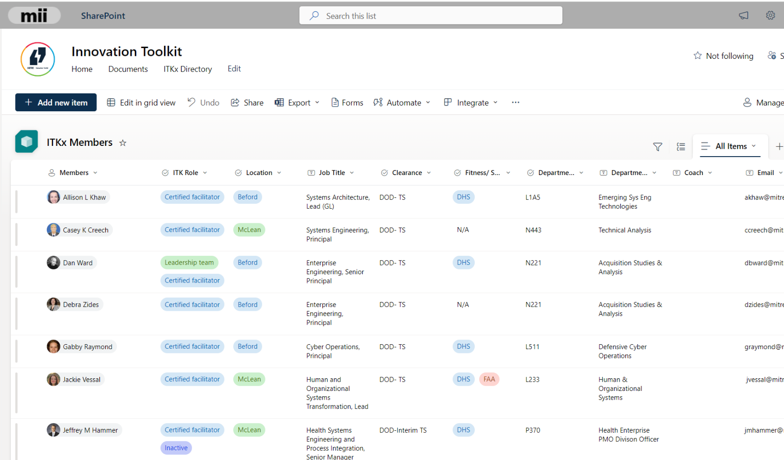
https://mitre.sharepoint.com/sites/ITK/Lists/ITKx%20Members/AllItems.aspx
Notes:
Lynne
To help navigate the community, we developed this handy little online directory – it shows people’s locations, clearance & suitability info, whether they’re certified or not.

Slide 17
Stand-Up Meeting: Mondays at 4:00*
This Photo by Unknown Author is licensed under CC BY
*Subject to change &
continued experimentation
Notes:
Lynne
We also have a regularly scheduled 15-min stand-up meeting on Mondays – it’s a chance to connect with the rest of the group, and we review all the incoming requests to make sure each one gets addressed. You’re welcome to dial in!
We also have bigger ITK gatherings once or twice a year, along with Lunch & Learns and other events.

Slide 18
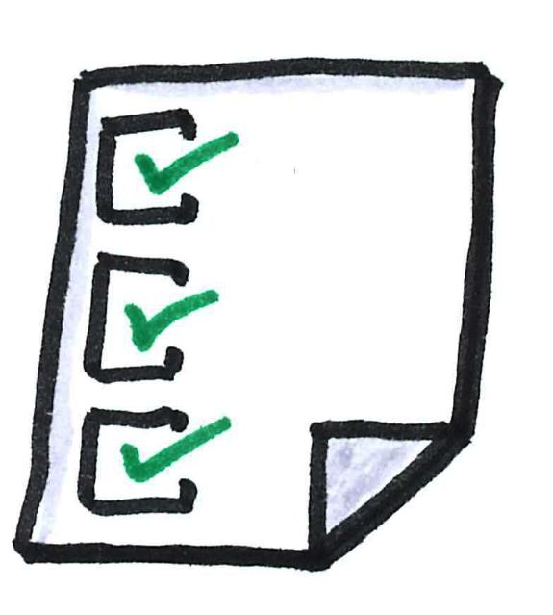
ITK INTAKE PROCESS FORM
FJ: Request ITK
Event Name
POC
Location
Date and Time
Participants: how many, who are they, location(s)
Key problem(s) you are trying to solve and challenge(s) you're facing
Outcome / Goal you would like to achieve
Charge Code
How did you hear about us?
Notes:
Dan
Something about how to put a proposal together.
FJ: Request ITK to start the process
Weekly review at Stand-Up

Slide 19
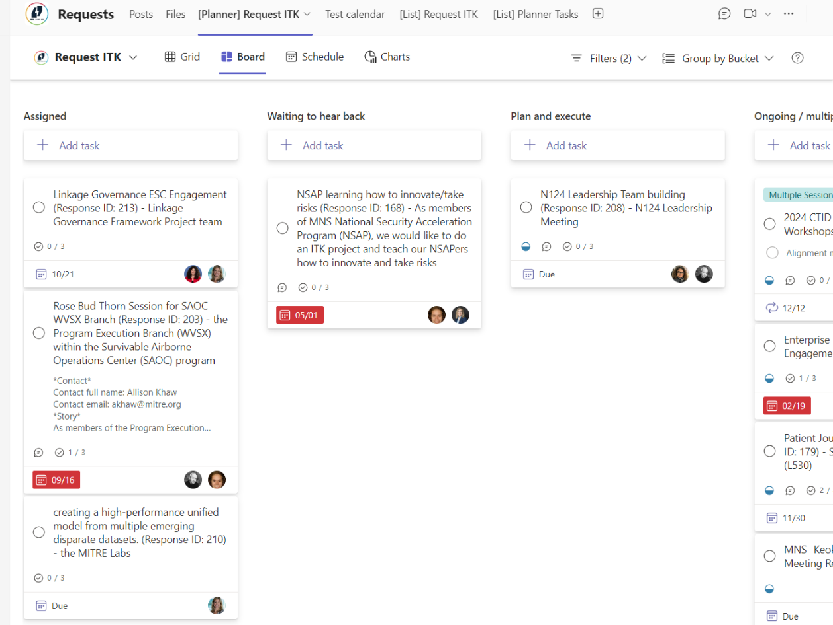
Notes:
Dan
The ITK Request Tracker…

Slide 20
Planning For an ITK Workshop
Intake
Prepare
Follow up
Deliver
Notes:
Lynne

Slide 21
Prepare Checklist
Schedule an intake session with the requestor
Ask them to invite others from the project as needed
Find a co-facilitator
the ITKx Teams chat and the ITK Monday standup are good for this
After the intake session, prepare your materials (Mural, print outs, order stickies if in person)
Coordinate with your co-facilitator on roles
Practice!
Arrive for the session 5-10 minutes early
Notes:
Lynne

Slide 22
The Intake Meeting
Listen more than you talk
Have you used an ITK tool before? If yes, which tool? How did it go?
Tell me more about your project, the sponsor, the project team
What is the outcome you would like to see at the end of this session?
Where does this session fit in the timeline of the project?
How much time do you have for this session?
Sometimes a requestor requests a specific tool. Hold this request lightly as you listen.
Suggest a tool or tool chain (depending on time)
Confirm the charge code
Notes:
Lynne

Slide 23
How to Say Yes
For a one-hour workshop, you will need a minimum of 4 hours of charge code time
Two hours of prep, one hour workshop, one hour follow up
Preferably you will also have a co-facilitator (which doubles the cost but also increases the impact)
Clear need for ITK
Some variation of an ITK tool is needed
Not straight facilitation and not notetaking
Enough prep time
Ideally two weeks advance notice
Notes:
Lynne

Slide 24
How to Say No
Do it quickly
Use guidelines on previous slide as a filter
Resist long explanations about why you are saying no
Offer an alternative
Don’t negotiate against yourself
Remember, we’ve got your back
Notes:
Lynne
Sometimes the timeline is too short, the request doesn’t fit ITK or there are other red flags

Slide 25
Following the Intake Meeting
Meet with your co-facilitator to plan the workshop
Discuss roles and who does what
Draft a run of show
Prepare a Mural or determine how to conduct in person
Practice!
Send a brief proposal to the requestor
Name, date, time of session
Name of facilitators
Location or Virtual (Teams or Zoom)
Goal outcome
Tool(s) to be used and high-level process outline
Confirm hours and charge code to be used
Notes:
Lynne

Slide 26
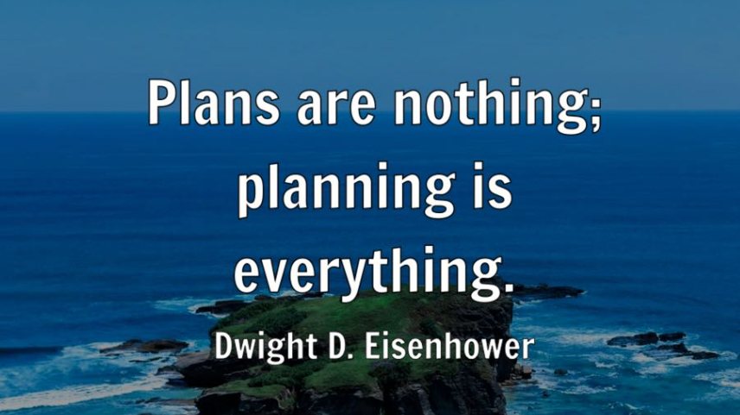
Notes:
Lynne

Slide 27
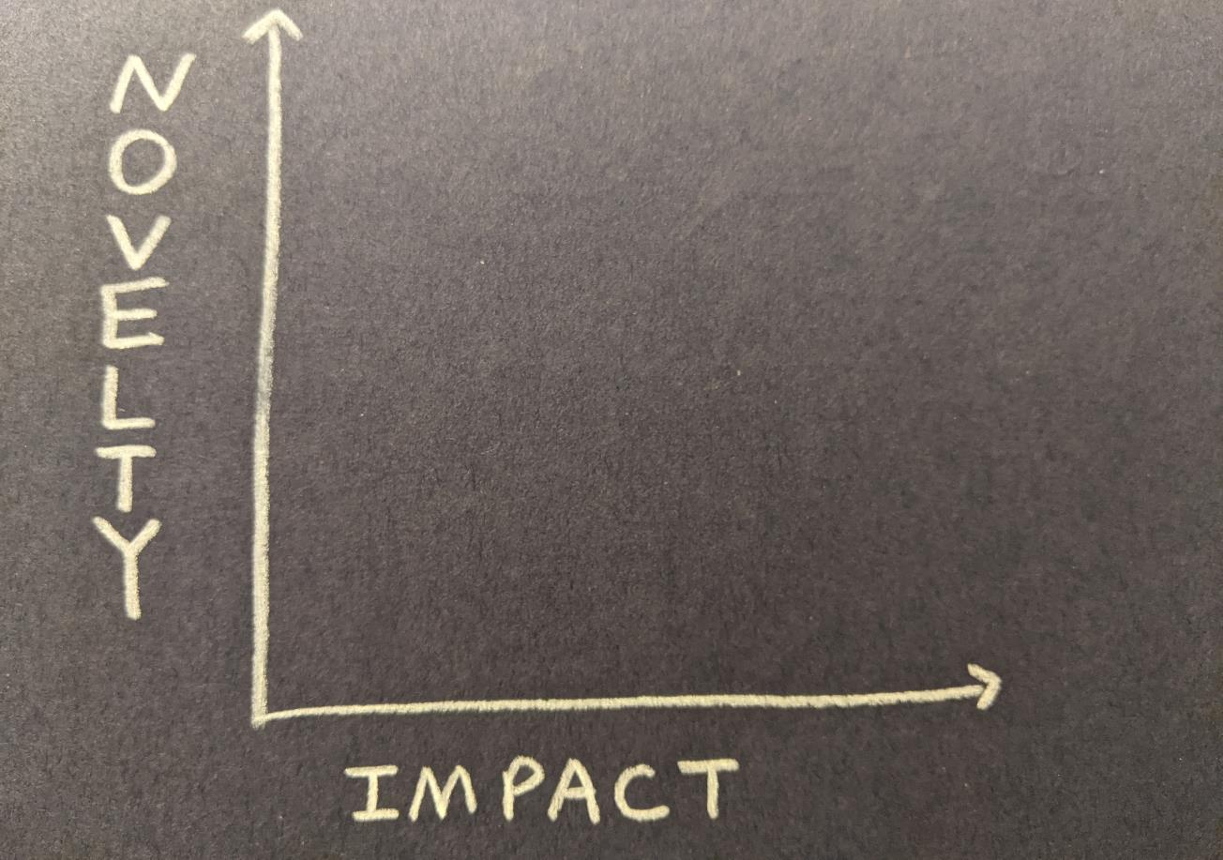
Notes:
Dan
OK, now we’re going to shift from mechanics of ITK sessions to a philosophy of innovation
The ITK team defines innovation as “novelty with impact.”
We’ve been using that definition for a couple years, and then it occurred to us that we could graph it out like this. When we did, we discovered some interesting stuff.

Slide 28
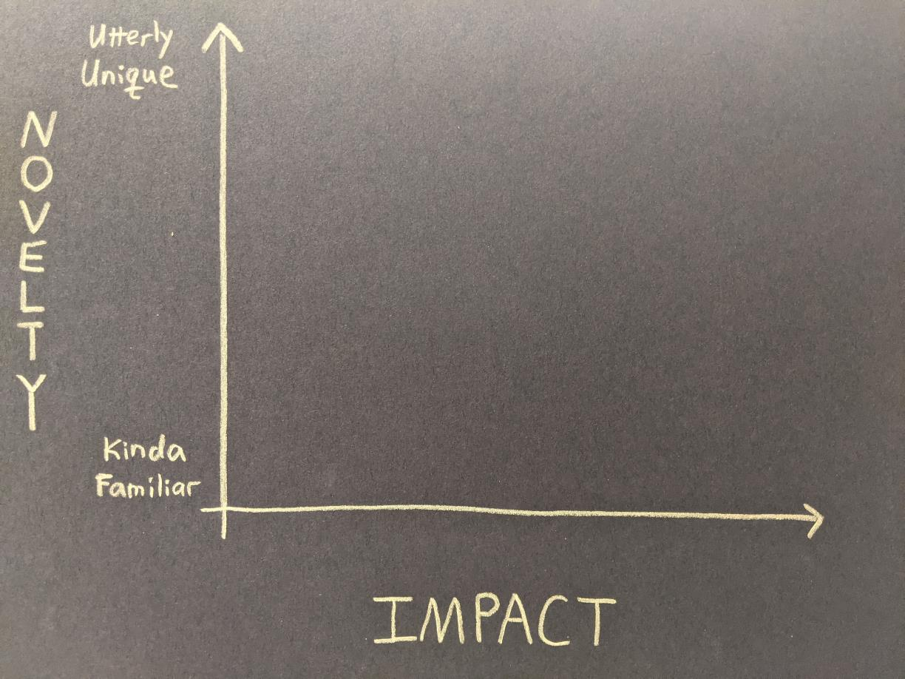
Notes:
Dan
For example, it immediately became clear that both novelty and impact exist along a spectrum. The spectrum of novelty ranges from low-end stuff that is “kinda familiar” to high end stuff that is “utterly unique”
Of course, context matters. Stuff that you find familiar may sound strange to me, and things that are common in one domain might be unheard of in another area. The point is just that there’s a spectrum of novelty, from low to high.

Slide 29
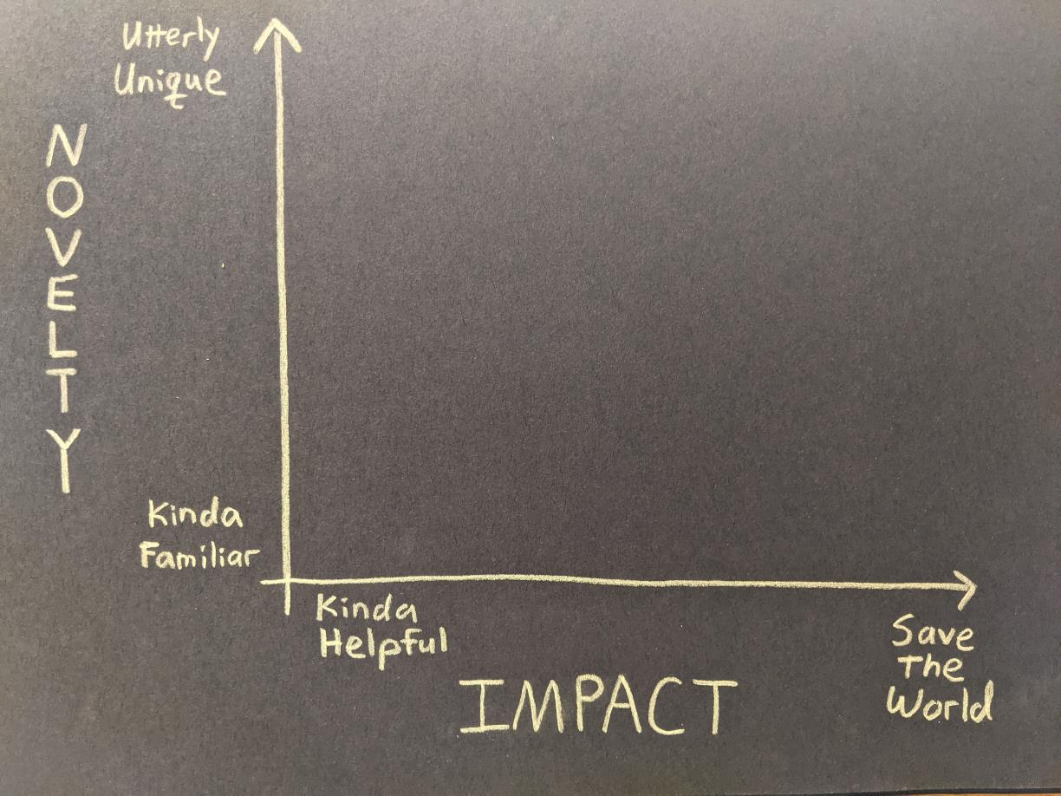
Notes:
Dan
Impact has a similar spectrum, ranging from stuff that’s kinda helpful to stuff that absolutely saves the world.
And just like with Novelty, when it comes to impact a thing that’s just kinda helpful to one person might save another person’s life. Different people at different times and in different situations might find different things have different levels of impact.
Questions?

Slide 30
MINOR
Notes:
Dan
In the lower left corner we find things that are kinda familiar and kinda helpful…
These might be efficiency innovation or a sustaining innovation (to use Clayton Christensen’s terms). There’s nothing wrong with Minor innovations, if we do enough of them they could really add up, and this is 100% a legitimate type of innovation. Mildly novel and mildly impactful… but still innovative.

Slide 31
MAJOR
Notes:
Dan
And in the upper right we find Major innovations, which are utterly unique and save the world. In an absolute sense, these are pretty rare, but they do occur.
But I think these two quadrants are NOT the most interesting areas of this diagram.

Slide 32
EARLY
Notes:
Dan
Instead, things really start to get interesting in the other two quadrants – the upper left and lower right.
Early innovations often pop up in the upper left area. These are new and unfamiliar, often operating on a small scale.
The impact on an individual user or customer might be huge, the impact on the world tends to be relatively low.

Slide 33
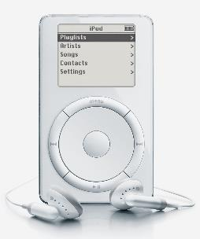
iPod
Oct 2001
Notes:
Dan
For example, when the iPod came out in 2001, nobody had seen anything quite like it. Its novelty was off the charts. And for people who got one for Christmas that year, it totally changed the game on how they bought and listened to music.
But… they only sold 125,000 of them in that first quarter. Similarly, the impact on Apple’s bottom line was fairly low at first and the impact the overall market for the first year or two was fairly limited… because not a lot of people had one. Not a lot of people knew anyone who had one. Did any of you have an iPod in Oct 2001?

Slide 34
MATURE
Notes:
Dan
Over time, as an innovation matures, it often slides into the lower right corner of our graph. The dynamic here is that familiarity decreases novelty – as more people hear about it, as more people use or own the thing, it becomes less novel – by definition. AND… as more people use it and benefit from it, the impact goes up.
So to follow our iPod example, in 2005 Apple sold about 20M iPods. Now everyone has an iPod. Or at least everyone’s seen an iPod, or knows someone who has one. It’s less novel… but more impactful. As sales continued to rise, not only did Apple make money (impact to the company) the iPod went on to change how music is distributed and musicians get paid (impact beyond the company & its customers), to say nothing of how we manage intellectual property… The iPod basically launched the market for personal music devices (impact to competitors).
The iPod’s impact was enormous over time… well beyond the impact on the individual customer who could now carry 1,000 songs in their pocket… even as its novelty decreased…
And look, if your product is having an impact on people who aren’t even your customers… that’s some big impact.

Slide 35
The
Maturity
Slope
Notes:
Dan
But here’s the thing – and here’s what feels so interesting about this – movement along this maturity slope (or popularity slope) can feel like failure to an innovator, and can look like failure to a critic.
People wrote articles about how Apple is losing their magic because the iPod isn’t novel anymore… even while the impact was still growing.
That sort of raises the question of why we do innovation in the first place – do we do it to introduce novelty, or to have an impact? I contend that IMPACT is the point… and so moving in this direction is a sign of success, not failure.
However, it is also a different kind of work. Some people prefer to be in the upper left corner and then to hand things off to someone else who then takes it to the lower right. Nothing wrong with either one, nothing wrong with having a preference. But there is something wrong with claiming that only one of these represents “real” innovation.
So let’s talk about this a little – thoughts & questions?

Slide 36
It’s more
important to
cross this line…
Notes:
Dan
Let’s make it clear – it’s more important to cross this line, in the direction of increasing impact

Slide 37
…than it is to cross this one
Notes:
Dan
Than it is to cross this line, in the direction of increasing novelty.
That’s an important concept to keep in mind as you’re facilitating sessions… and an important conversation to have with customers! (because it’s easy to get distracted by novelty and overlook impact…)

Slide 38
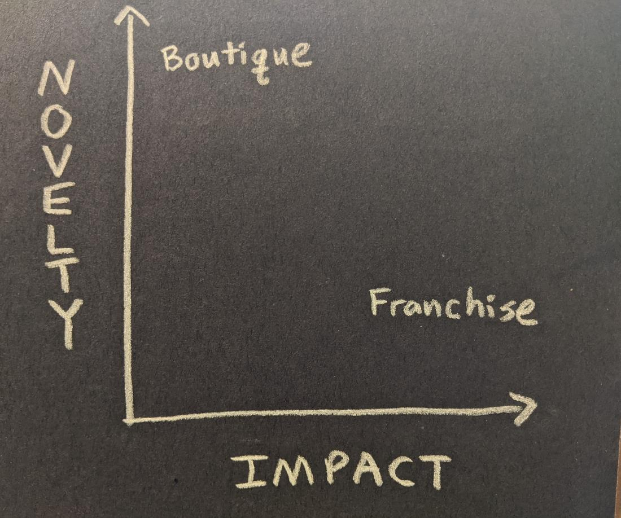
Notes:
Dan
These two corners also help shine a light on another dichotomy – the difference between a boutique and a franchise.
Most boutiques tend to live in the upper left corner – they are one-off product or service, at a small scale, that might be highly valued by a small set of customers, but their overall impact to the larger ecosystem is limited.
In contrast, Franchises are in the lower right. Franchises are copies – they are standardized and thus less novel. Walk into a chain store and you know what to expect – it’s familiar. But Franchises have a larger potential impact, because their reach goes farther and they can influence things like supply chains and legislation and markets.
Boutiques are Up Scale, while Franchises are Scaled Up. Both can be innovative… just different kinds of innovation.
And again, some people have a strong appetite for novelty and want to stay in the boutique area. Nothing wrong with that. Others want to get to the scaled-up franchise asap. Again, both have merit… both are legitimate types of innovation… but both require different skills and reflect different priorities. I think it’s helpful to recognize where you want to be and where you don’t want to be.

Slide 39
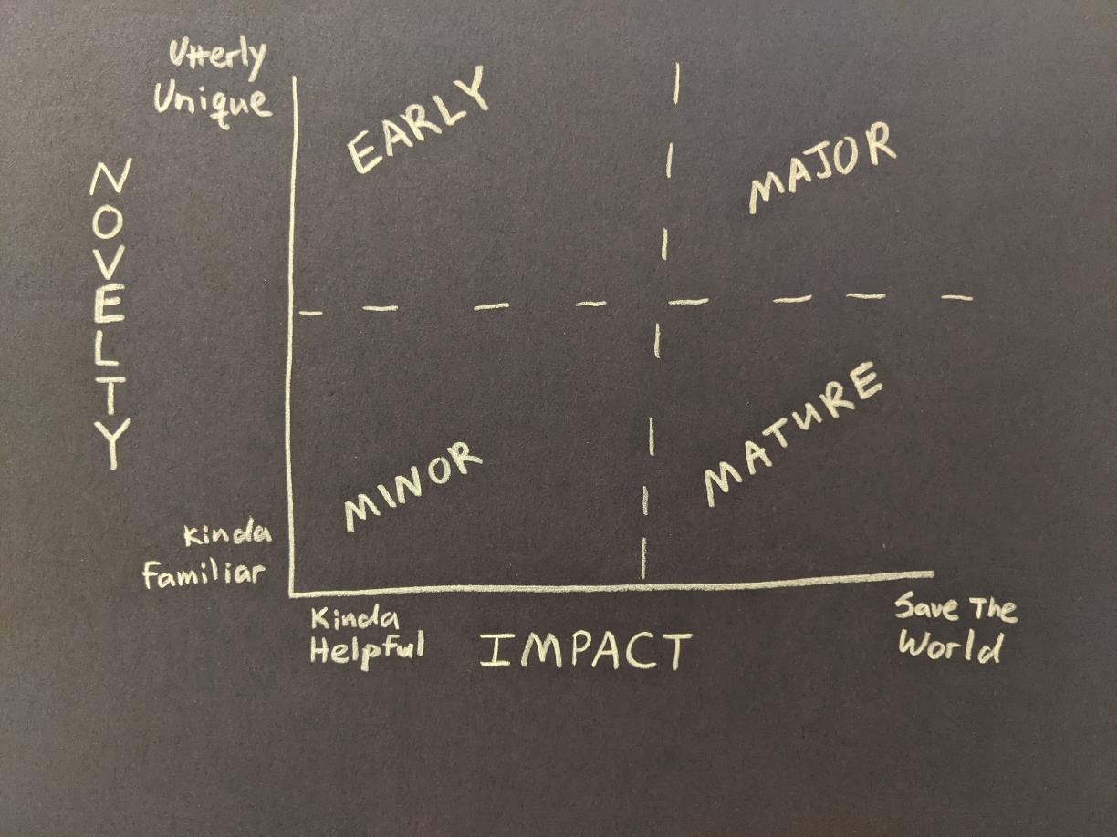
Notes:
Dan
So here’s the whole thing all in a single image…
We wanted to share all this with you to help build a common vocabulary that makes it easier for us to talk about things like values and decision-making styles and an organization’s vision & mission & goals. And hopefully this vocabulary also helps each of us better understand our own preferences and priorities – so we can see where we fit and feel most comfortable –working boutique or franchise – and to also recognize the preferences and priorities of the people around us… and their contribution to the mission.
So I’d love to open it up for any questions and comments before we take a break and then come back for our next activity

Slide 40
Just Early?
Or
Frivolous?
Celebrate?
Or
Double Check?
Incremental?
Or
Trivial?
Keep Going?
Or
Refresh?
Notes:
Dan
Questions to ask in each quadrant

Slide 41
LUNCH!

Slide 42
ITK Facilitator Panel
Notes:
Lynne introduce

Slide 43
BREAK!

Slide 44
TOOL CHAINS
Notes:
Dan
Set the stage – what are tool chains & why do we build them?
What do you already know about tool chains? Why might we use them?

Slide 45
Which best describes your project situation?
I need to explore the problem space.
I need to explore the solution space.
I need to evaluate and/or improve a potential solution.
Notes:
Dan
Let’s see a few scenarios and match them with some tool chains.
Maybe you’re still figuring out what the problem even is and whether there is a “there” there. That’s Category 1.
Others may have an understanding of the problem and have some ideas on how to address it, but need to work through it a bit to bring some focus & specificity to the plan. That’s category 2.
And of course some of you are in the third category – you know exactly what you want or need to do. You’ve got a firm grasp on the problem space and perhaps even have a solution mapped out. You’re beyond brainstorming and you’re ready to refine and execute a plan of action.
You’ll use different tools, depending on your particular situation.

Slide 46
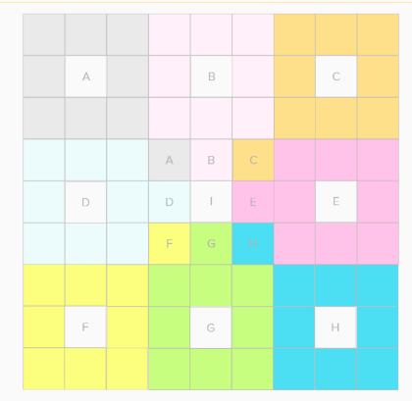
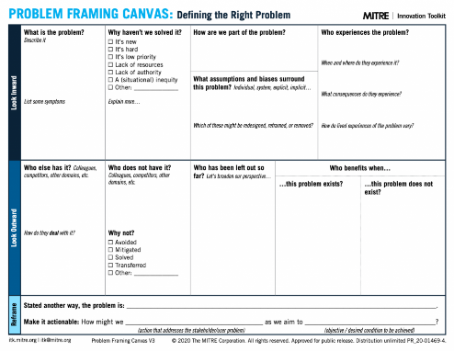
Option 1: I need to explore the problem space.
LOTUS
BLOSSOM
STORM
DRAINING
PROBLEM
FRAMING
ALT:
MINDMAPPING
DOT VOTING
Notes:
Dan
For those of you in the first situation, where you don’t quite have an idea of what the project entails yet, we recommend a tool chain that looks something like this.
You might start with the Lotus Blossom, which is our favorite ideation tool. We find that it helps teams develop a larger quantity of higher quality ideas faster than traditional brainstorming methods. The output is a collection of ideas that are binned and categorized according to their relationship to each other, all in a handy little color-coded artifact you can carry forward into the next activity. As an alternative, you could try Mindmapping instead – it’s a similar tool, minus the boxes.
You’ll follow up the idea generation with a Storm Draining exercise. Storm draining is basically the opposite of brainstorming, and it helps your team distill a big list of ideas down to the small number of key ideas you would actually implement. Lotus Blossom is a divergent method for producing lots of ideas, and Storm draining a convergent thinking method, to help you simplify and streamline. Instead of that, you could try a technique called DOT VOTING with your completed Lotus Blossom, to have everyone basically vote for their top 3 choices.
That sets the stage for the Problem Framing. Our problem framing canvas aims to help answer the question “what problem are we trying to solve?” That can be harder to do than it sounds, but it’s super important. That problem statement is the foundation of the work you’ll do in the context of your project.

Slide 47
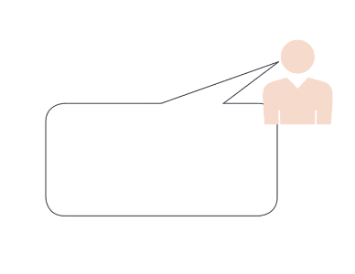
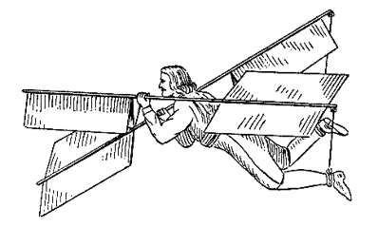
Option 2: I need to explore the solution space.
PERSONA
STORYBOARDING
PROTOTYPES
ALT:
PAINSTORMING
JOURNEYMAPPING
Notes:
Dan
OK, now what if you already have the inkling of plan and you just need to put some meat on the bones?
In that situation, we like to start with the Persona tool. This guides you through describing your user or customer, the person who will benefit from your work. Understanding their pain points, priorities, their goals and motivations can go a long way towards making sure your proposal is actually valuable to someone. As an alternative, you may want to try the PAINstorming tool, which is a slightly different take on understanding the user.
Once you’ve got a persona developed, tell their story using Storyboarding. This basically involves documenting the steps, the activities, the use cases that your Persona will go through as they put your solution into practice. You can make a variety of storyboards to test out different scenarios and use cases. It can be playful and fun, and it also creates a terrific communication tool to help people understand what your project is all about.
Once you’ve done some storyboarding, time to build prototypes. I would like to emphasize that it’s not about building A prototype. It’s about prototypes – plural. Using simple materials that operate at the speed of thought, start creating little mock-ups and demonstrators to explore your ideas in three dimensions (or 2D if it’s on a screen). Check out MITRE Visiting Fellow Tom Chi’s terrific talk about rapid prototyping for more tips on that. And of course, these prototypes can facilitate discussions with sponsors or other stakeholders to further develop the idea and the details surrounding the idea.

Slide 48
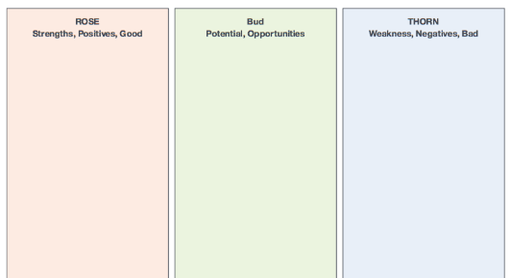
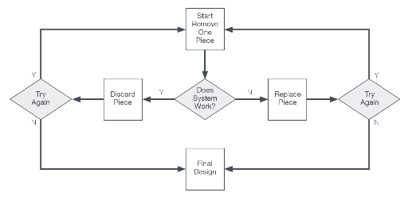
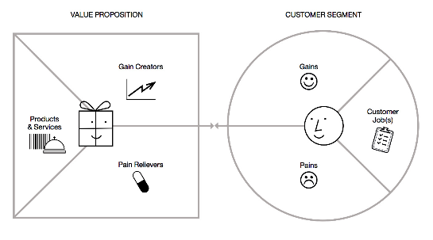
Option 3: I need to evaluate and/or improve a potential solution.
ROSE
BUD
THORN
ROSE
BUD
THORN
TRIMMING
VALUE
PROPOSITION
Notes:
Dan
Finally, some of you might have a pretty solid grasp on the goal of a project. You have something significant to work with, but need to determine how to move forward and execute, which puts you in a very different position than the first two options.
If that’s the case, you may want to start with an analytical tool called Rose, Bud, Thorn. This one is fairly well known, so you may have seen it before. It’s deceptively simple but I find it to be a powerful way to get insight into what is good about your mature idea (and thus might be expanded or repeated), what parts are bad or weak (and thus might be improved), and what parts have unrealized potential (and thus might be explored further).
Once you’ve done your RBT analysis, you may consider the Trimming tool I mentioned a while back. This is where you remove or replace some part of the idea, where you minimize friction between parts, and really refine it to the point where every piece is there for a very specific reason.
Then you take your trimmed idea and build out the value proposition canvas, which helps you identify and express the specific value you’re bringing to the table, for the specific beneficiary. And it’s not a hypothetical thing, it’s based on actual analysis and trimming of a real concept.

Slide 49
Pick Your Tool Chain
1)
LOTUS
BLOSSOM
STORM
DRAINING
PROBLEM
FRAMING
2)
PERSONA
STORYBOARDING
PROTOTYPES
3)
ROSE
BUD
THORN
VALUE
PROPOSITION
TRIMMING
Notes:
Dan
As a general rule, if you’re not sure which toolchain to use, start with the smaller number.
So if you’re not sure if you’re ready to be exploring solutions, take the time to explore the problem space and solidify your understanding of the problem first.
You could certainly go through all three toolchains one after the other, use all 9 tools, but we designed each of these chains to be fairly complete.
Now, these are not the only tool chains you might consider. I mentioned alternatives for a lot of these, and depending on your situation you might go with a completely other set. For example, if you’re having difficulties engaging with stakeholders or prioritizing limited resources, you may want to design a different toolkit to help support that sort of exploration. We can help you with that if you’d like.

Slide 50
FACILITATION FLOWERS EXERCISE
Get into groups of 3-4
A few minutes of prep
Swap lead facilitator every 10 minutes
Facilitate either a Lotus Blossom or RBT
Continue previous OR start new tool
TOPIC: HMW innovate on hybrid teams?

Slide 51
THE
SONGWRITING
EXERCISE
Notes:
Lynne
You may be wondering why we’re going to spend the next hour doing an exercise in songwriting…
Show of hands: Has anyone ever written a song before?

Slide 52
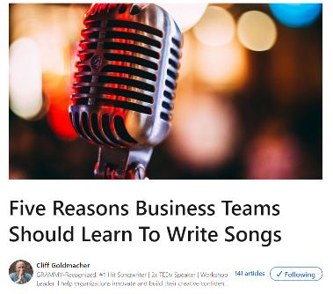
Five Reasons To Write Songs by Cliff Goldmacher
Makes you think differently
Take you out of your comfort zone
Shows you can do the “impossible”
Improves your ability to communicate
Brings teams together
https://www.linkedin.com/pulse/five-reasons-business-teams-should-learn-write-songs-cliff-goldmacher/
Notes:
Lynne
Cliff Goldmacher is a musician and consultant, he wrote an article about why business teams should learn to write songs.
From a MITRE perspective, do you think it’s helpful or important to do these five things?
Learning to write songs makes you think differently
I’ll begin by saying I’m a big fan of the Abraham Maslow quote, “if the only tool you have is a hammer, then every problem looks like a nail.” Consider exploring your ideas and objectives through the lens of songwriting as a new “tool” in your problem-solving toolkit. By examining ideas through metaphor and the emotion-rich language of lyrics, you’re opening up a new way of approaching old or persistent work challenges which will lead to novel and innovative solutions.
2. Learning to write songs takes you out of your comfort zone
As human beings we naturally lean towards preserving the status quo. It’s comfortable and gives us the illusion of control. The reality, however, is that the “safety” of the status quo is anything but safe. We may not want to change but the world will change around us no matter what we want. Leaving your comfort zone in pursuit of a new way to solve problems and examine ideas is a good reminder that the real rewards and solutions exist in leaving the tried and true behind. On top of that, songwriting as a high challenge, high skill and clear objective practice helps business teams achieve a flow state which is, in and of itself, highly satisfying and profoundly motivating.
3. Writing a song shows you that you can do something “impossible”
For most people, the idea of writing a song can seem more like a magic trick or an impossible dream. But my favorite part of what I do with business teams is that I take smart people who don’t consider themselves to be creative and I give them the tools to explore and enhance their creativity. By breaking down the process of songwriting into its component parts, I show the team that songwriting is a craft that can be learned. When a team “does the impossible” and writes a song, there’s a tangible boost of confidence that carries forward and helps the team tackle other seemingly “impossible” issues.
4. Learning to write songs improves your ability to communicate
The beauty of the lyric writing is how it requires us to communicate only the most critical parts of our ideas and say them in a way that is both clear and memorable. While the verses of songs improve our ability to use image-rich language in the service of telling a story, it’s the chorus that teaches us the skill of distilling a message so that it not only makes a clear point but also does it in a way that people will want to hear. If communication is a muscle, then writing song lyrics is a serious workout.
5. Writing songs brings teams together around a common cause
There’s nothing quite like a challenge with a clear goal to bring a team together. Above and beyond exploring ideas and objectives, learning to write songs bonds teams around learning a new way to express themselves. The finished song (and every team I’ve ever worked with finishes their song) serves as tangible - and singable - proof that the team has rallied and done something they weren’t sure that they could do. It’s like a shot of jet fuel for team bonding.

Slide 53
Five Six MORE Reasons To Write Songs by Cliff Goldmacher
Demonstrates that we are all creative
Methodically access our creativity
Helps get over a generalized fear of failure
A shortcut to the emotional crux of any issue
Takes us back to a beginner’s mindset
BONUS REASON: It’s Fun!!
https://www.linkedin.com/pulse/five-more-reasons-business-teams-should-learn-write-songs-goldmacher/
Notes:
Lynne
He wrote a second article that had five – or six – more reasons.
How about this list? Anything here seem valuable or important for your work at MITRE? What stands out?
Beginner’s mindset…that experimentation that we bring to things we are just starting.
Conclusion
It is highly likely that becoming a songwriter isn’t the reason you joined MITRE.
Regardless, using songwriting as a new way to explore ideas and improve your team’s creativity and communication will make you and your team better equipped to handle the challenges you face on a daily basis.

Slide 54
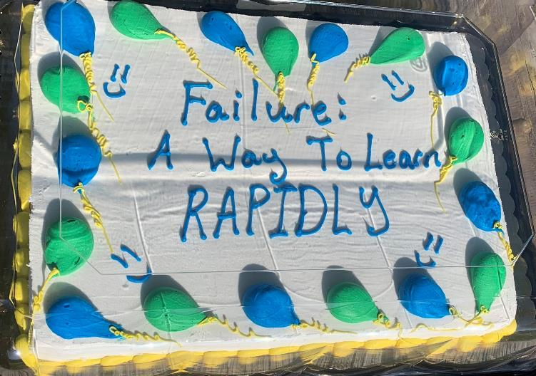
Here’s A Cake
You did your best
You took your shot
You gave it everything you’ve got
But sometimes things
Just don’t turn out
We hoped for rain
Then got a drought
So here’s a cake
I made for you
Have some cake
I’ll have some too
We’ll share this cake
With everyone
And turn our failures
Into fun
Forget the rain
Enjoy the sun
We made our plans
We dreamed real big
We took that shovel
And started to dig
But there’s no gold
Down in that mine
And everything
Didn’t turn out fine
Here’s a song Dan wrote…
Notes:
Lynne/Dan
And just to put our money where our mouth is, here’s a song Dan wrote about ITK’s failure cake practice… and then Niall White put some music to it and ended up performing it at a conference at the Kennedy Center last fall.
To be clear, this was not my first draft… what I wrote was different from what Niall sang at Poptech
But the point is it’s not all fun and games, except it is!

Slide 55
We’re ONLY going to do the HARDEST part…
Notes:
Lynne
OK, hopefully you’re convinced that there’s a good reason to write songs, and that even at MITRE it’s something we can and should do.
Good news / bad news – Today, we’re only going to do the hardest part of writing songs.
Well, YOU are going to do the hardest part, and we’ll help…
Anyone want to guess what that is?

Slide 56
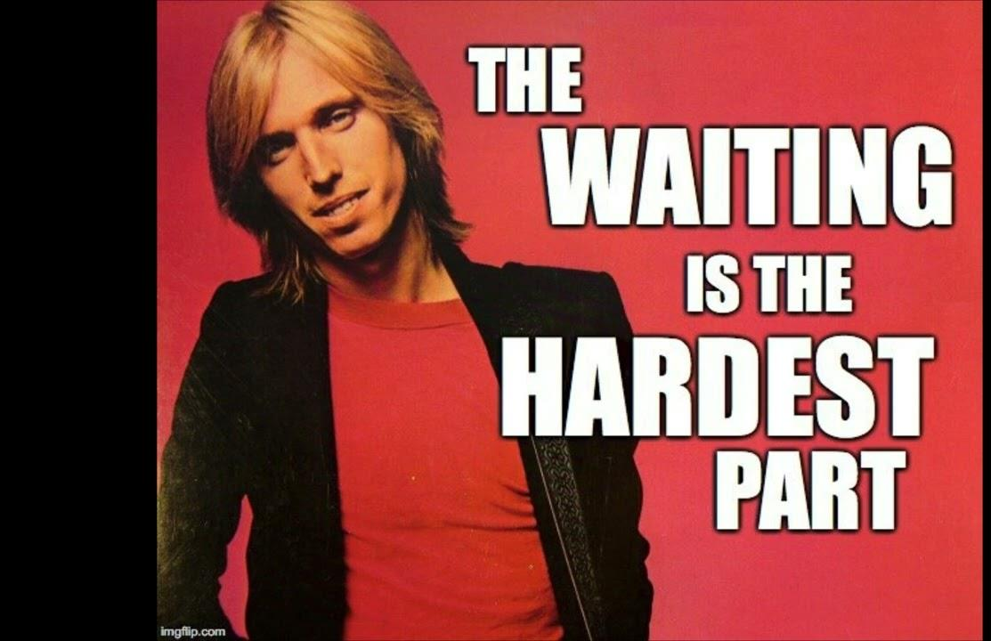
Notes:
Lynne
OK, all due respect to Tom Petty, but the hardest part is actually… getting started.
Once you do that, the rest is easier…

Slide 57
EXERCISE #1: SEE SONG STRUCTURE
Notes:
Dan
Alright, let’s get started. This is something I did as I prepared to write lyrics for the Failure Cake song.
Think of a song you like. Any song. Write down the lyrics by hand (you can google them if you need to)
Then we want you to notice where the beats & rhymes occur (hint – not always where you might think!)

Slide 58
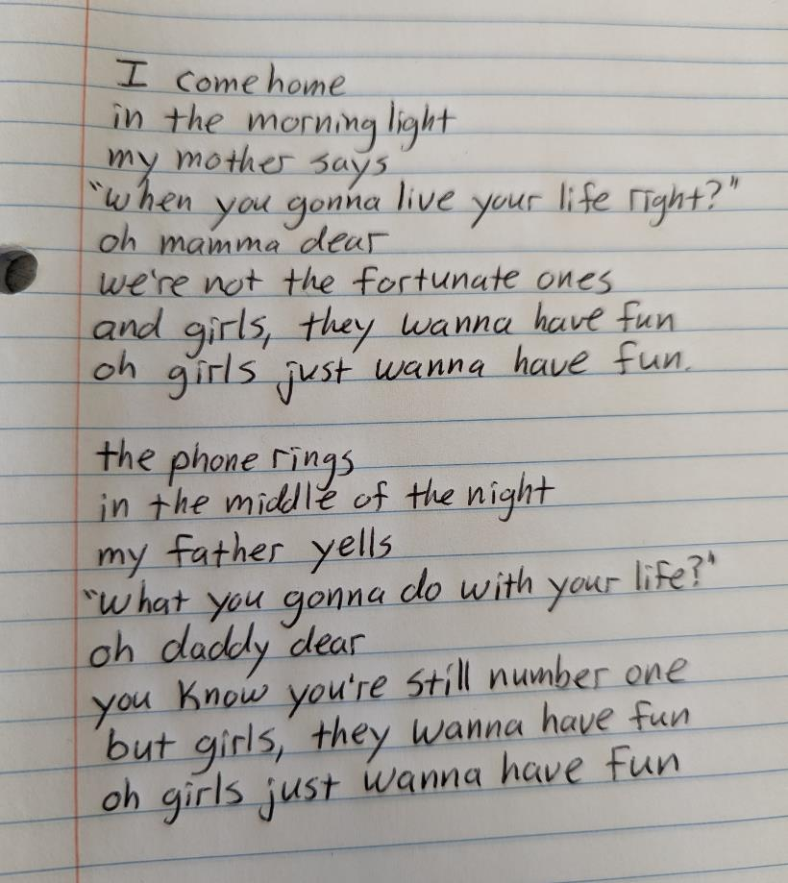
Notes:
Dan
We picked this set of lyrics from a song you’ve probably heard, and I wrote them out in a notebook.
Why it’s important to write it out by hand…get a feel for the physiciality of it all. Requires you to engage with the words differently – stretches a muscle that we don’t use that often any more

Slide 59
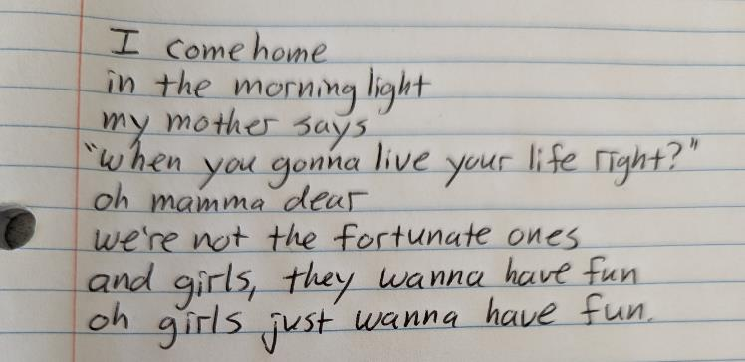
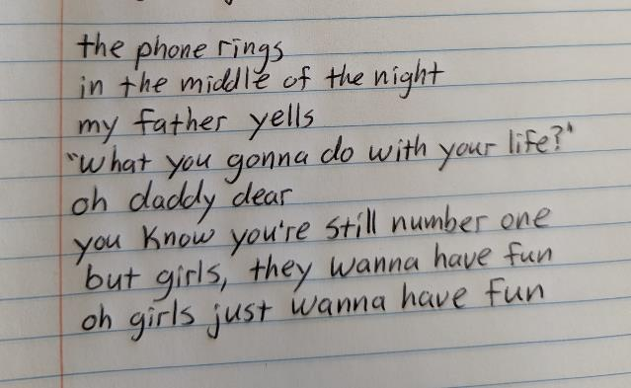
Notes:
Dan
Put those two stanzas side-by-side, and you can really see the pattern here.
Notice the rhymes: light / right / night, and she even rhymes “ones” with “fun” – it’s NOT a perfect rhyme, but it’s a perfect lyric.
And then we see the opposites within that same repeated pattern:
morning light / middle of the night
Mother says / father yells
So quickly google the lyrics to a song you like (if you need to look them up) and write them out by hand… doesn’t have to be the whole song, but at least two stanzas (and maybe a refrain?)

Slide 60
EXERCISE #1: SEE SONG STRUCTURE
Step 1: Pick a song you like
Step 2: Copy out the lyrics out by hand (look ‘em up if you need to)
Step 3: Notice the rhymes, beats, patterns, etc
Notes:
Dan
Here it is in 3 easy steps. Pick, copy, notice

Slide 61
EXERCISE #2: WORD LADDER
Notes:
Lynne
This is an exercise from Jeff Tweedy’s book – write two columns…

Slide 62
10 verbs associated with a physician
10 nouns in your field of view
Examine
Thump
Prescribe
Listen
Write
Scan
Touch
Wait
Charge
Heal
Cushion
Guitar
Wall
Turntable
Sunlight
Window
Carpet
Drum
Microphone
Lightbulb
Notes:
Lynne
The Word Ladder exercise starts by quickly writing down two columns – verbs on one side, nouns on the other.
In this case, we went with verbs associated with doctors and nouns of things we can see

Slide 63
10 verbs associated with a physician
10 nouns in your field of view
Examine
Thump
Prescribe
Listen
Write
Scan
Touch
Wait
Charge
Heal
Cushion
Guitar
Wall
Turntable
Sunlight
Window
Carpet
Drum
Microphone
Lightbulb
The drum is waiting
By the window listening
Where the sunlight writes
On the cushions
Prescribed
Thump the microphone
The guitar is healing
Notes:
Lynne
Now, connect nouns and verbs that don’t normally go together. Jeff Tweedy explains it in his book – he says it’s “…not so much to generate a set of lyrics to but to remind myself of how much fun I can have with words when I’m not concerning myself with meaning or judging my poetic abilities…”
Here’s part of what Jeff Tweedy came up with. It’s not brilliant, but it’s not the worst.
And remember, we’re only doing the hardest part. We’re just getting started.
The next step is to toss out the rules we just followed and make something that makes more sense, more song-like. Not obligated to use every word…

Slide 64
the drum is waiting by the windowsill
where the sunlight writes its will on the rug
my guitar is healed
by the amp plug charging the wall
and that’s not all
I’m always in love
The drum is waiting
By the window listening
Where the sunlight writes
On the cushions
Prescribed
Thump the microphone
The guitar is healing
“That’s still a bit awkward but it’s definitely enough to jump-start my brain…”
- Jeff Tweedy
Notes:
Lynne
So here’s the example from his book, which ends up following a melody from a Wilco song…
And again, THIS IS NOT A GREAT SONG. It is a START and an IMPROVEMENT over the blank page and over the first sketch…

Slide 65
YOUR WORD LADDER
10 verbs associated with MITRE
Or your project
Or your sponsor
Or being a leader
10 nouns you might find in a coffee shop
Or a waiting room
Or a military base
Or a forest
Make pairs that don’t normally go together
Notes:
Lynne

Slide 66
EXERCISE #3: STEAL WORDS
Step 1: Flip to a random page
Step 2: Pick a word or phrase that catches your attention
Step 3: Copy it onto your paper
Step 4: Shuffle the phrase around,
Notes:
Dan
Here’s our next exercise in four easy steps.
We’re going pass out some newspapers / books and have you look for “found poetry” or just bits & phrases that have a rhythm, a vibe, or a message you like.
Look for an anchor word (Tweedy talks about finding the word catastrophe). Keep in mind, when we’re talking about lyrics, we’re talking about WORDS. Words have sounds and feelings as well as meanings. Words have length and syllables, they rhyme with other words (or don’t)
Then shuffle the words around, rearrange and play…

Slide 67
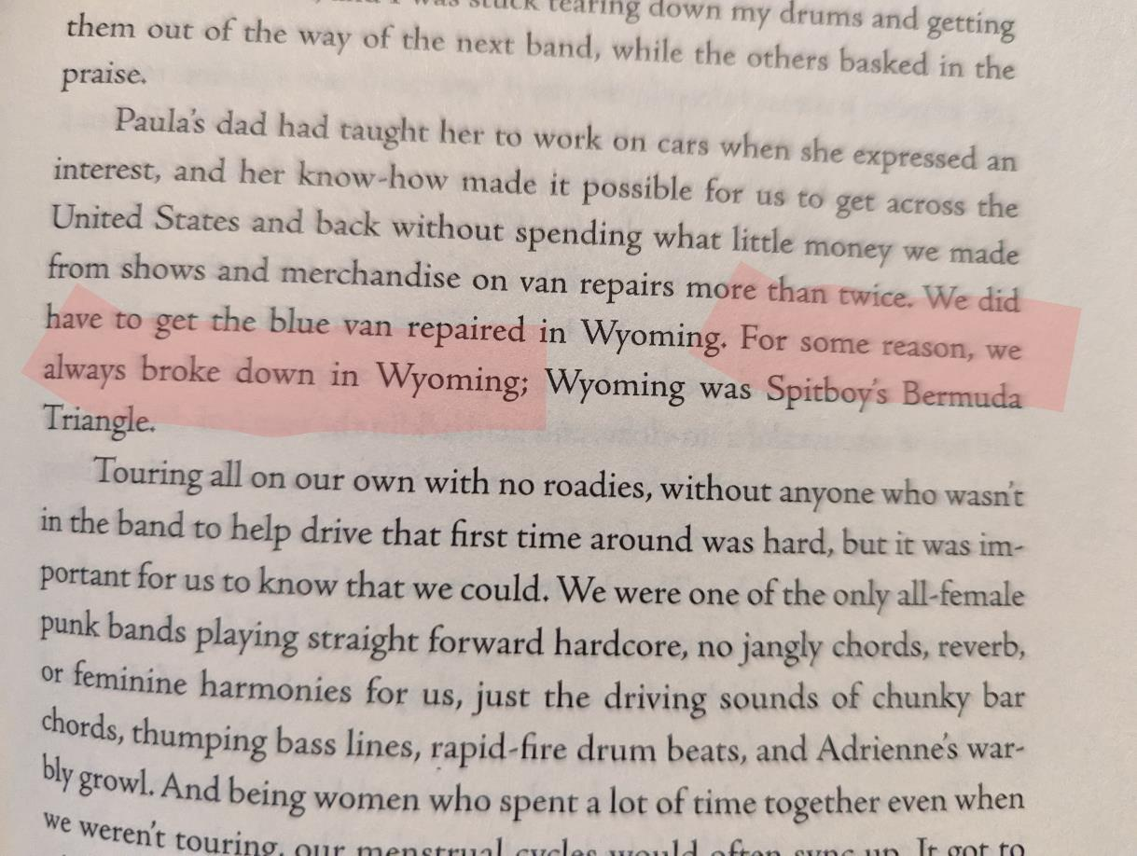
Notes:
Dan
Here’s an example of what this exercise might look like: I opened this book to a random page and my eyes caught on the phrase “for some reason…”
That sounded like a lyric to me – can’t you imagine a song titled For Some Reason?
Then I kept reading and the line “for some reason, we always broke down in Wyoming” just seemed like a perfect anchor for the kind of song I like.
The word “always” kinda killed me. It sort of begs the question “Why do we always break down in Wyoming?”
When I asked myself that question, I noticed the Why in Wyoming… and then I pivoted a little and thought “Why do we always go to Wyoming if we always break down there?”
That got me thinking about how “going to Wyoming” (do you hear the rhyme & rhythm of that phrase?) could be a metaphor for all kinds of breakdowns and counterproductive behaviors, all kinds of losses

Slide 68
EXERCISE #3: STEAL WORDS
Step 1: Flip to a random page
Step 2: Pick a word or phrase that catches your attention
Step 3: Copy it onto your paper
Step 4: Shuffle the phrase around,
Notes:
Dan
We’ll put 5 minutes on the clock for you to go steal some words

Slide 69
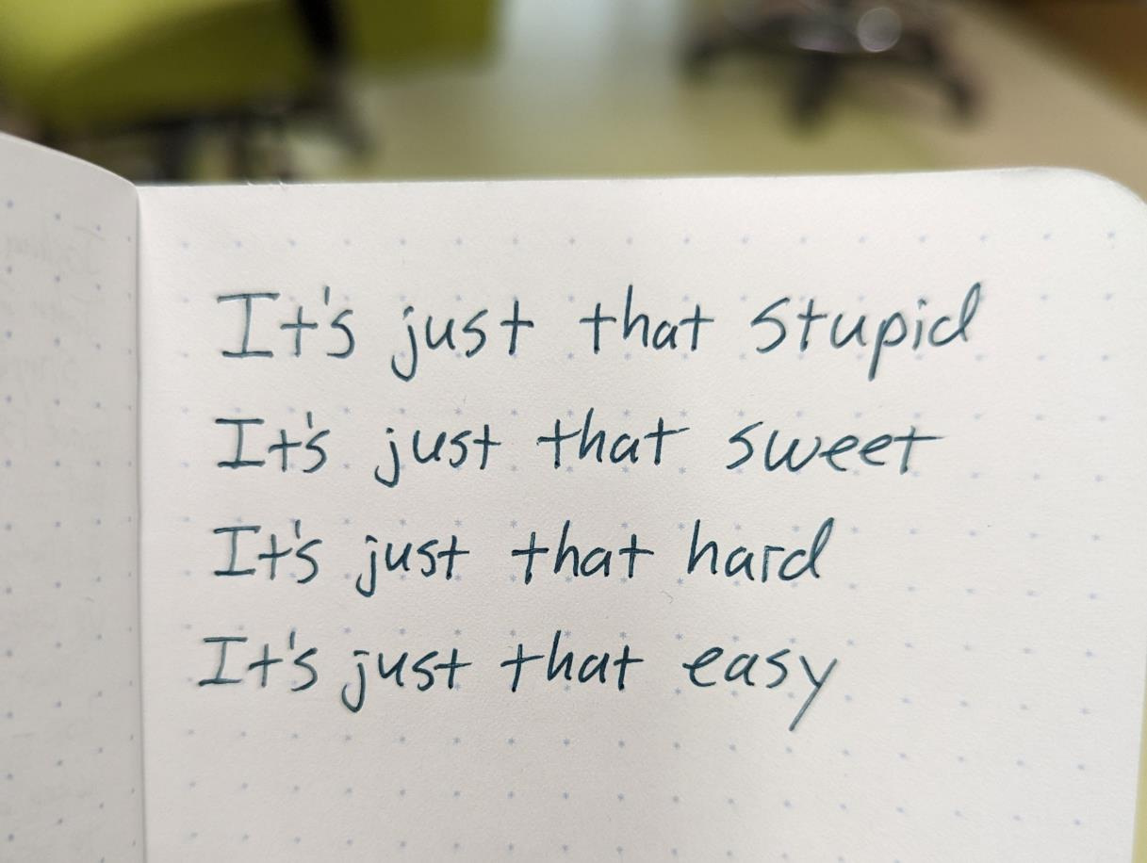
Notes:
Dan
Here’s a little snippet I wrote in my notebook as I thought about this songwriting exercise – it doesn’t use ANY of the first three exercises… and that’s sort of the point too. These exercises are supposed to unlock and enable and inspire – but feel free to go offroading and just write some stuff down.
This isn’t a final lyric, it doesn’t rhyme, the rhythm isn’t there yet, I’m not sure they’re in the right order… I want to put “sweet” in the fourth line… but I can imagine taking something like this and working on it, rearranging it, finding a rhythm to it…
I can imagine going back to the song structure exercise with this in hand… or blending this with some pairs from the word ladder… you get the picture.

Slide 70
WRITE THAT FIRST DRAFT*
*your first incomplete, partial, sketchy draft
Notes:
Dan
Again, we’re ONLY doing the hard part – getting started.
Take the words from exercises 2 & 3 – your word ladder and your stolen words – and start putting them into a structure that looks something like what you saw in exercise #1
You don’t have to use it all. Throwing away some pieces is just as important as finding some pieces.
You’ve got 5 minutes…

Slide 71
Share Your Draft
Share your draft with two other people. Sing it if you want!
This Photo by Unknown Author is licensed under CC BY-NC-ND

Slide 72
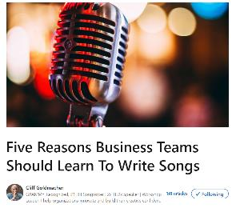
Five Reasons To Write Songs by Cliff Goldmacher
Makes you think differently
Take you out of your comfort zone
Shows you can do the “impossible”
Improves your ability to communicate
Brings teams together
Notes:
Lynne
Remember these reasons from an hour ago? How does this line up with your experience from the past hour?
Do any of these sound familiar? Did writing a song do any of this for you?

Slide 73
Five Six MORE Reasons To Write Songs by Cliff Goldmacher
Demonstrates that we are all creative
Methodically access our creativity
Helps get over a generalized fear of failure
A shortcut to the emotional crux of any issue
Takes us back to a beginner’s mindset
BONUS REASON: It’s Fun!!
Notes:
Lynne
How about this list?

Slide 74
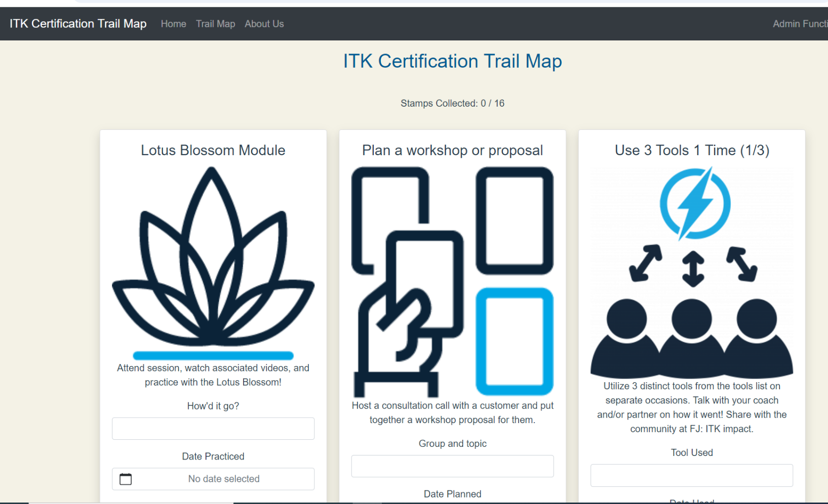
https://itkcert.mitre.org/trailmap
Notes:
Lynne
Time to collect some stamps!!

Slide 75
Next Steps!
Set up your Trail Map (and check stuff off!)
Find a buddy
Find a coach
Use ITK on your project (with your buddy!)
Come to ITK Stand-Up (Mondays at 4pm)
What will you do by NEXT TUESDAY?
Notes:
Lynne

Slide 76
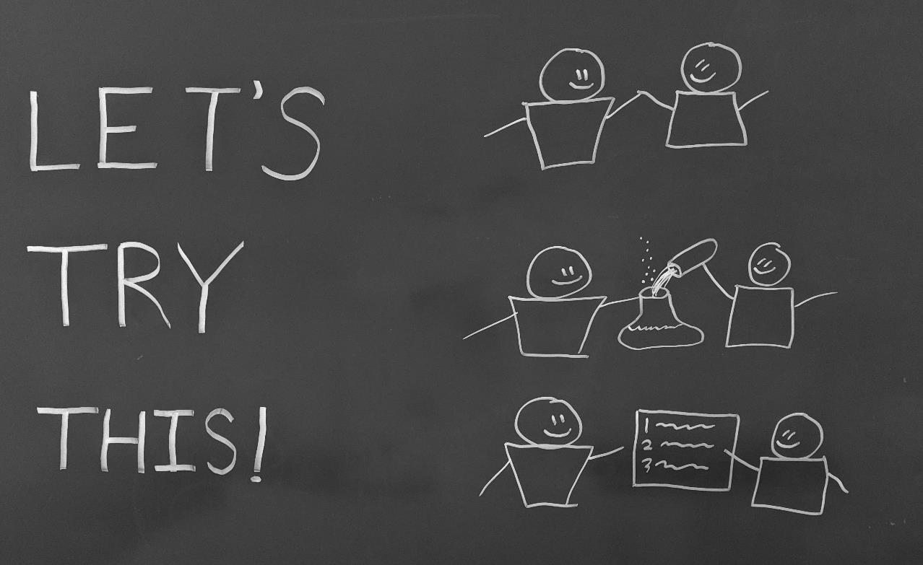
Notes:
These three words are pretty much a magic formula for making things happen. But they’re harder to say than you might think.
The next slide breaks it down a bit…

Slide 77
Notes:
LET’S – Implies an “us,” implies we have some people in mind to join in on the experiment, and it takes some work to FIND these people.
TRY – Reflects a level of boldness & courage to attempt something where the outcome may be unpredictable
THIS – Requires a thoughtful, specific description of the thing you are proposing – again, this takes some work!
Consider the Let’s Try This framework as the basis for a proposal – For LET’s - Who will you invite? For TRY – try to achieve what? For THIS - what ACTION do you propose? And for the exclamation mark - how can you bring the energy?

Slide 78
THE CONFIDENCE PARADOX
CONFIDENCE
COMPETENCE
ACCEPT
THE CHALLENGE
APPLY
OURSELVES
Notes:
We’ve talked about a lot of things over the past 2 days, and I want to leave you with one final concept I call the Confidence Paradox. My friend Dr. Patti Fletcher describes this in her book Disrupters
She makes the case that Confidence comes from Competence – when we’re good at something, we feel more confident.
In turn, Competence comes from Applying Ourselves. In other words, we get good at things by DOING.
And in order to Apply Ourselves, we have to first Accept the Challenge – to say “Yes, I’ll try this.”
And here’s the paradox: we tend to accept the challenge only when we feel confident – but if we wait until we feel confident, we’ll never actually get started

Slide 79
THE CONFIDENCE PARADOX
CONFIDENCE
ACCEPT
THE CHALLENGE
COMPETENCE
APPLY
OURSELVES
Notes:
What is the key to resolve the paradox? Accept the challenge before we feel confident and before we are fully competent.
Accepting the challenge has to be the first step. We literally can’t start anywhere else.

