Slide 1
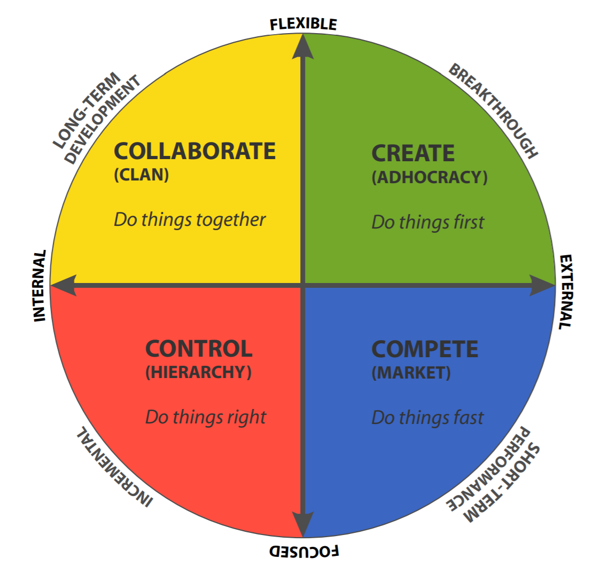
THE
COMPETING VALUES
FRAMEWORK
Dan & Lynne’s Quick Intro
to
Cameron & Quinn’s CVF
©2024 The MITRE Corporation. ALL RIGHTS RESERVED Approved for public release. Distribution unlimited 24-02352-2
This work is licensed under CC BY-SA 4.0.
Notes:
We were introduced to the CVF earlier this year, and have found it to be really interesting & helpful.

Slide 2
ASSESSING
EFFECTIVENESS?
Notes:
The basic question the CVF set out to explore was how to assess and define organizational effectiveness.
Surprise –their main finding is that there is NO SINGLE MEASURE of effectiveness that works for every organization or project, all the time.
Instead, they identified 4 distinct quadrants that a project or organization might move through.

Slide 3
internal
external
Notes:
The CVF is built on a pair of intersecting axes – this one shows Internally vs Externally focused org’s.
That is, organizations where they find it important to focus on the internal environment – understanding who we are & what we do, etc, versus organizations who are focused on the external environment – threats, opportunities, competitors, customers, etc

Slide 4
flexible
internal
external
focused
Notes:
And org’s that value being flexible vs being focused.
Note – flexible doesn’t mean unfocused, and focused doesn’t mean inflexible. Flexible means being open to a wide range of options, while Focused generally means we’ve made some decisions and picked some options.
Don’t worry too much about what these terms mean precisely yet – that’ll be clearer as we go along. Right now the point is just that these are COMPETING values –internal and external are opposites, and flexibility & focus (as they define them) are opposites

Slide 5
flexible
CREATE
GREEN
(Adhocracy)
DO THINGS FIRST
internal
external
focused
Notes:
I think the easiest way to understand it is by looking at what happens in each quadrant.
Each one is assigned a color for easy reference, and the upper right is GREEN – in this quadrant, we value doing things FIRST. It’s all about ideas & energy & creative thinking. Classic Innovation activities, with a high emphasis on NOVELTY. The verb here is CREATE
This is typical Start Up values. It’s also common for artists and creatives and serial entrepreneurs, in MITRE this is where the MIP fans like to live. Anyone who likes to quickly move from idea to idea. Show of hands –anyone identify with that?
BUT… here’s the warning: If a team is all green all the time, loads of ideas… but tends to be light on teamwork & implementation & finishing things. Greens are often tempted to move on to the next thing instead of getting it all wrapped up.

Slide 6
flexible
COLLABORATE
YELLOW
(Clan)
DO THINGS TOGETHER
GREEN
(Adhocracy)
DO THINGS FIRST
internal
external
focused
Notes:
So that brings us to the YELLOW quadrant. If Green is about doing things first, Yellow is about doing things TOGETHER.
It’s all about bringing people together and establishing shared values & culture. Big emphasis on supporting, guiding, mentoring. The verb is Collaborate
Groups that skew yellow tend to use language like “we’re all a family here.” ITK leaned into this really hard early on (and still) – and for me personally, YELLOW is my happy place. I love bringing people together, building small teams where we can know each other. I love connecting & introducing people to each other, helping to support & advise…. Anyone else a Yellow like me?
If you have a team that’s all yellow all the time – excellent off-sites, everyone’s supported and loved, but can get stale & slow to make decisions & miss opportunities to actually do stuff that matters.

Slide 7
flexible
YELLOW
(Clan)
DO THINGS TOGETHER
GREEN
(Adhocracy)
DO THINGS FIRST
internal
external
RED
(Heirarchy)
DO THINGS RIGHT
CONTROL
focused
Notes:
The next quadrant is RED – if Green is do things first, yellow is do things together, Red is about doing things RIGHT. We’ve shifted from valuing flexibility to valuing focus, so now there’s a big emphasis on nailing down our procedures and processes, examining our systems to make them better, getting things under engineering control so they’re repeatable, predictable, and efficient. The verb is Control.
This is classic ENGINEERING values. MITRE skews Red. So does the Pentagon. So any RED’s in this group?
But if it’s all red all the time, can be inhumane, boring, stale, sterile, bureaucratic – while also being super efficient (but potentially in a very narrow sense of efficiency)

Slide 8
flexible
YELLOW
(Clan)
DO THINGS TOGETHER
GREEN
(Adhocracy)
DO THINGS FIRST
internal
external
RED
(Heirarchy)
DO THINGS RIGHT
BLUE
(Market)
DO THINGS FAST
COMPETE
focused
Notes:
Our last quadrant is Blue, and this one is about doing things FAST – again, Competing Values, and here we value speed.
In the Blue quadrant, we focus on winning – and that means identifying & understanding the market, pursuing the metrics of competition, thrilling your customers and crushing the competition. So the verb here is COMPETE
This is classic industry values (and Special Forces and athletes) – gotta maximize profit, gotta dominate the environment, gotta beat all competitors. Show of hands – who feels the need for speed?
But all blue all the time – you’ll crush it, then flame out spectacularly, burn out the team, and if someone comes along with a new idea (GREEN), they just might eat your lunch.

Slide 9
Notes:
I generally avoid sports examples, but I came across this on LinkedIn and it was too good to pass up
What color is Deion Sanders being here? (blue) What color is he disparaging? (yellow).
See the friction across the diagonals, the “conflict” in Conflicting Values Framework.
And also see the (begrudging) acknowledgement of the value of that Harmon – classic Yellow value – even in a strong Blue situation.

Slide 10
flexible
How can we support each other?
What haven’t
we tried yet?
internal
external
How can we be
more efficient?
How can we outperform the rest?
focused
Notes:
Based on the primary values & verbs, here are the key questions we ask in each quadrant.
If you’re not sure which quadrant you’re most aligned with / comfortable in – which one is your happy place – ask yourself which of these questions do you find most interesting? Which one would you most want to answer? You might be interested in several, but does one stand out?
Does this question set help? Any thoughts here?

Slide 11
flexible
YELLOW
(Clan)
DO THINGS TOGETHER
GREEN
(Adhocracy)
DO THINGS FIRST
FRICTION
internal
external
RED
(Heirarchy)
DO THINGS RIGHT
BLUE
(Market)
DO THINGS FAST
focused
Notes:
Here’s where things get interesting – and this is really the reason I like the framework & wanted to share it - we tend to see antagonism & friction across the diagonals.
If Greens are constantly asking “What have we not tried yet?” and the Reds are asking “How can we get things under control?” – what are those two groups going to think of each other?
Similarly, if Yellows are asking “How can we support each other?” and the Blues are asking “How can we outperform the competition?” – what does that do to the team’s effectiveness?

Slide 12
flexible
YELLOW
(Clan)
DO THINGS TOGETHER
GREEN
(Adhocracy)
DO THINGS FIRST
partnership
internal
external
RED
(Heirarchy)
DO THINGS RIGHT
BLUE
(Market)
DO THINGS FAST
focused
Notes:
This might be my Yellow tendencies speaking, but the research shows effective teams learn to blend & cooperate.
The ideal team has a full rainbow, but here’s the twist…

Slide 13
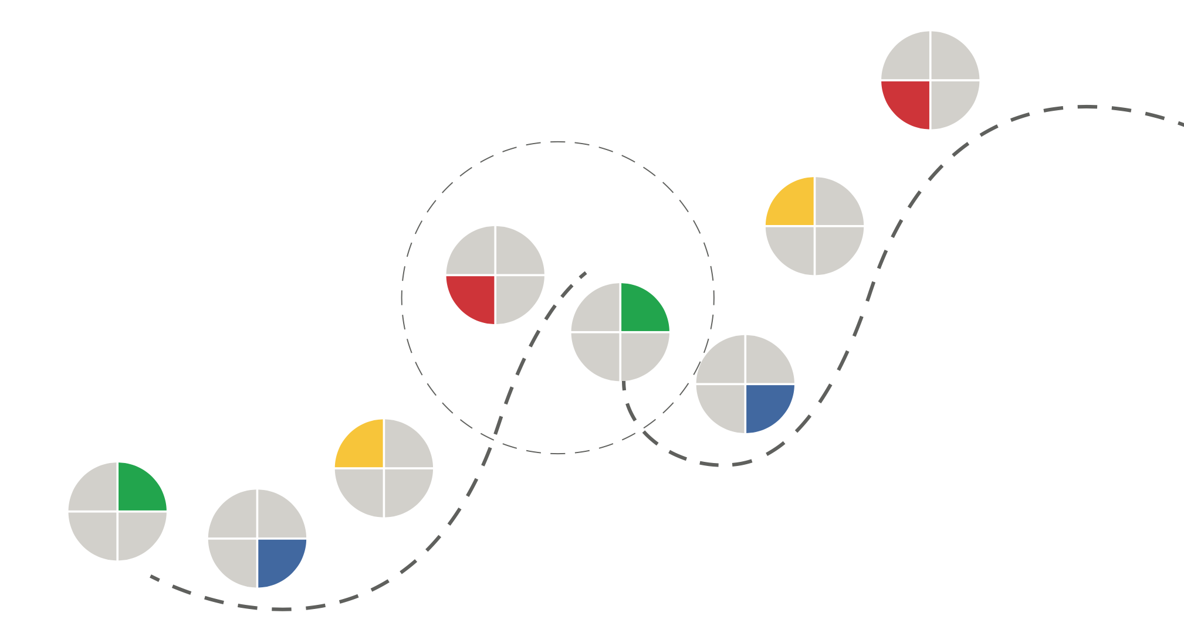
Notes:
We need to shift from one dominant color to another several times over the life of a project… or the life of an organization. Failure to make these transitions is one of the big reasons organizations fail.
For example, the circled peak is where RED’s focus on scaling and standardization make the organization addicted to their present success and lead them to avoid or resist exploring new areas (which is what Green does). So that’s Blockbuster, Kodak, or Blackberry… any organization that fell to the innovator’s dilemma.
This isn’t the only way to proceed from color to color – the point is the transitions, not the pattern. I could imagine doing these colors in different orders – starting with yellow then going to blue and so on. What’s harder to imagine is an effective organization that stays effective by staying in a single color for the long haul.
Have you ever seen a team get stuck in one area? And yes, the GREEN can be just as resistant to change as the RED… maybe even more so.

Slide 14
I’LL DECLINE AN
INVITATION IF:
flexible
It looks
LONELY
It looks
BORING
internal
external
I can’t see the
GUARDRAILS
I can’t see the
SCOREBOARD
focused
Notes:
One more little insight to help you understand each color – let’s look at what makes each color decline an invitation.
For GREEN – they’ll tend to decline if the thing looks boring, predictable, or obvious. If it’s repetitive, old fashioned, already been done, or if there’s no room to explore and experiment. Greens want to make sure we’re exploring new ground, otherwise why bother?
For YELLOW – they’ll decline if the thing looks lonely, unsupported, or isolated. If there’s no opportunity to bring people together or if there’s not a consensus that it’s something people want to do. Yellows want to make sure they’re connected to people and not leaving anyone behind, otherwise they’re out.
For RED – they’ll decline if they can’t see the guardrails and instructions. If it’s not clear what right looks like (‘cause then we might be wrong!) or if the outcome is not predictable. Like playing pool, Reds want to call their shot before taking it (otherwise they won’t take it).
For BLUE – they’ll decline if they can’t see the scoreboard or the finish line. If there’s no way to earn points or there’s no way to win. Reds want to be able to keep score, otherwise why bother?

Slide 15
MY STRONGEST
CRITICISM IS:
flexible
There’s no
HEART
There’s nothing
NEW
internal
external
That’s doing it
WRONG
It’s so
SLOW
focused
Notes:
Since values are all about what we think is important, our values also shape our perception of what’s WRONG. Color will indicate the way we’ll criticize a project, organization, or situation.
GREEN will complain when things are repetitive and similar, or when it looks too much like stuff they’ve seen before.
YELLOW’s criticisms tend to be around the people dimension – there’s no heart, it leaves people behind,
RED will object when they detect divergence from the approved methods, when we’re not complying or going after the agreed-upon objectives
BLUE’s critiques tend to be around how long things are taking, how slow it’s moving
Keep this in mind when you’re pitching an idea to someone -

Slide 16
CVF
USE CASE
Notes:
OK, so how do you use this?
First – as a vocabulary. It gives us a way to describe & understand our own preferences & tendencies & tastes, as well as the preferences of the people around us.
As a Green I can say “Oh, Bob’s not an idiot or a soul-sucking bureaucrat. He’s a Red and he’s trying to make sure we do things right, and Red is an important contributor to the team and helps balance out some of the tendencies I bring as a Green…” And there are times when RED should be in the driver’s seat…

Slide 17
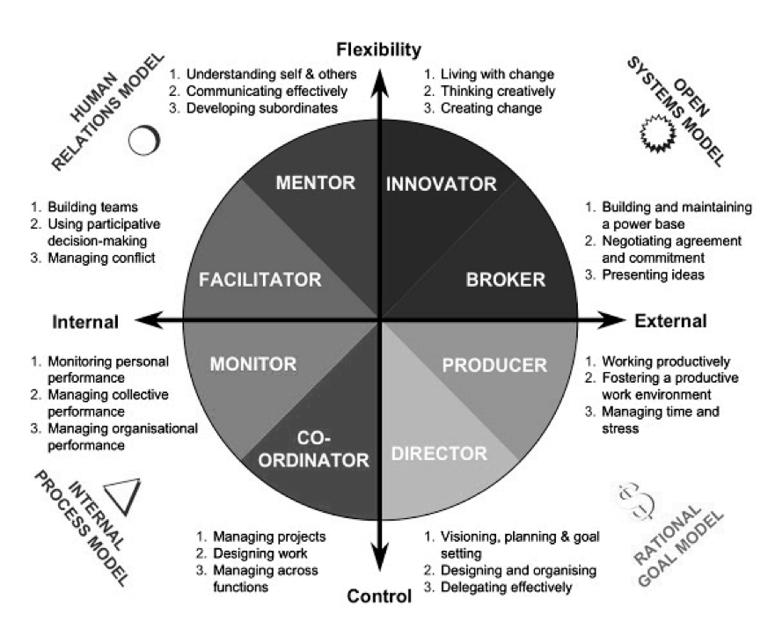
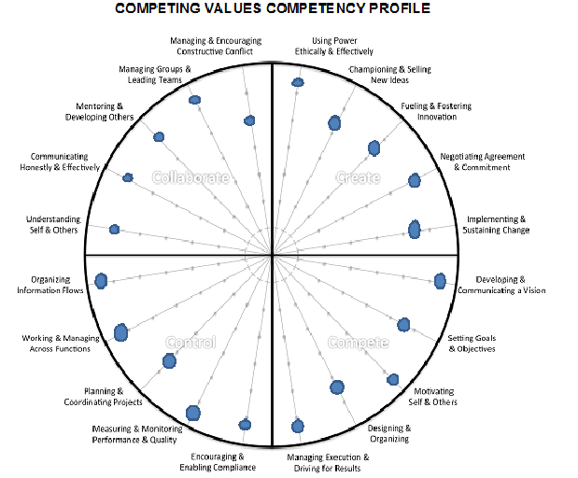
Notes:
If you’re interested, you can go MUCH deeper into all this – the four quadrants each get divided into sub-quadrants, there’s a whole set of competencies in each quadrant… we’re not going to go that deep in the 30 minutes we have today, but I want you to know it exists.

Slide 18
https://www.boomhogeronderwijs.nl/media/8/download_pdf_culture_assessment_workbook.pdf
Notes:
If you want to learn more, download this PDF guide by Robert Quinn and Kim Cameron, Quinn is the one who created the framework in the first place. It includes an assessment you can use to “diagnose your organization” and I’ll put the link in the chat.
https://www.boomhogeronderwijs.nl/media/8/download_pdf_culture_assessment_workbook.pdf
Hope it’s been helpful. Questions & thoughts & discussion?

Slide 19
IT’S IMPORTANT
TO BE
flexible
APPRECIATIVE
& WARM
COURAGEOUS
& DIFFERENT
internal
external
RELIABLE
& CAREFUL
BETTER THAN
THE REST
focused

Slide 20
I LIKE TO
TALK ABOUT
flexible
TRUST
& TEAMS
IDEAS
& TECH
internal
external
PROCESS
& COMPLIANCE
PERFORMANCE
& STRATEGY
focused

Slide 21
flexible
NO
LONE WOLVES
NO
LIMITATIONS
internal
external
NO
SURPRISES
NO
SLACKING OFF
focused

Slide 22
I DON’T
MIND BEING
flexible
SOFT
WEIRD
internal
external
FIRM
FEARED
focused

Slide 23
I’M PROUD
OF MY
flexible
COMMUNITY
ORIGINALITY
internal
external
CONSISTENCY
STATS
focused

Slide 24
I WANT TO
flexible
KNOW YOU
INSPIRE YOU
internal
external
TEACH YOU
MOTIVATE YOU
focused

Slide 25
I SPEND
MY ENERGY
flexible
CONNECTING
EXPLORING
internal
external
CORRECTING
WINNING
focused

Slide 26
MARKET
RESEARCH
REPORT
flexible
I’D LIKE TO INTRODUCE YOU TO ALL THE NEW FRIENDS I MADE WHILE DOING MARKET RESEARCH
HERE’S THE PROTOTYPE I BUILT AFTER TALKING TO ONE POTENTIAL CUSTOMER…
internal
external
HERE’S YOUR COPY OF THE COMPREHENSIVE RESEARCH REPORT. SORRY IT’S LATE BUT FORMATTING AND REVIEWING IS A SLOW PROCESS
HERE’S THE LIST OF OUR COMPETITOR’S GAPS AND WEAKNESSES WE CAN EXPLOIT WITH OUR NEXT OFFERING…
focused

Slide 27
FAVORITE SONGS
flexible
Yellow Submarine
The Beatles
Wanna Be Starting Something
Michael Jackson
internal
external
This Is How We Do It
Montell Jordan
We Are The Champions
Queen
focused

