Slide 1
TRIZ Prism
Introduction
©2024 The MITRE Corporation. ALL RIGHTS RESERVED Approved for public release. Distribution unlimited 24-02352-4
This work is licensed under CC BY-SA 4.0.

Slide 2
TRIZ PRISM
2) GENERAL
PROBLEM
3) GENERAL
SOLUTION(s)
1) SPECIFIC
PROBLEM
4) SPECIFIC
SOLUTION
Notes:
The TRIZ Prism is a four-step problem-solving approach borrowed from TRIZ (aka the Theory of Inventive Problem Solving).
Step one is to identify a specific problem you are working on.

Slide 3
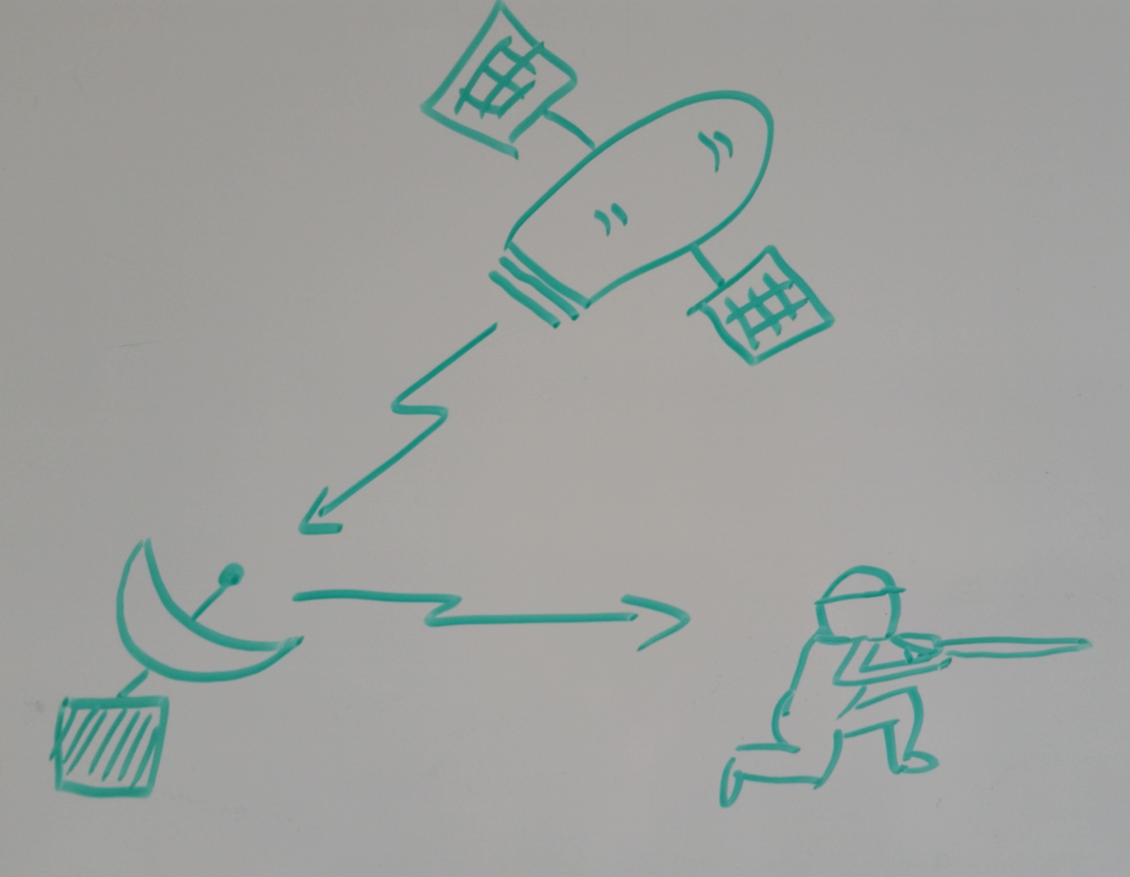
TRIZ PRISM
2) GENERAL
PROBLEM
3) GENERAL
SOLUTION(s)
This satellite image file is too large to send to a special operations soldier in Afghanistan using the very limited bandwidth available.
1) SPECIFIC
PROBLEM
4) SPECIFIC
SOLUTION
Notes:
For example, this was a real problem I worked on in the early 2000’s.
It was REALLY hard.

Slide 4
TRIZ PRISM
2) GENERAL
PROBLEM
3) GENERAL
SOLUTION(s)
1) SPECIFIC
PROBLEM
4) SPECIFIC
SOLUTION
Notes:
Often, the specifics of a problem make it difficult to imagine solutions.
So the next step is to rephrase the specifics of your problem into general terms.

Slide 5
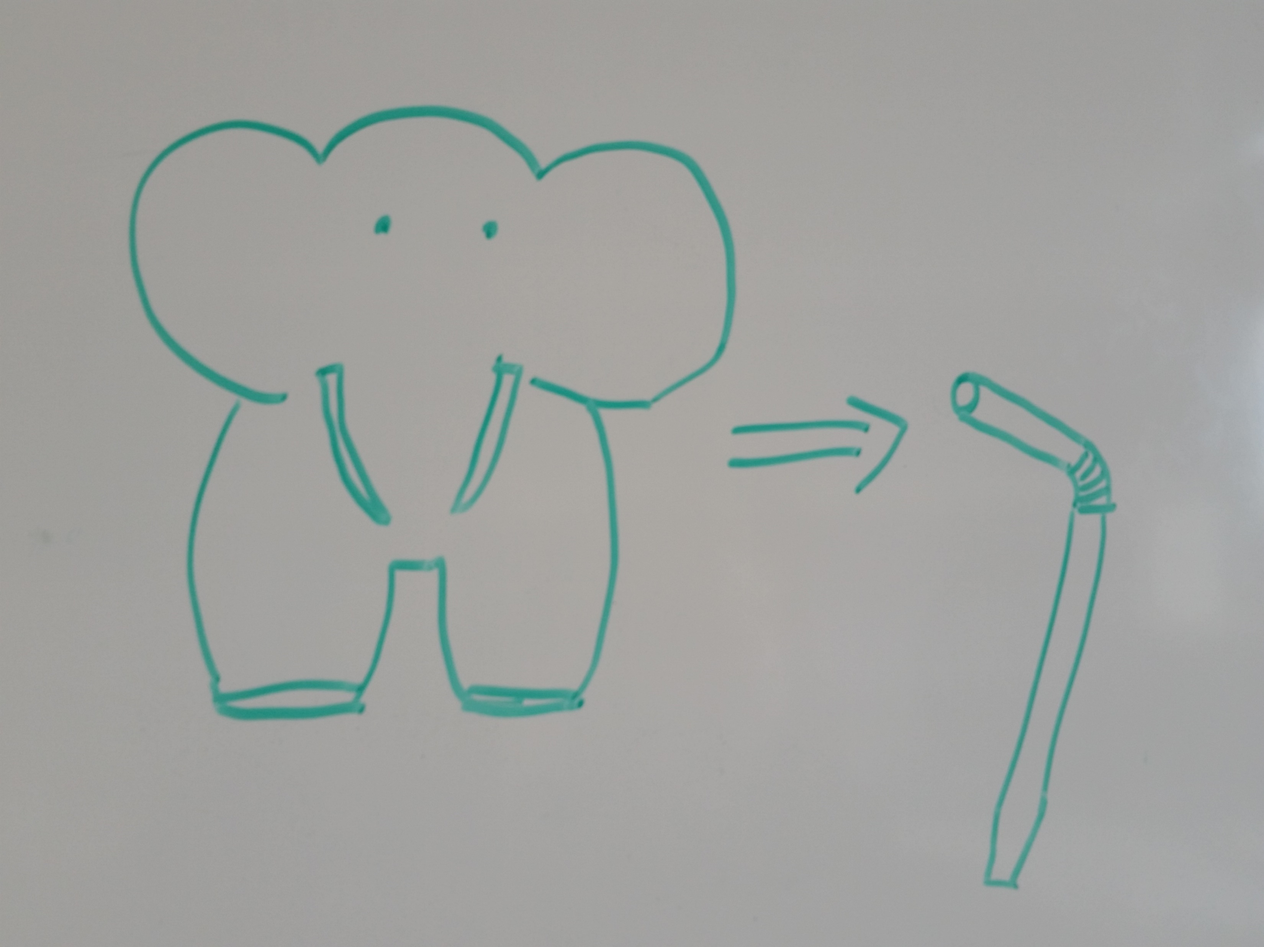
TRIZ PRISM
2) GENERAL
PROBLEM
3) GENERAL
SOLUTION(s)
This large object does not fit through this small aperture.
This satellite image file is too large to send to a special operations soldier in Afghanistan using the very limited bandwidth available.
1) SPECIFIC
PROBLEM
4) SPECIFIC
SOLUTION
Notes:
For example, instead of talking about specific satellite image files and limited comms pipes, we talked about moving Something Big through Something Small.
Turning our specific problem into a general problem statement helped open the aperture and moved us into an “open mode” where we could imagine a wider range of possible solutions.

Slide 6
TRIZ PRISM
2) GENERAL
PROBLEM
3) GENERAL
SOLUTION(s)
1) SPECIFIC
PROBLEM
4) SPECIFIC
SOLUTION
Notes:
That leads to Step 3: make a list of typical solutions to “that type of problem.”

Slide 7
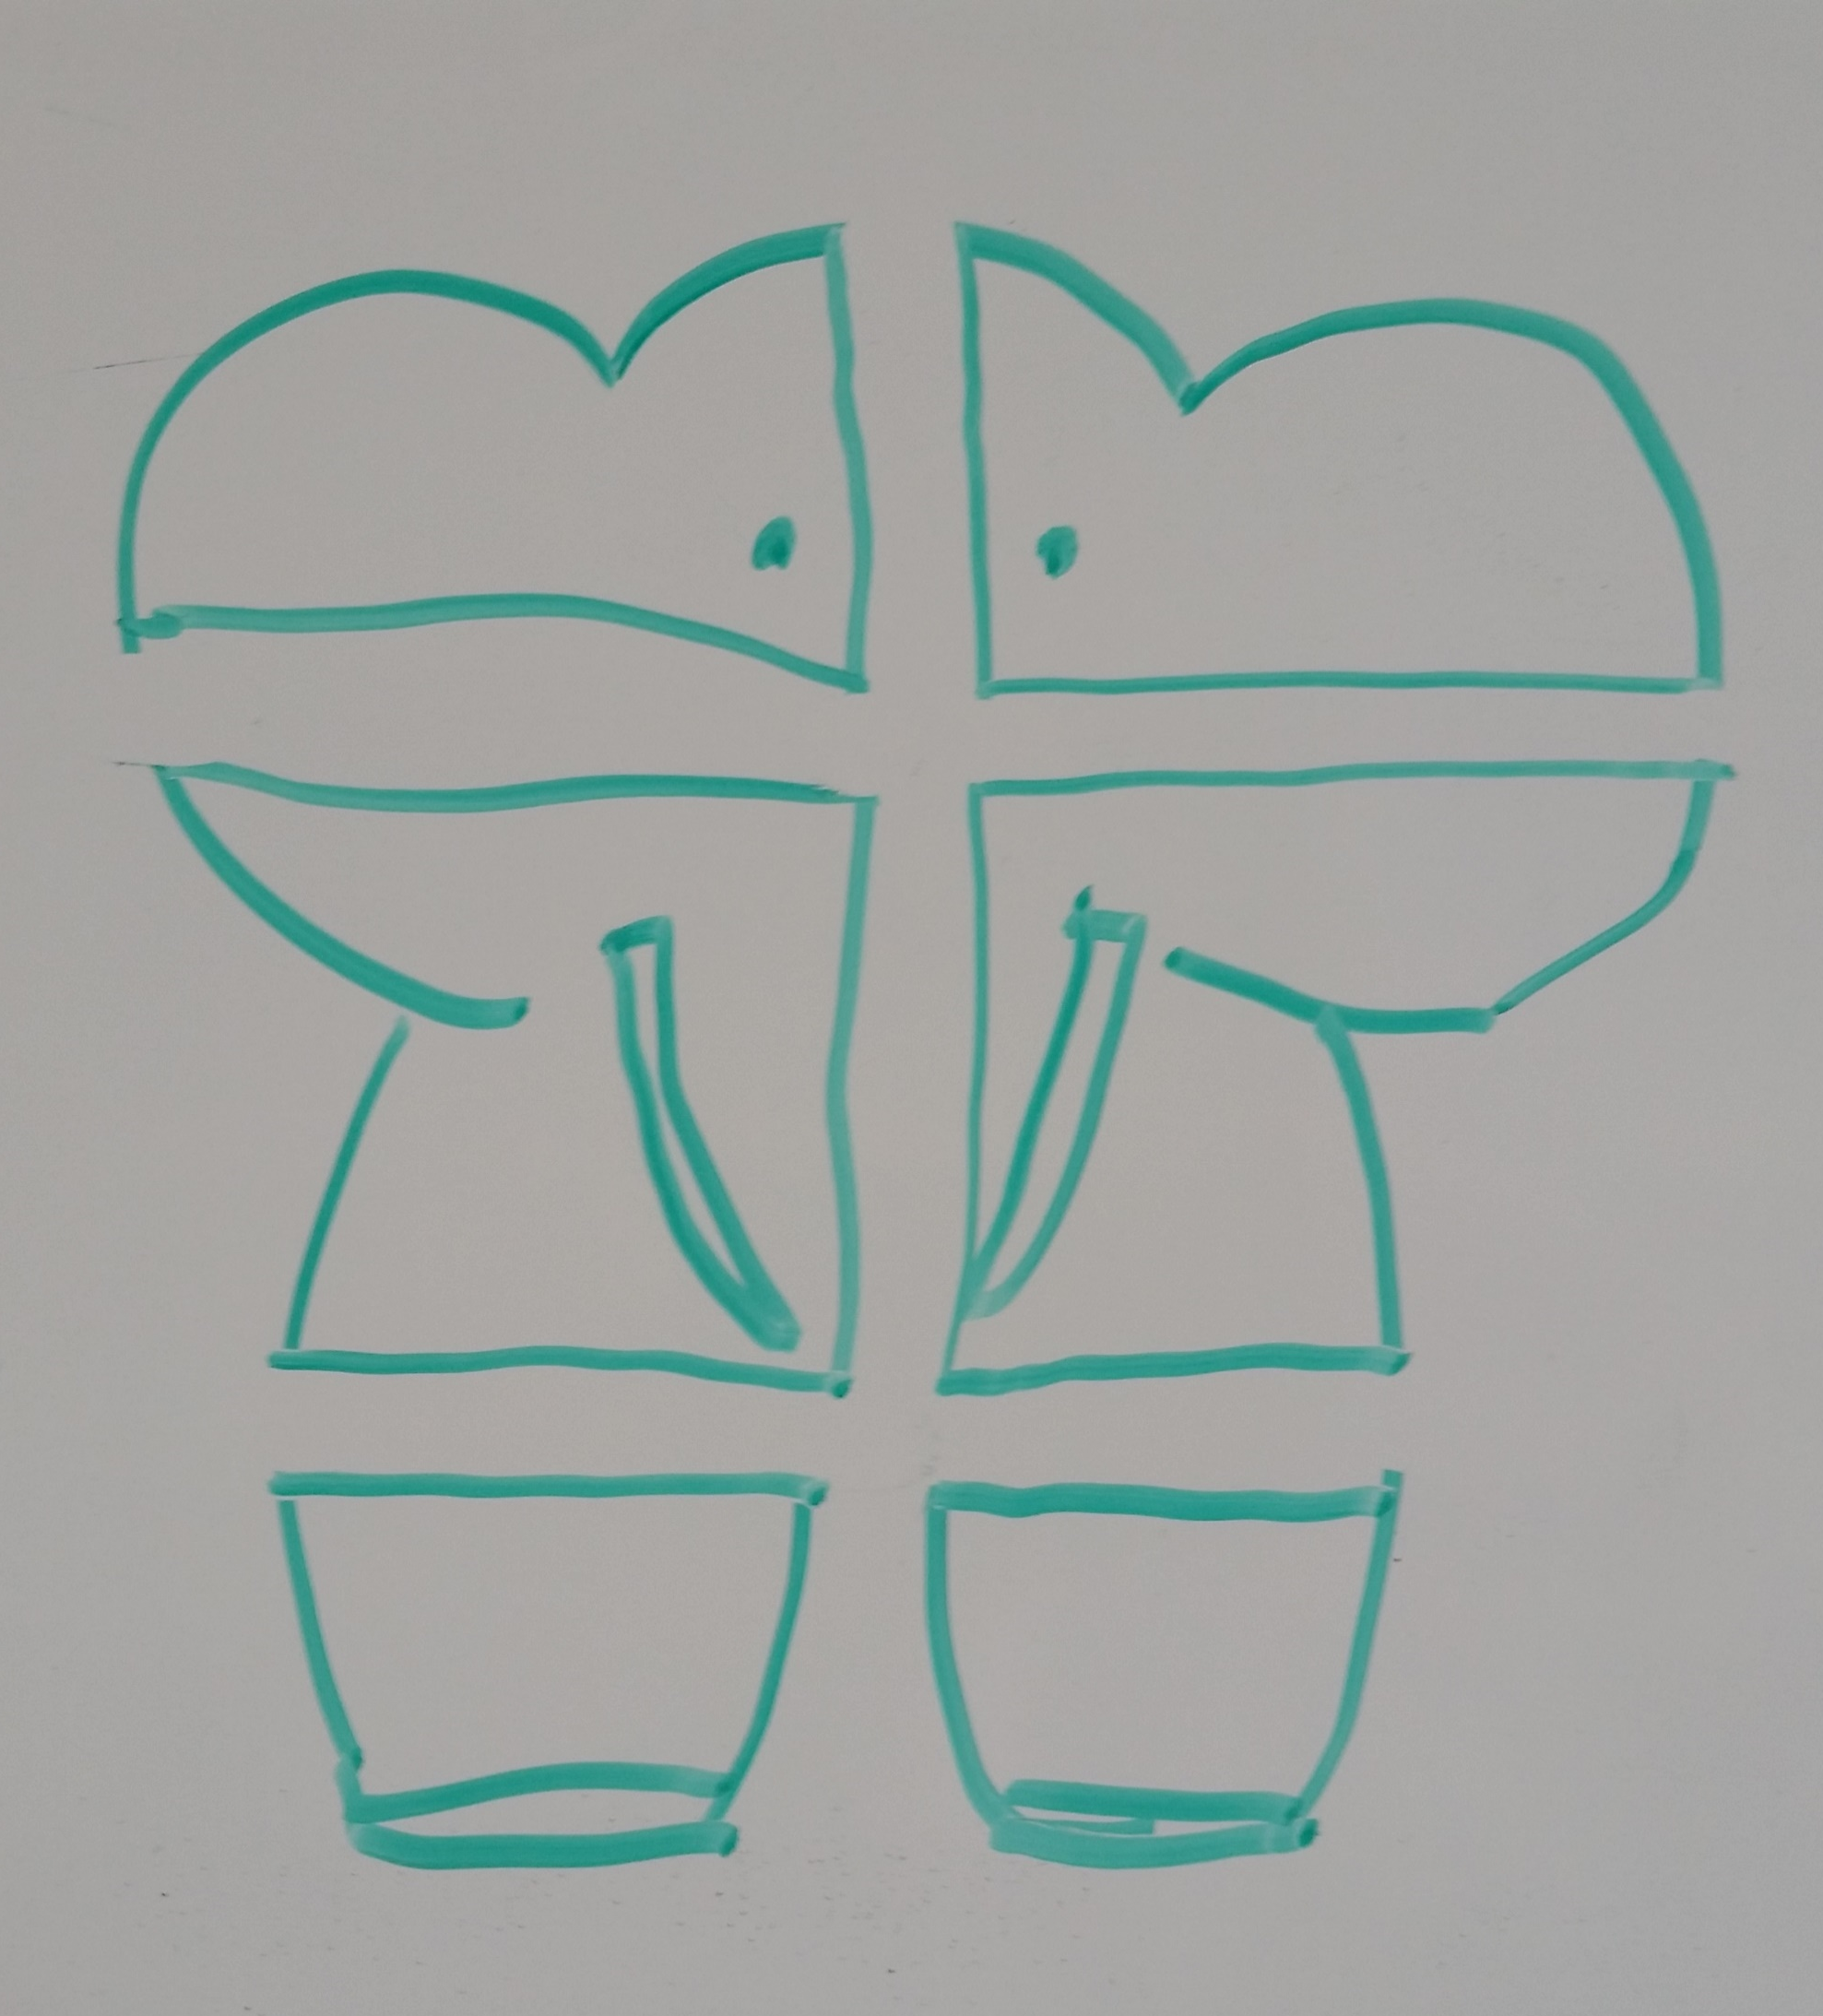
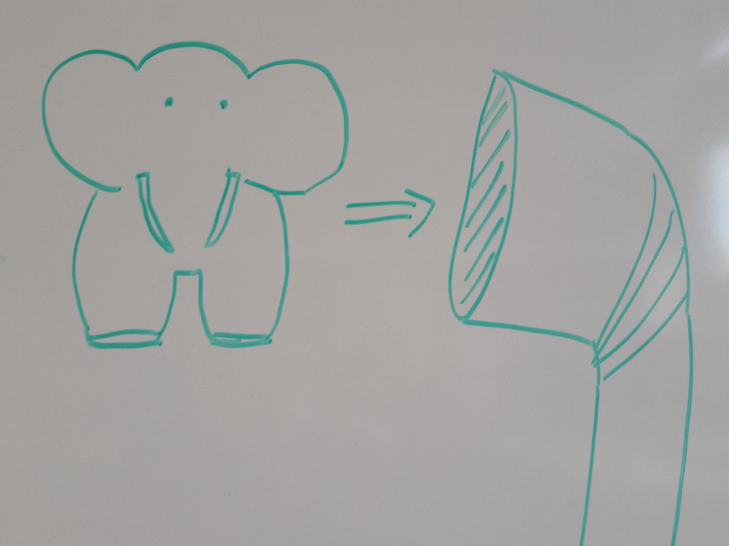
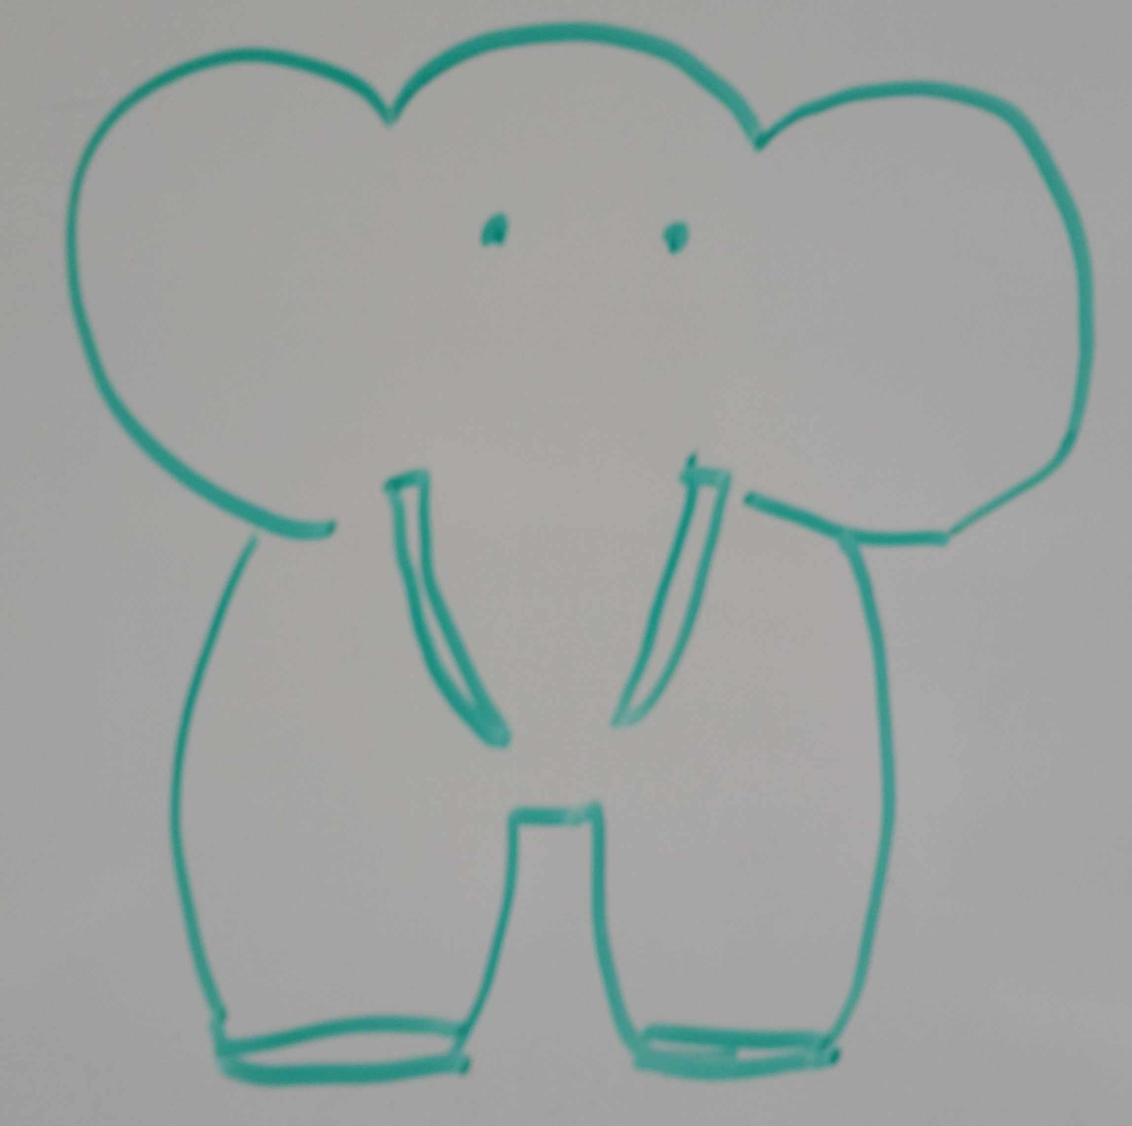
TRIZ PRISM
2) GENERAL
PROBLEM
3) GENERAL
SOLUTION(s)
This large object does not fit through this small aperture.
a)
a) Divide large object into pieces.
b) Use larger apertures.
c) Use smaller versions of object.
d) Use multiple apertures.
b)
c)
d)
1) SPECIFIC
PROBLEM
4) SPECIFIC
SOLUTION
Notes:
So, how do we push a Something Big through Something Small? How can we get an elephant through a soda straw?
Smaller elephants? Larger straws? Divide the elephant into pieces? Use more than one straw?

Slide 8
TRIZ PRISM
2) GENERAL
PROBLEM
3) GENERAL
SOLUTION(s)
1) SPECIFIC
PROBLEM
4) SPECIFIC
SOLUTION
Notes:
The fourth step is to translate those general solutions back into the specific terms of the problem we’re working on.

Slide 9
TRIZ PRISM
2) GENERAL
PROBLEM
3) GENERAL
SOLUTION(s)
Divide large object into pieces.
Use larger apertures.
Use smaller versions of object.
Use multiple apertures.
Allow soldier to request small image chips of specific areas rather than entire satellite image.
1) SPECIFIC
PROBLEM
4) SPECIFIC
SOLUTION
Notes:
In our case, we converted elephants back into satellite image files, and soda straws back into communication pathways.
It turns out the deployed troops didn’t need the whole elephant. They just needed part of the elephant. So we figured out a way to let them request a small image chip they could download quickly.

Slide 10
TRIZ PRISM
2) GENERAL
PROBLEM
3) GENERAL
SOLUTION(s)
This large object does not fit through this small aperture.
Divide large object into pieces.
Use larger apertures.
Use smaller versions of object.
Use multiple apertures.
This satellite image file is too large to send to a special operations soldier in Afghanistan using the very limited bandwidth available.
Allow soldier to request small image chips of specific areas rather than entire satellite image.
1) SPECIFIC
PROBLEM
4) SPECIFIC
SOLUTION
Notes:
And here it is, all on a single chart…

