Slide 1

Intrapreneurship Lessons From LIFT
©2024 The MITRE Corporation. ALL RIGHTS RESERVED
Approved for public release. Distribution unlimited 24-02352-8
This work is licensed under CC BY-SA 4.0.

Slide 2
Being An Entrepreneur
Self-selected (not assigned)
Operate with autonomy
Focused on delivering something customers pay for
May get initial support from investors
Exposure to loss / risk & access to upside / profits

Slide 3
Being An Intrapreneur
Self-selected (not assigned)
Operate with autonomy
Focused on delivering something customers pay for
May get initial support from Company
Less exposure to loss / risk & access to upside / profit

Slide 4

(NOT A LINEAR CHECKLIST)
Notes:
We’re going to walk through a series of actions and steps related to being in intrapreneur – but please don’t mistake this for a linear process or checklist.

Slide 5
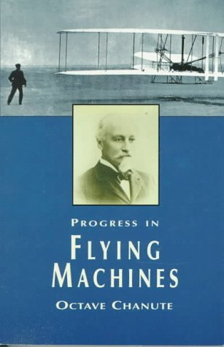
DO THE READING &
JOIN THE CONVERSATION
Notes:
One thing that distinguishes pro’s from hobbyists is that pro’s DO THE READING. They stay up to date on the latest development & they contribute to the wider conversation.
Chanute’s book assembled stories & data from every aviation experiment anyone had done. He corresponded with aviators around the world, and he published their stories & findings. This is key because you’ve got to know what is already happening in the field.
How can you do the reading & join the conversation? What books / blogs / outlets can you engage with & contribute to? (and be sure to avoid the situation where you propose something that someone else is already doing)

Slide 6
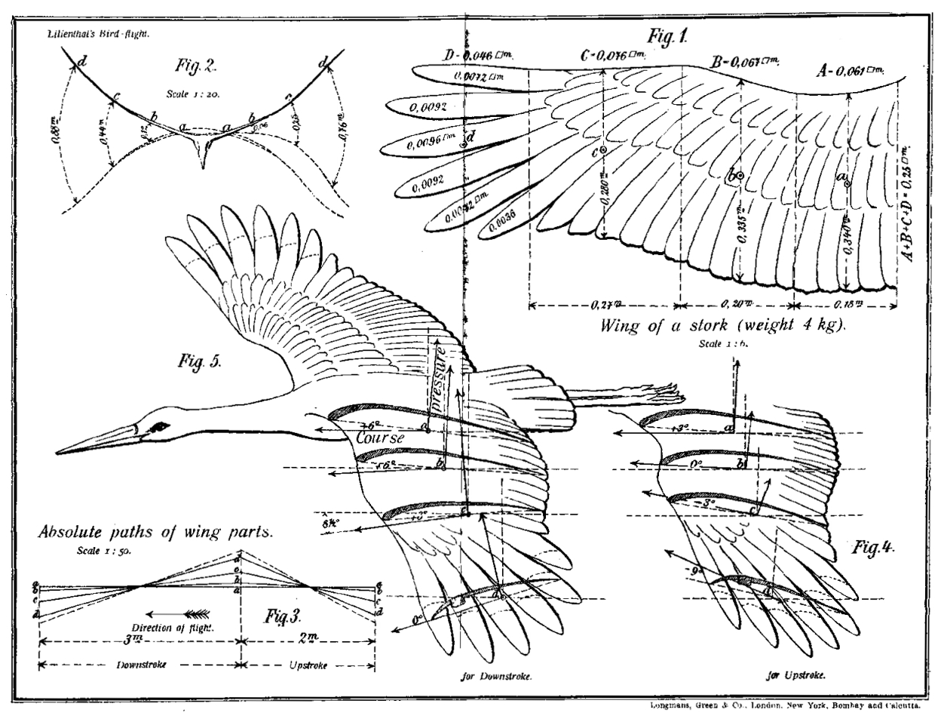
FIND A PROBLEM THAT INTERESTS YOU
Notes:
Do you already have a problem you’re interested in?
How specific is it? How broad? How widespread?
If you don’t have one in mind… do the reading…

Slide 7
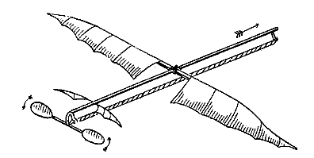
Deconstruct The Problem
“…important and quite successful upon the small scale on which it was tried.”
PENAUD - 1871
Notes:
Another key practice is to deconstruct the problem.
Story from LIFT: Alphonse Penaud’s little rubber band powered flying machine was a simple, elegant way to experimentally solve one small piece of the problem of flight: where to connect the wings to the fuselage.
With sticks & paper, in his back yard, he did BIG science on a shoestring budget – by focusing on the NEXT piece of the puzzle to be solved.
What’s your equivalent of Penaud’s plane? What is the NEXT piece of the puzzle to explore / solve?

Slide 8
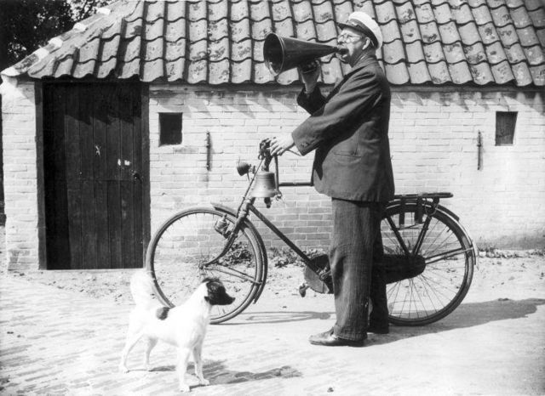
Ask Permission
Beg Forgiveness
Declare Intent
Notes:
Forget the “It’s better to beg forgiveness than ask permission” garbage – intrapreneurs don’t do either!
Not asking permission – we don’t need it.
Not begging forgiveness – we don’t need that either.
Instead, we’re making the decisions we can make, and doing them out loud. Transparent, visible, autonomy, accept accountability
What would it look like if you just declare your intent? Gotta be specific about what you’re proposing, doing the things you can do and making the decisions you can make on your own recognizance…

Slide 9
Share Your Question Out Loud
What is the worst thing about this product / design?
What is your sponsor’s biggest unmet need?
The thing we’re trying to figure out is _____________
Is there a better way to _______________?
Who is already working on ________________?
Would it be helpful if _______________?
Notes:
Sharing your question out loud might help you find someone who has already answered it, or you might find other people who are also asking that question and who want to join you in finding an answer.
And sharing your question out loud means you need to HAVE A QUESTION.

Slide 10
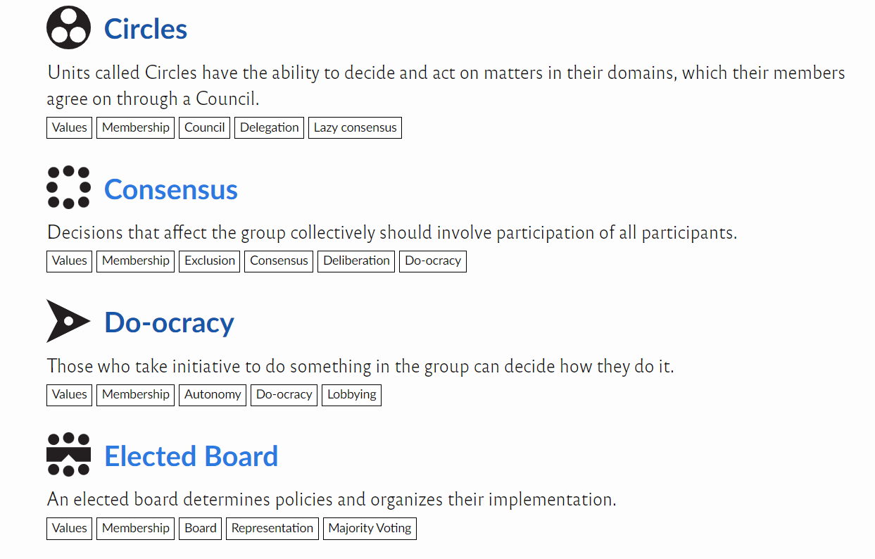
BUILD YOUR TEAM
https://communityrule.info/
Notes:
Innovation & Intrapreneurism are team sports – and the Community Rule website can help you define a clear structure for how your team makes decisions…
Finding volunteers & interested collaborators, building trust (eat together!!), and being clear about how you make decisions…
HOMEWORK: Check out Community Rule & talk about it with someone.

Slide 11
“The people who made the most progress were the collaborators and bridge builders, the includers and inviters, the
broad-minded generalists and
discipline blenders.”
“The
people
who had the
hardest time were the
isolated excluders, the
narrow-minded specialists,
and the arrogant purists.”
LIFT, pg 105
Notes:
Go wide, be inclusive, cross disciplines…

Slide 12
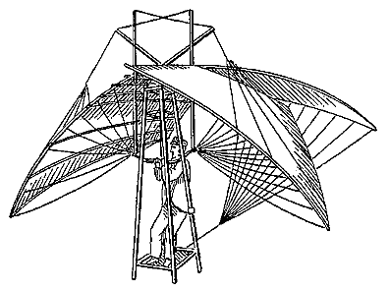
DON’T TAKE RISKS.
DO EXPERIMENTS.
DE GROOF -1864
Notes:
This is one of my favorite lines in my book LIFT. I like it because it’s actionable advice. Go take risks is pretty vague. Go do an experiment is specific – there is such a thing as an experimental method.
Tell DeGroof’s story (crashed & died, but “a few prior experiments with a bag of sand…”). If we focus on TAKING RISKS, we’ll do what DeGroof did… But if we focus on DOING EXPERIMENTS & gathering data, we may find safer ways to learn…

Slide 13
Intervention
followed by
observation
Notes:
let’s break down this word experiments – the simplest form of an experiment is simply an intervention followed by an observation.
We’ll change something, introduce some new element or make a modification, then we’ll pay attention to what happens. We’ll collect some data and reflect on it.
So… what (singular) Intervention can you make (change / add / remove / rearrange / etc)? And what (plural) Observations will you make (measure, collection, assess, count, etc)?

Slide 14

Notes:
I think the RICE acronym describes our approach pretty well – together, we did a long-running series of short experiments designed to help us understand what stuff works, what we like to do, what the users actually want & need… and we’re continuing to do it even now.

Slide 15
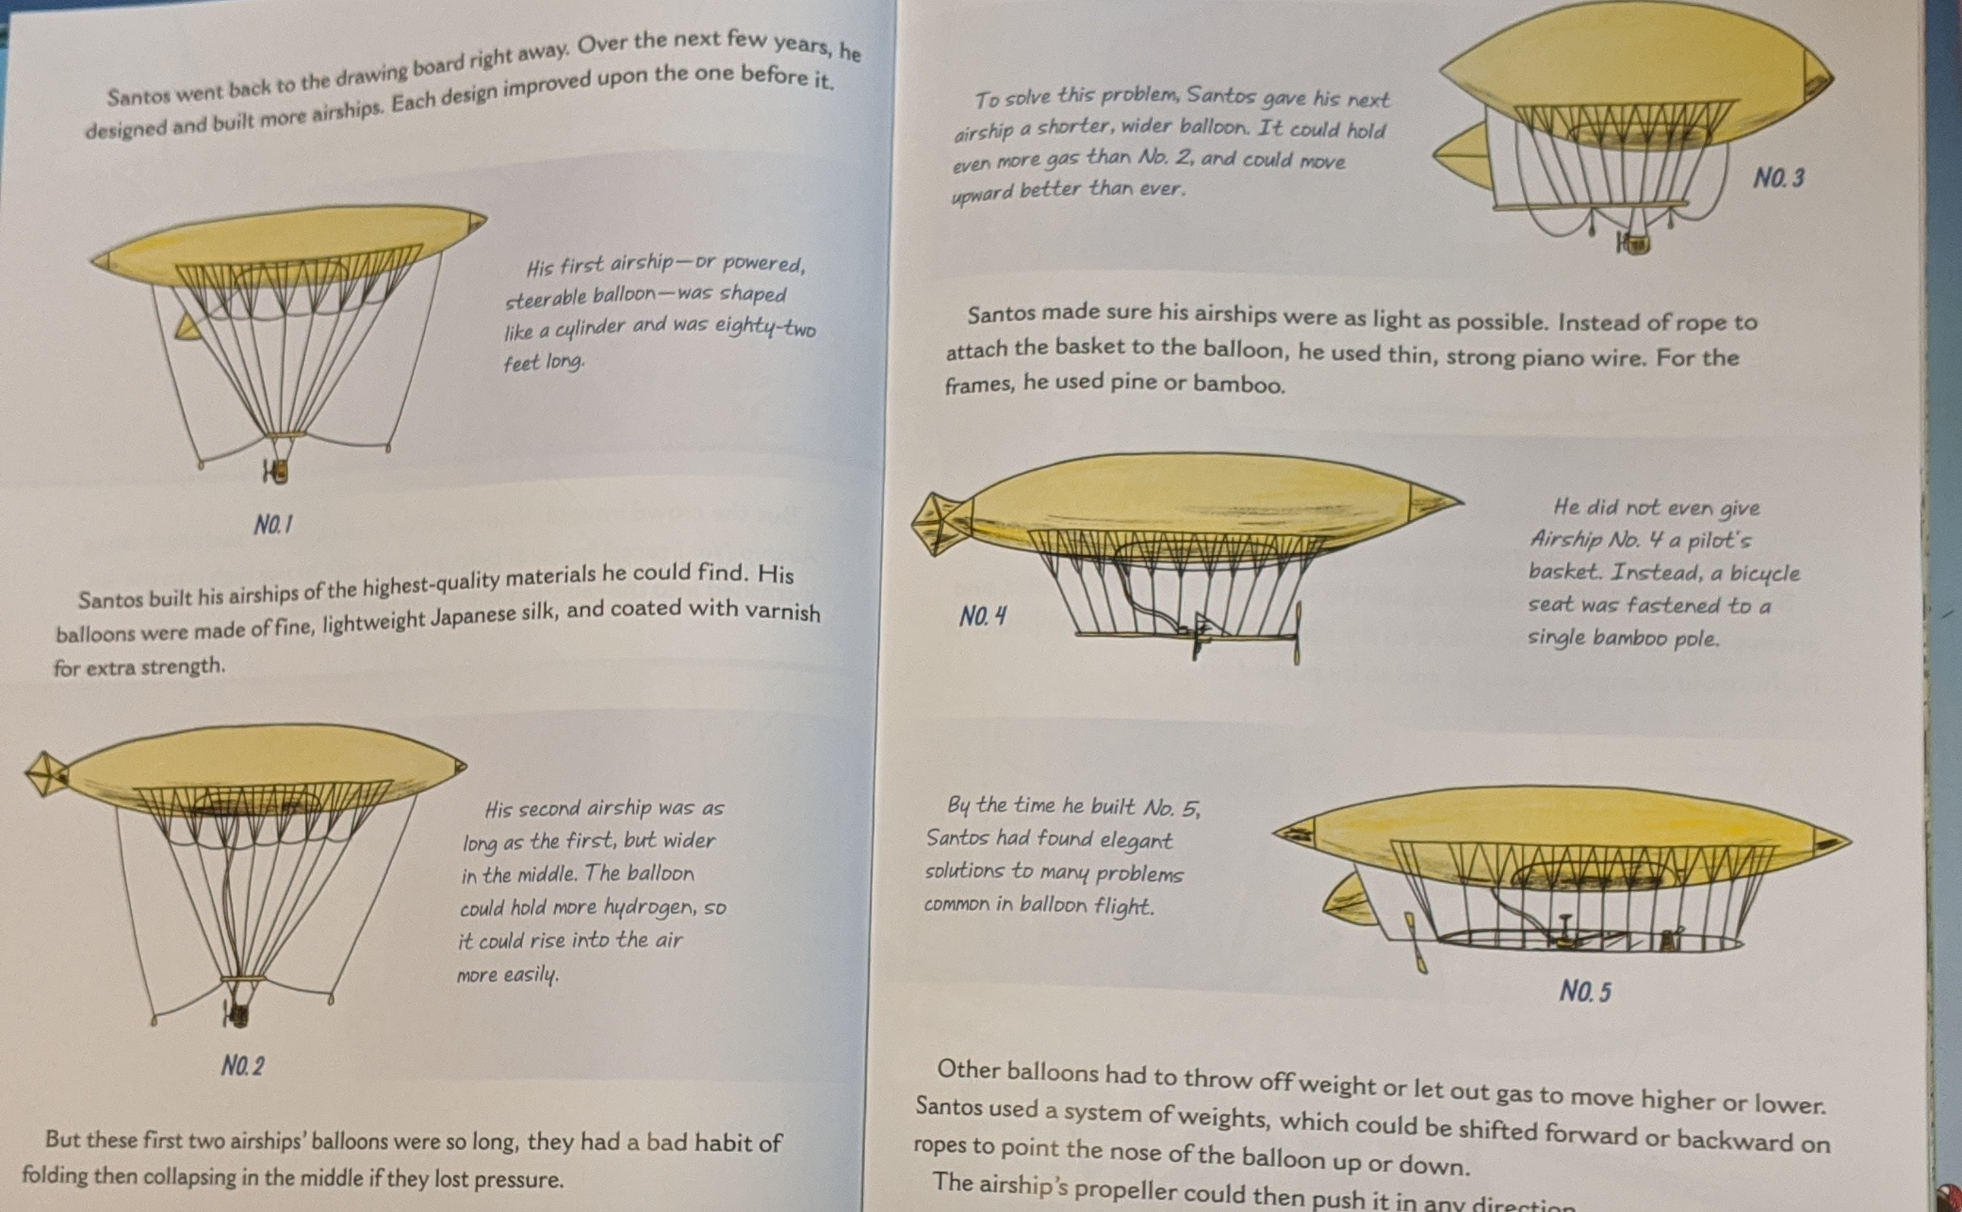
From A Dream of Flight, by Rob & Jef Polivka
Notes:
For example, Alberto Santos=Dumont (the main topic of chapter 3 of LIFT) built a series of airships. This layout is from a book titled A Dream of Flight – it’s a kid’s book but I highly recommend it. This layout shows the iterative approach to his experiments. Each of Alberto’s designs fixed a flaw from the previous versions, strengthened a weak point or provided some new function. This is STUDY FAILURE plus DO EXPERIMENTS
The first few tended to crumple and crash quickly. Eventually he came up with a design that won some major prizes and even built a small personal airship he’d use to travel from his apartment to a local café…

Slide 16
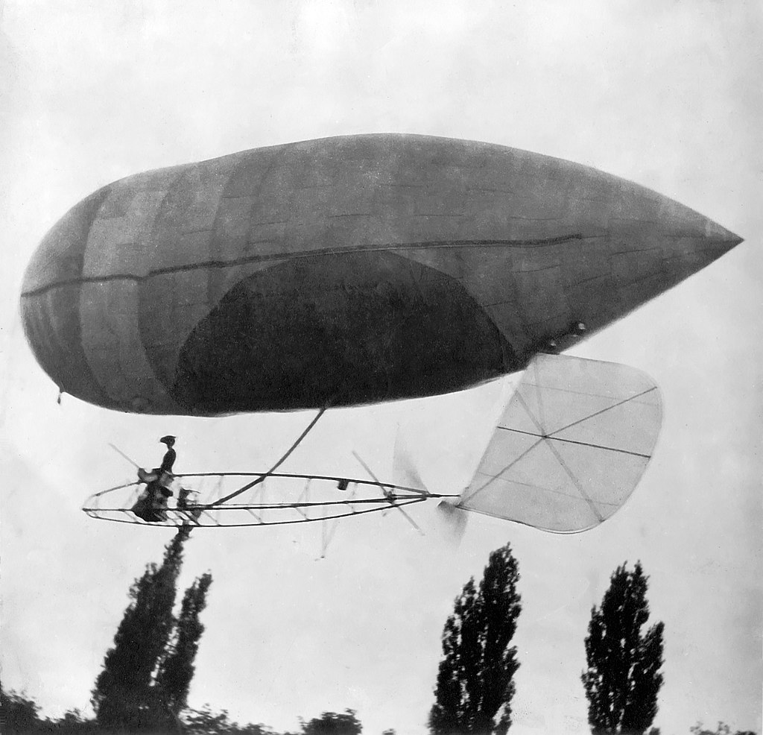
REAL > HYPOTHETICAL

Slide 17
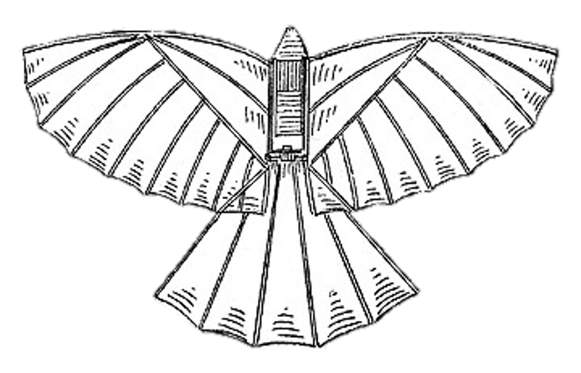
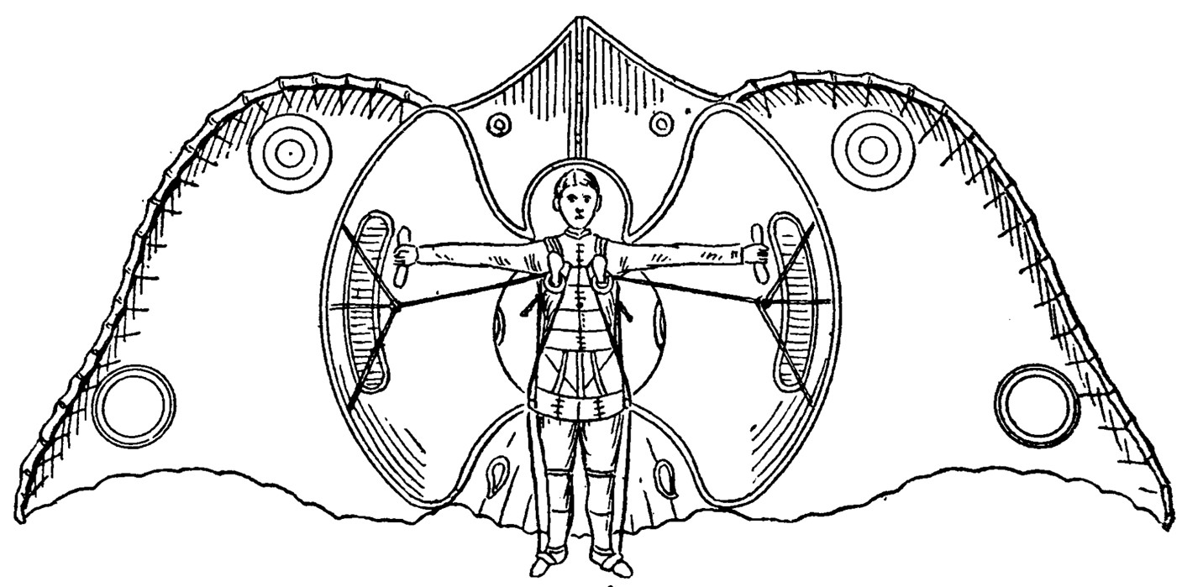
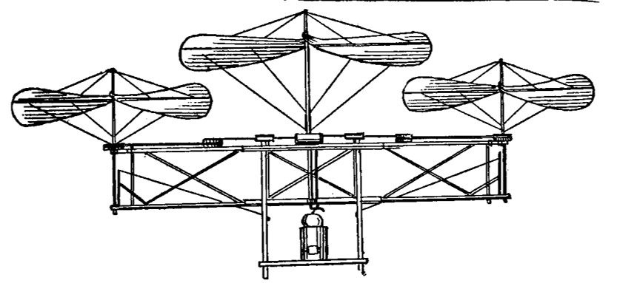
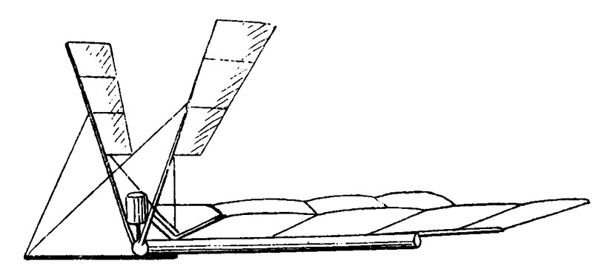
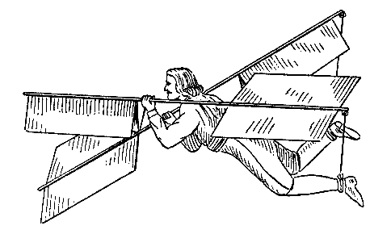
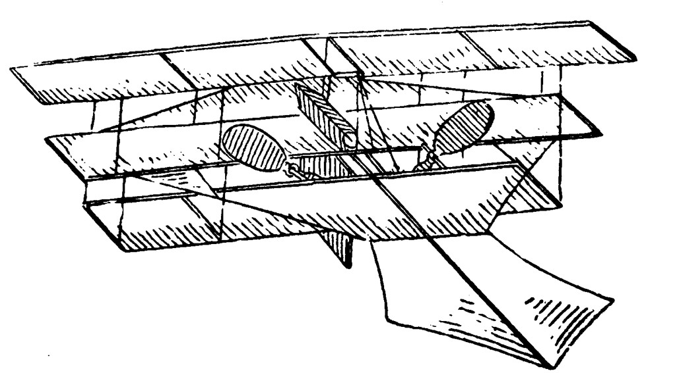
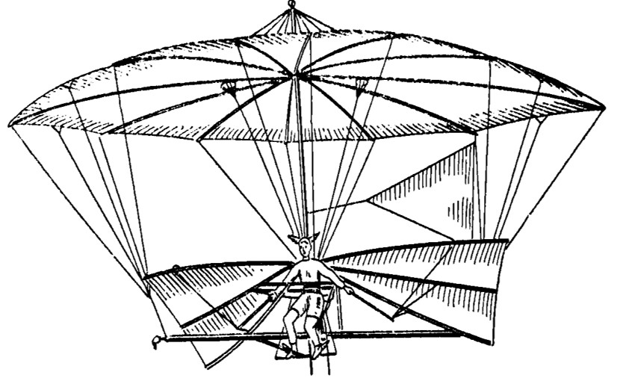
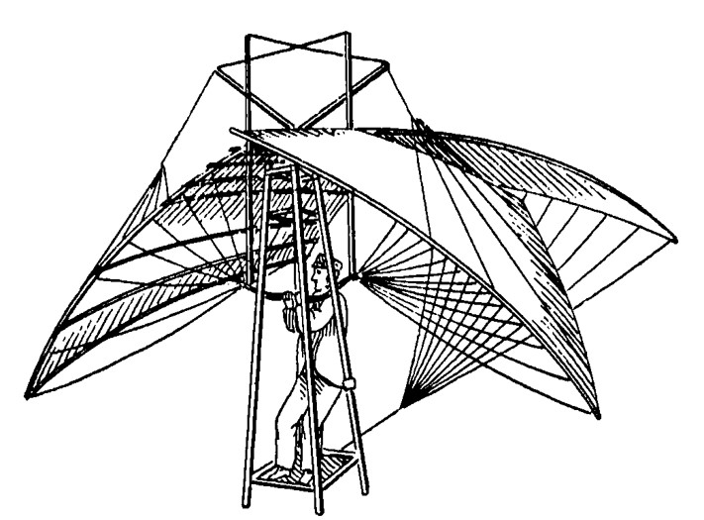
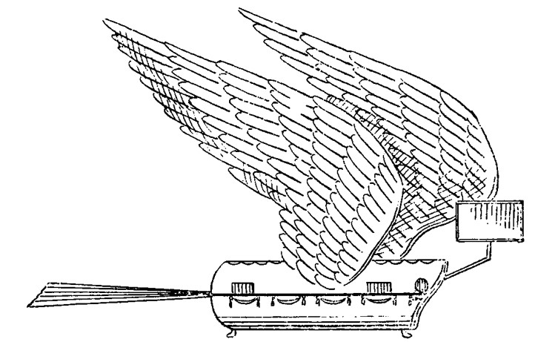
STUDY FAILURE
Notes:
One key activity (a first topic, not necessarily a “first step”) is to study failure – make a list of attempts that didn’t work out (yours & others!), and evaluate for patterns, partial progress, etc.
Do the analysis to see if you can distinguish between promising paths and dead-ends. Are some getting closer & making progress, while others are bad ideas we can abandon?
Nothing on your list? Write “Failed to fail” and then go try something that produces a result!

Slide 18
“Failure is never the whole story, nor the end of the story.”
Notes:
Based on extensive study of failure, one key observation we’ve made is that it’s almost never the whole story or the end of the story. It’s a PART of the story

Slide 19
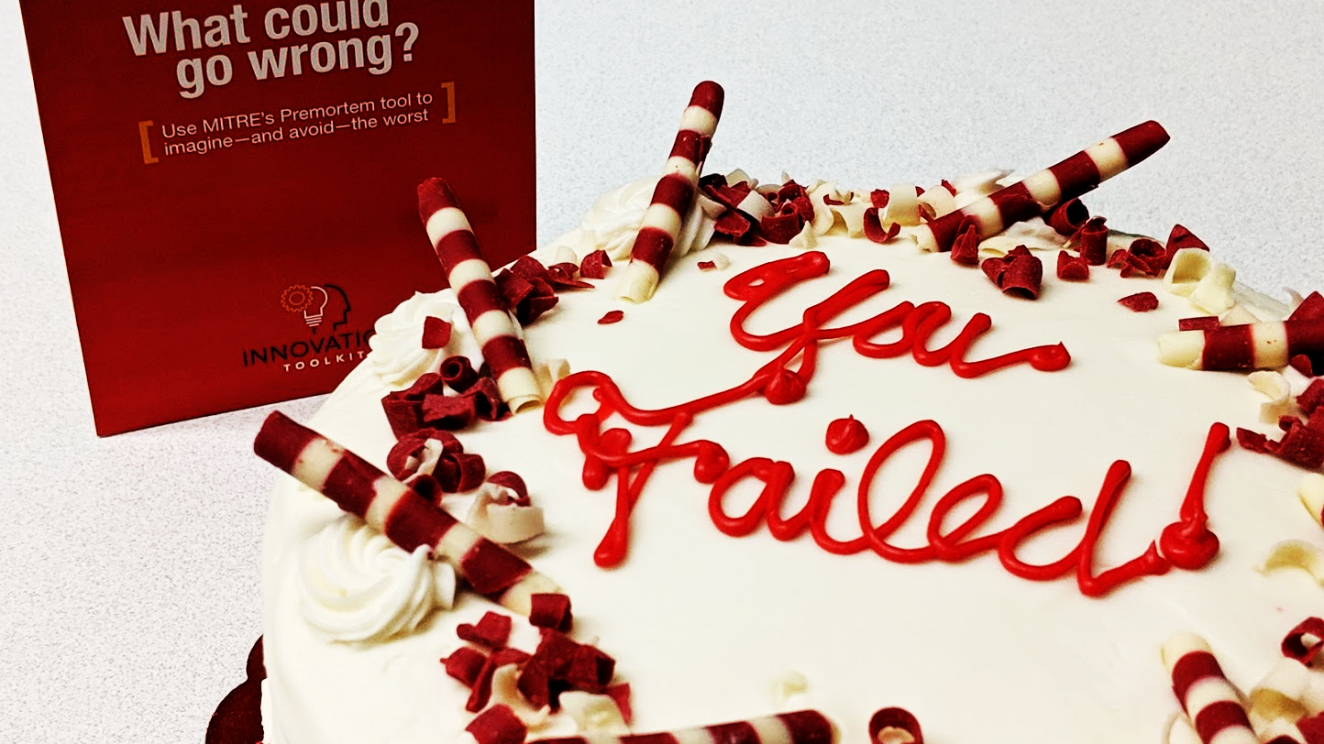
Notes:
One specific method for studying failure is to have a Failure Cake. Gather the team, slice the cake, and discuss the experience.
In part we’re aiming to destigmatize failure. Sharing a cake together sort of takes some of the sting out… and it’s a specific thing you can all do with your teams too.
Also, in order to learn something new, we have to be willing to be bad at it at first. Cake can help foster that willingness to be bad at something…
How do you think your team would respond to a failure cake party?

Slide 20
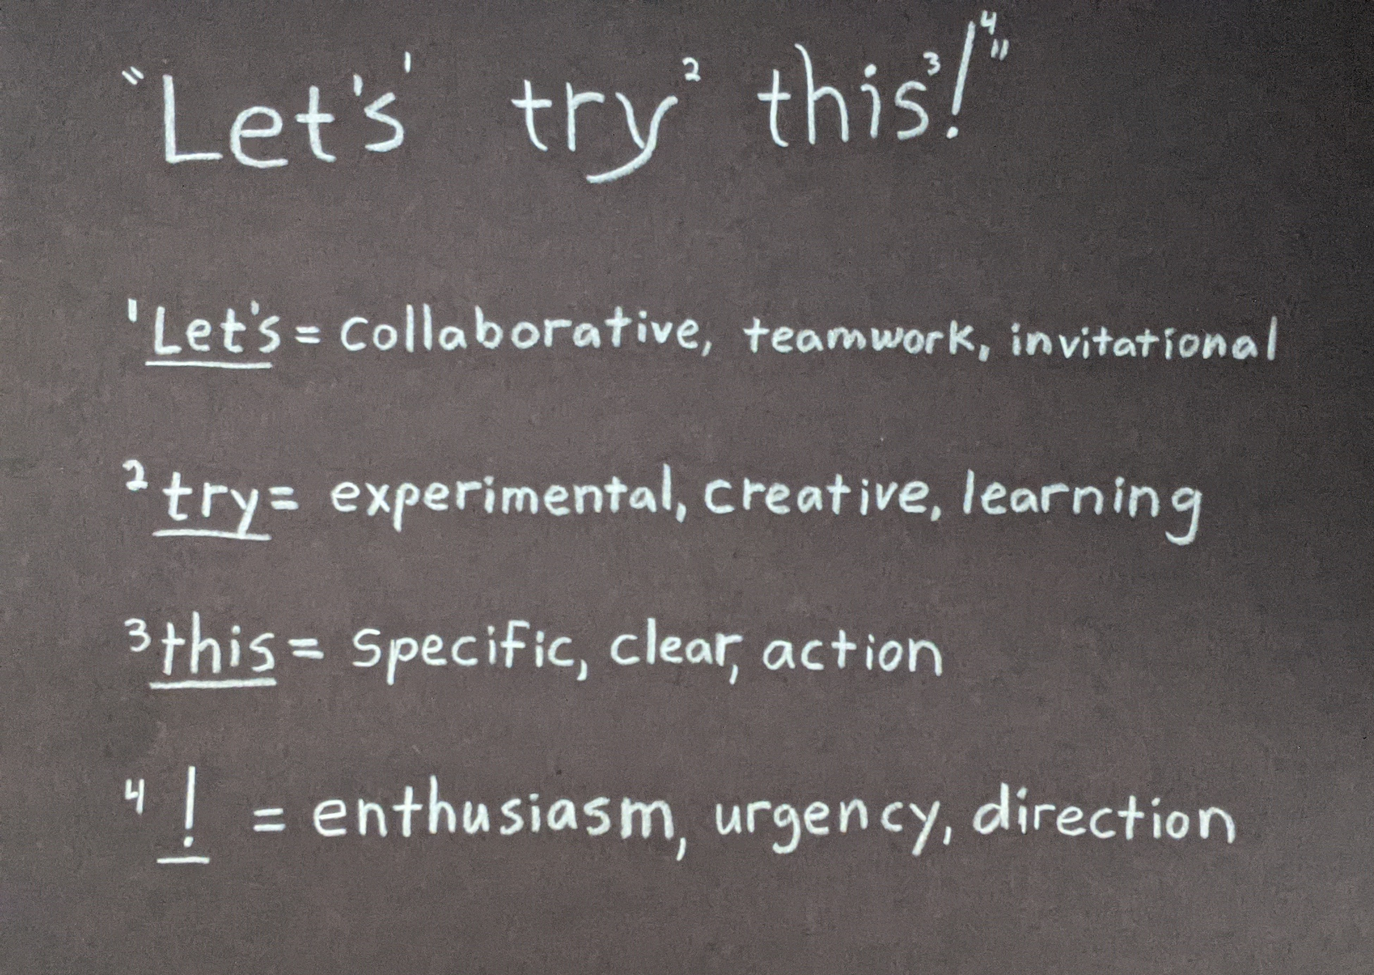
Notes:
These three words are pretty much a magic formula for making things happen. But they’re harder to say than you might think.
LET’S – Implies you have some people in mind to join in on the experiment, and it takes some work to FIND these people.
TRY – Reflects a level of boldness & courage to attempt something where the outcome may be unpredictable
THIS – Requires a thoughtful, specific description of the thing you are proposing – again, this takes some work!
Consider the Let’s Try This framework as the basis for a proposal – who is included in LET’s? What would constitute a TRY (vs a DO – turns out Yoda was wrong!)? What is your THIS? And how can you bring the “!”?

Slide 21

FUNDING
STREAMS
Notes:
The main thing that distinguishes intrapreneurs from hobbyists is funding.
The GEANT hot air balloon was intended to raise funds to support aviation experiments. But it was huge & expensive & basically bankrupted the people who built it. So don’t put all your hopes & dreams into single basket or a single funding source. Find a collection of customers, supporters, sponsors, etc…
Where might you start? Make a list of 10 potential funding sources…

Slide 22
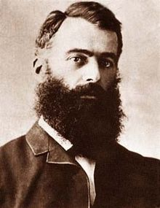


SHARE WHAT YOU KNOW
Notes:
Creative approaches to IP management
LIFT: Hargrave published nothing & shared all his data…
ITK: Used CC BY/NC/SA license
Homework: Get smart on CC’s

Slide 23
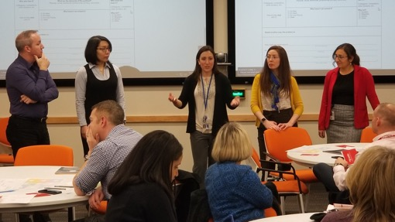
Intrapreneuring At MITRE
Notes:
MITRE EXAMPLE: In 2016, a small group launched MITRE’s Innovation Toolkit project.
We were a self-selected group with a crazy little idea – what if MITRE had an innovation toolkit, a collection of methods & techniques that we could all use to help solve hard problems.
Initial idea: let’s adopt someone else’s toolkit! Didn’t find any that were a good fit, so we moved on to Plan B – make our own.
And yes, early on we discussed our plans to take over the world, so we were aiming high… but we were also doing the small, incremental work that’s necessary to get us there.

Slide 24
TELL YOUR STORY
“Innovating
Out Loud”
(but not TOO loud)
Notes:
Have to navigate the tension inherent in this dynamic – out loud / not too loud.
What should you say, when, to whom?

Slide 25
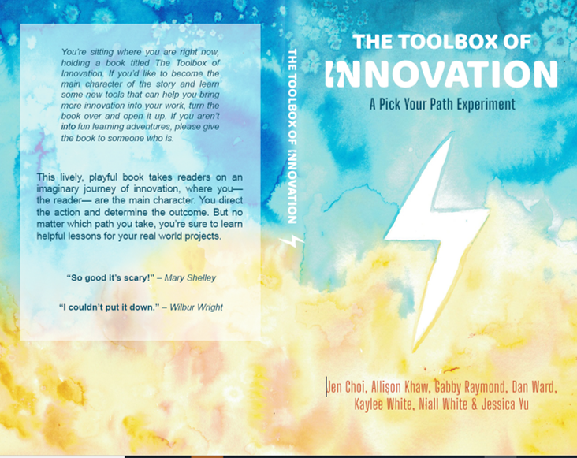
Notes:
Team Toolkit wrote a book. Didn’t ask permission, nobody told us to do it, we just said “Hey, this could be fun, let’s see if we can do it…”
This is DECLARE INTENT, EXPERIMENT, COLLABORATE, BUILD TEAM, TELL STORY
And we’ve sold almost 600 copies… It’s never going to be on a Best Seller list, but that’s almost 600 people we’ve been able to directly touch…

Slide 26
Team Toolkit’s Approach
Rapid series of little experiments
Eat Your Own Dogfood Drink Your Own Champagne
Constant collaborative reflection
Building products & services for internal customers
Fee for service
MITRE “investors” ($25K - $300K)
Offer to external customers
Notes:
We ran a quick series of little experiments ON OURSELVES… Constantly trying, testing, exploring, experimenting IN THE REAL WORLD / on real projects
Adopted a “drink our own champagne” philosophy – using this stuff on OUR projects.
We constantly reflected on & discussed & analyzed our experiences – what could we do differently next time?
We tested out a variety of products & services, got some initial investors, eventually got $300K from Jason… then nothing from Jason and instead reached out to the Innovation Center directors…

Slide 27
PERSIST?
The Entrepreneur’s
Eternal Question:
PIVOT?
PERISH?
Notes:
We continued to ask which of these three actions we should take – the classic 3 P’s from the Lean Startup.
Write this down & post it on your wall.

Slide 28
Questions To Help You Get Started
What product / service might you provide?
Who will want that product / service?
What demand signals are you detecting?
How are you incorrectly interpreting those demand signals?
What is the smallest / fastest version you can produce?
How can you start delivering now?
Who will work with you?
How little can you run on (vs How much do you need?)
Who is already doing this kind of thing?

Slide 29













START
Find A Problem
You’re Interested In
Declare
Intent
Deconstruct
The Problem
Do the reading
Real Beats
Hypothetical
Build Your
Team
Do Experiments
Study Failure
Share What
You Know
Multiple
Funding Streams
Tell Your
Story

