Slide 1
Innovation Dynamics
©2024 The MITRE Corporation. ALL RIGHTS RESERVED Approved for public release. Distribution unlimited 24-02352-5
This work is licensed under CC BY-SA 4.0.

Slide 2
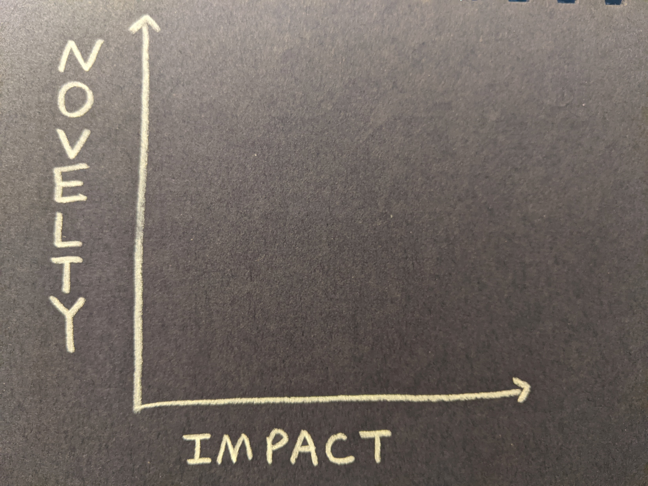
Notes:
The ITK team defines innovation as “novelty with impact.”
We’ve been using that definition for a couple years, and then it occurred to us that we could graph it out like this. When we did, we discovered some interesting stuff.

Slide 3
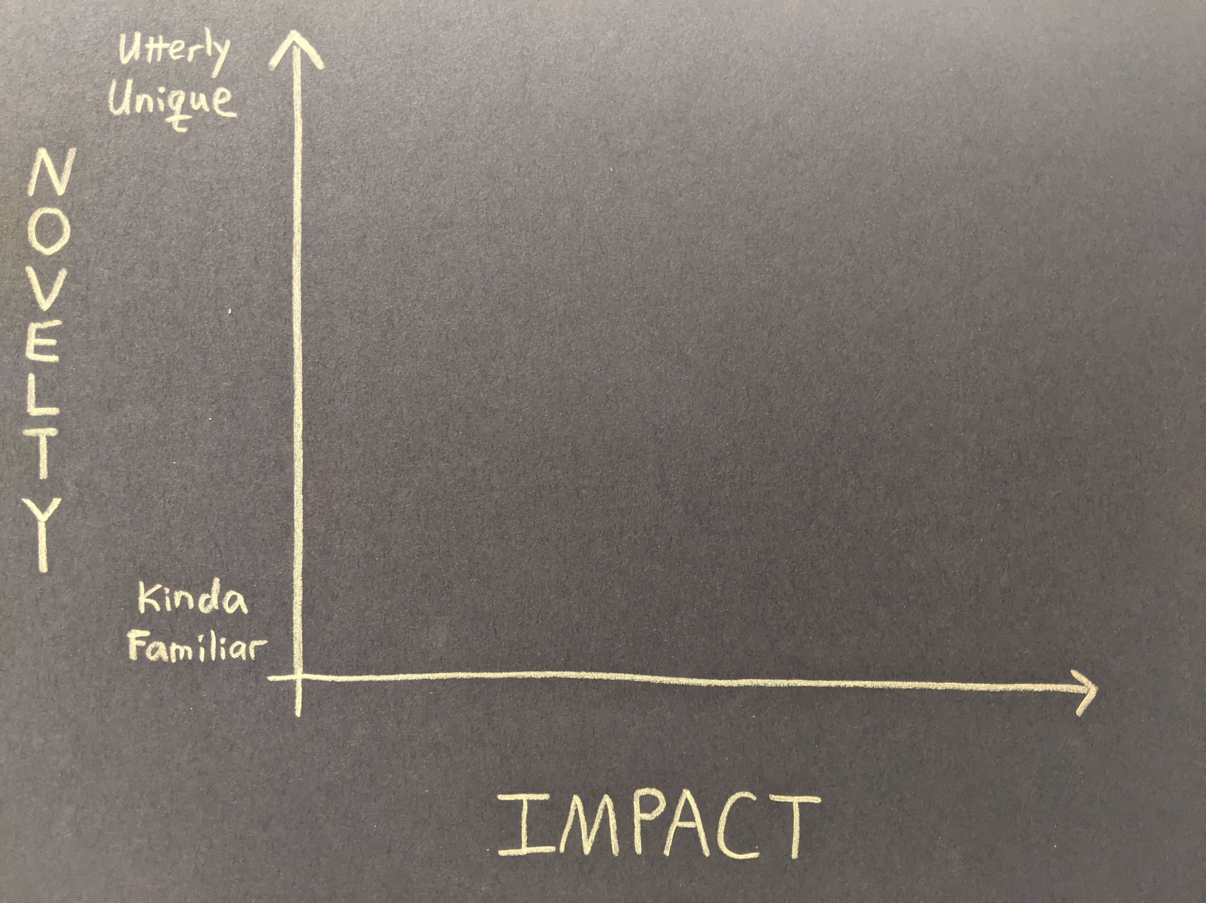
Notes:
For example, it immediately became clear that both novelty and impact exist along a spectrum. The spectrum of novelty ranges from low-end stuff that is “kinda familiar” to high end stuff that is “utterly unique”
Of course, context matters. Stuff that you find familiar may sound strange to me, and things that are common in one domain might be unheard of in another area. The point is just that there’s a spectrum of novelty, from low to high.

Slide 4
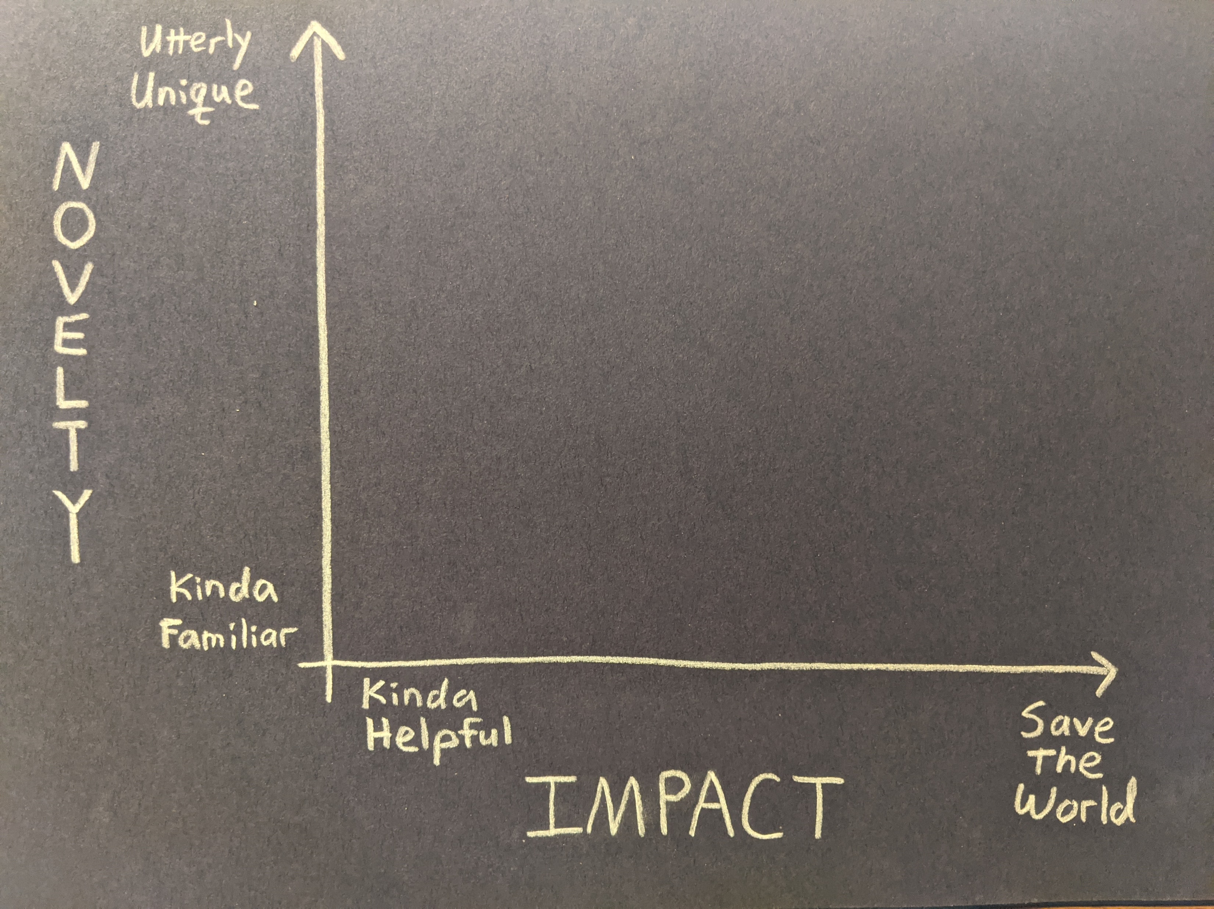
Notes:
Impact has a similar spectrum, ranging from stuff that’s kinda helpful to stuff that absolutely saves the world.
And just like with Novelty, when it comes to impact a thing that’s just kinda helpful to one person might save another person’s life. Different people at different times and in different situations might find different things have different levels of impact.
Questions?

Slide 5
MINOR
Notes:
In the lower left corner we find things that are kinda familiar and kinda helpful…
These might be efficiency innovation or a sustaining innovation (to use Clayton Christensen’s terms). There’s nothing wrong with Minor innovations, if we do enough of them they could really add up, and this is 100% a legitimate type of innovation. Mildly novel and mildly impactful… but still innovative.

Slide 6
MAJOR
Notes:
And in the upper right we find Major innovations, which are utterly unique and save the world. In an absolute sense, these are pretty rare, but they do occur.
But I think these two quadrants are NOT the most interesting areas of this diagram.

Slide 7
EARLY
Notes:
Instead, things really start to get interesting in the other two quadrants – the upper left and lower right.
Early innovations often pop up in the upper left area. These are new and unfamiliar, often operating on a small scale.
The impact on an individual user or customer might be huge, the impact on the world tends to be relatively low.

Slide 8
iPod
Oct 2001
Notes:
For example, when the iPod came out in 2001, nobody had seen anything quite like it. Its novelty was off the charts. And for people who got one for Christmas that year, it totally changed the game on how they bought and listened to music.
But… they only sold 125,000 of them in that first quarter. Similarly, the impact on Apple’s bottom line was fairly low at first and the impact the overall market for the first year or two was fairly limited… because not a lot of people had one. Not a lot of people knew anyone who had one. Did any of you have an iPod in Oct 2001?

Slide 9
MATURE
Notes:
Over time, as an innovation matures, it often slides into the lower right corner of our graph. The dynamic here is that familiarity decreases novelty – as more people hear about it, as more people use or own the thing, it becomes less novel – by definition. AND… as more people use it and benefit from it, the impact goes up.
So to follow our iPod example, in 2005 Apple sold about 20M iPods. Now everyone has an iPod. Or at least everyone’s seen an iPod, or knows someone who has one. It’s less novel… but more impactful. As sales continued to rise, not only did Apple make money (impact to the company) the iPod went on to change how music is distributed and musicians get paid (impact beyond the company & its customers), to say nothing of how we manage intellectual property… The iPod basically launched the market for personal music devices (impact to competitors).
The iPod’s impact was enormous over time… well beyond the impact on the individual customer who could now carry 1,000 songs in their pocket… even as its novelty decreased…
And look, if your product is having an impact on people who aren’t even your customers… that’s some big impact.

Slide 10
The
Maturity
Slope
Notes:
But here’s the thing – and here’s what feels so interesting about this – movement along this maturity slope (or popularity slope) can feel like failure to an innovator, and can look like failure to a critic.
People wrote articles about how Apple is losing their magic because the iPod isn’t novel anymore… even while the impact was still growing.
That sort of raises the question of why we do innovation in the first place – do we do it to introduce novelty, or to have an impact? I contend that IMPACT is the point… and so moving in this direction is a sign of success, not failure.
However, it is also a different kind of work. Some people prefer to be in the upper left corner and then to hand things off to someone else who then takes it to the lower right. Nothing wrong with either one, nothing wrong with having a preference. But there is something wrong with claiming that only one of these represents “real” innovation.
So let’s talk about this a little – thoughts & questions?

Slide 11
It’s more
important to
cross this line…
Notes:
Let’s make it clear – it’s more important to cross this line, in the direction of increasing impact

Slide 12
…than it is to cross this one
Notes:
Than it is to cross this line, in the direction of increasing novelty.

Slide 13
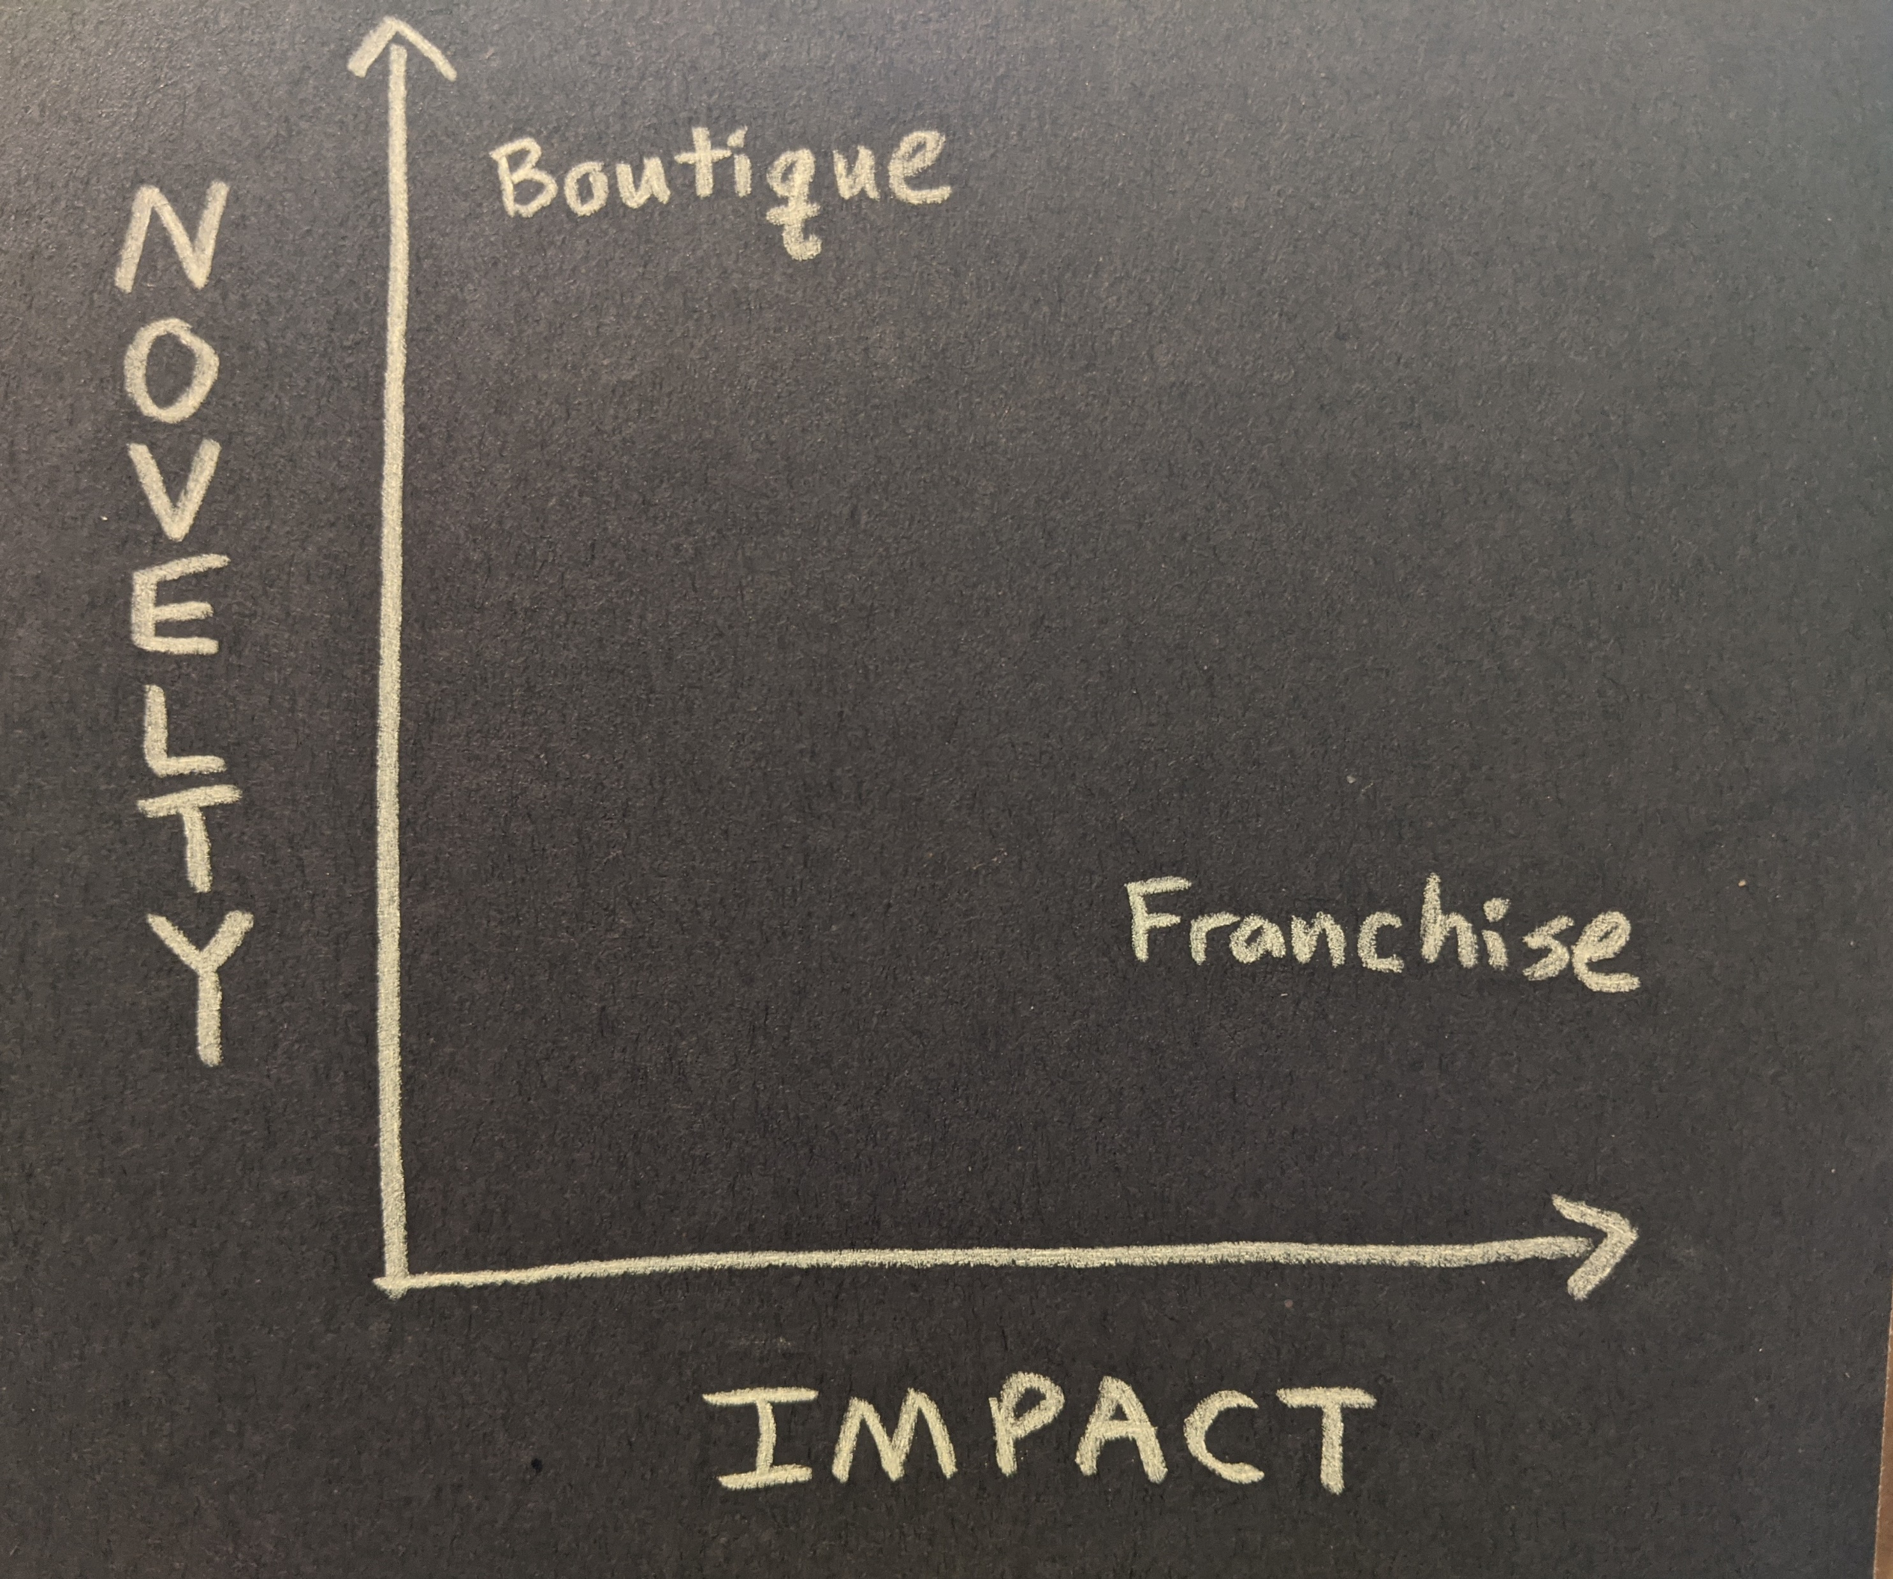
Notes:
These two corners also help shine a light on another dichotomy – the difference between a boutique and a franchise.
Most boutiques tend to live in the upper left corner – they are one-off product or service, at a small scale, that might be highly valued by a small set of customers, but their overall impact to the larger ecosystem is limited.
In contrast, Franchises are in the lower right. Franchises are copies – they are standardized and thus less novel. Walk into a chain store and you know what to expect – it’s familiar. But Franchises have a larger potential impact, because their reach goes farther and they can influence things like supply chains and legislation and markets.
Boutiques are Up Scale, while Franchises are Scaled Up. Both can be innovative… just different kinds of innovation.
And again, some people have a strong appetite for novelty and want to stay in the boutique area. Nothing wrong with that. Others want to get to the scaled-up franchise asap. Again, both have merit… both are legitimate types of innovation… but both require different skills and reflect different priorities. I think it’s helpful to recognize where you want to be and where you don’t want to be.

Slide 14
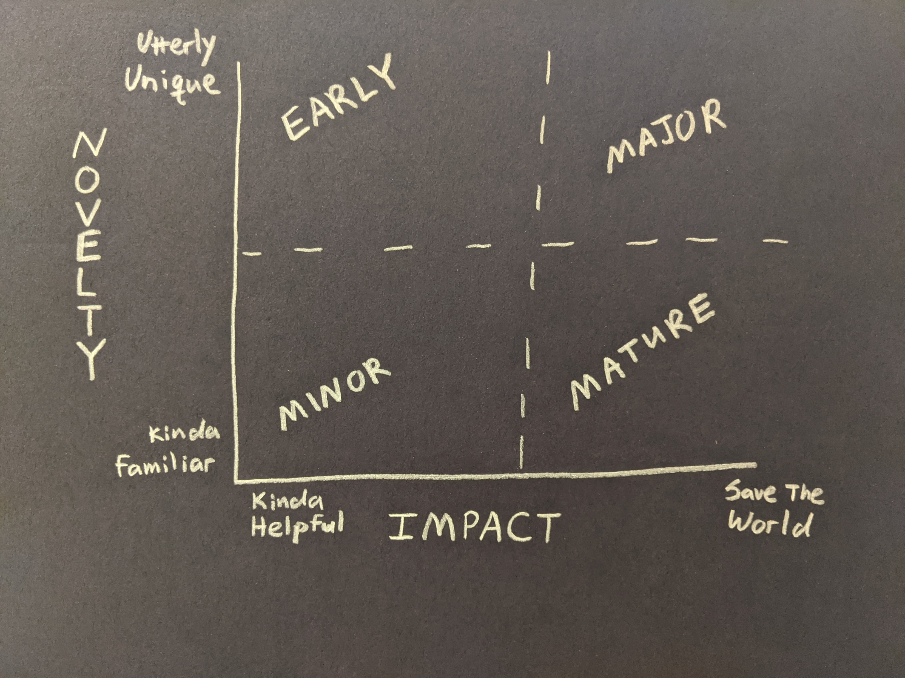
Notes:
So here’s the whole thing all in a single image…
We wanted to share all this with you to help build a common vocabulary that makes it easier for us to talk about things like values and decision-making styles and an organization’s vision & mission & goals. And hopefully this vocabulary also helps each of us better understand our own preferences and priorities – so we can see where we fit and feel most comfortable – as maximizer or satisficers, working boutique or franchise – and to also recognize the preferences and priorities of the people around us… and their contribution to the mission.
So I’d love to open it up for any questions and comments before we take a break and then come back for our next activity

Slide 15
Just Early?
Or
Frivolous?
Celebrate?
Or
Double Check?
Incremental?
Or
Trivial?
Keep Going?
Or
Refresh?
Notes:
Questions to ask in each quadrant

