Slide 1

INNOVATION
TOOLS & PRINCIPLES!
Part 2
A CRASH COURSE IN RAPID INNOVATION
WITH DAN WARD & LYNNE CUPPERNULL
©2024 The MITRE Corporation. ALL RIGHTS RESERVED
Approved for public release. Distribution unlimited 24-02352-3
This work is licensed under CC BY-SA 4.0.
Notes:
Reflect on yesterday – what marinated overnight? What questions did you come up with? Any ahas?
Today we’ll run through a brief intro to the innovation toolkit and give you the chance to use a couple of tools.
We’ll close out with an exercise we think will stretch you (in a good way).

Slide 2
ITK VISION
DEMOCRATIZE INNOVATION
TOOLS TECHNIQUES TRAINING TEAMMATES
Notes:
Lynne
A few words about our vision & mission.
A Vision is an aspirational description of the future. It should be clear, short, and inspiring.
ITK’s vision is to democratize innovation, to help create a world where everyone has access to the 4 T’s (tools, techniques, training, and teammates) that they need in order to be effective innovators.
How have you seen this in action so far in this workshop?

Slide 3
ITK MISSION
Help people understand
what innovation is and
how to do it.
Notes:
Lynne
A Mission statement then is a concrete description of a group’s present activities.
I LOVE that the first two words of ITK’s mission are HELP PEOPLE… that’s where we really focus our work.
The next two parts are WHAT innovation is and HOW to do it.
Lots of different opinions about what innovation means – when we use the word, we mean “novelty with impact”
As for HOW – that’s where the tools come in…
And a brief mention of our history – Team Toolkit started in 2017 as a side-hustle for a couple of us here at MITE’s Bedford location. ITK’s still a side hustle, but for many of us it can take up a significant part of our work week and it’s grown to over 50 people across the company in several loc’ns.

Slide 4
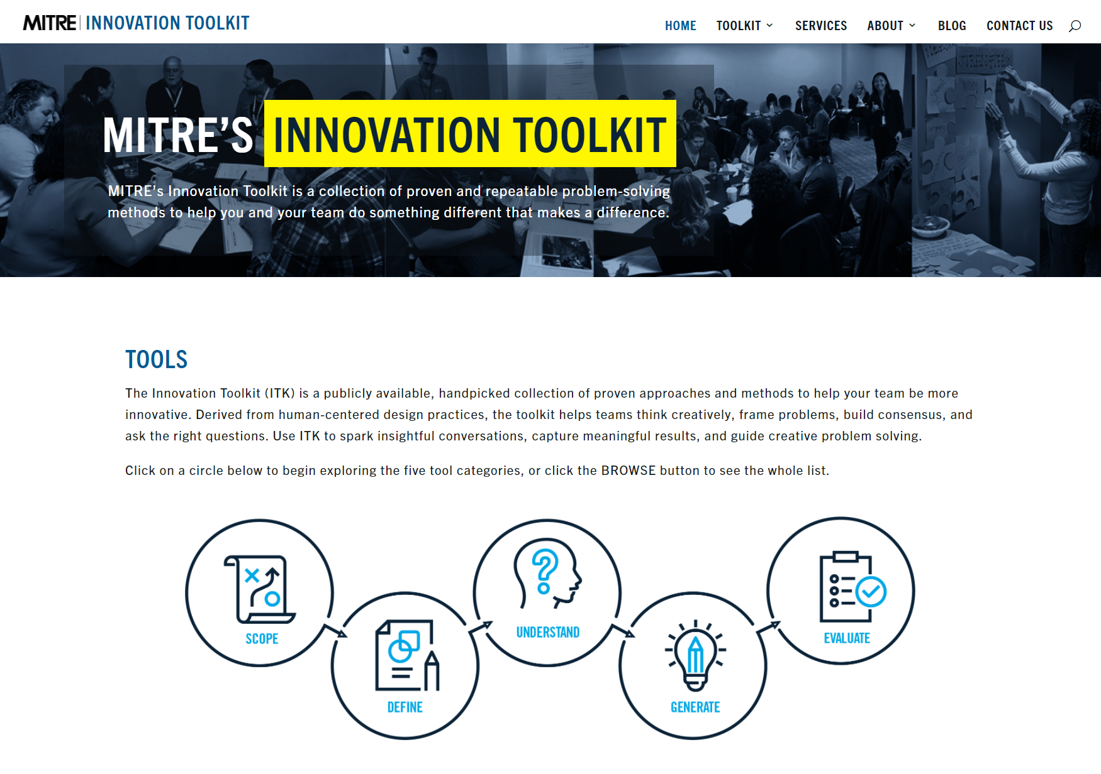
itk.mitre.org
A multi-disciplinary team of MITRE engineers curated the MITRE Innovation Toolkit to help our colleagues, teams and sponsors jump start the innovation process.
Notes:
Lynne
One my favorite things about my job is working with Team Toolkit and helping people use and understand our Innovation Toolkit
This is a set of tools & techniques designed to help teams work together and solve hard problems.
We want to shift the mindset from just jumping into developing solutions to really understanding the problem, the users, and the context to then deliver real value. We curated a collection of methods, tools, and techniques to help individuals go beyond brainstorming to make better decisions faster, unlock your team’s creativity, uncover uncommon results, and take action.
Our website is publicly available so you can share it with others.
FJ: ITK
https://itk.mitre.org/
We want to shift the mindset away from just jumping into solutions and instead towards doing the work to really understanding the problem, the users, and the context of the space they’re working in, so that when we deliver a solution it really does solve something.
These tools are delightfully low-tech and domain agnostic. I have personally used them with the most senior executives at NASA, with generals in the Pentagon, on our own projects, and with high school kids.

Slide 5
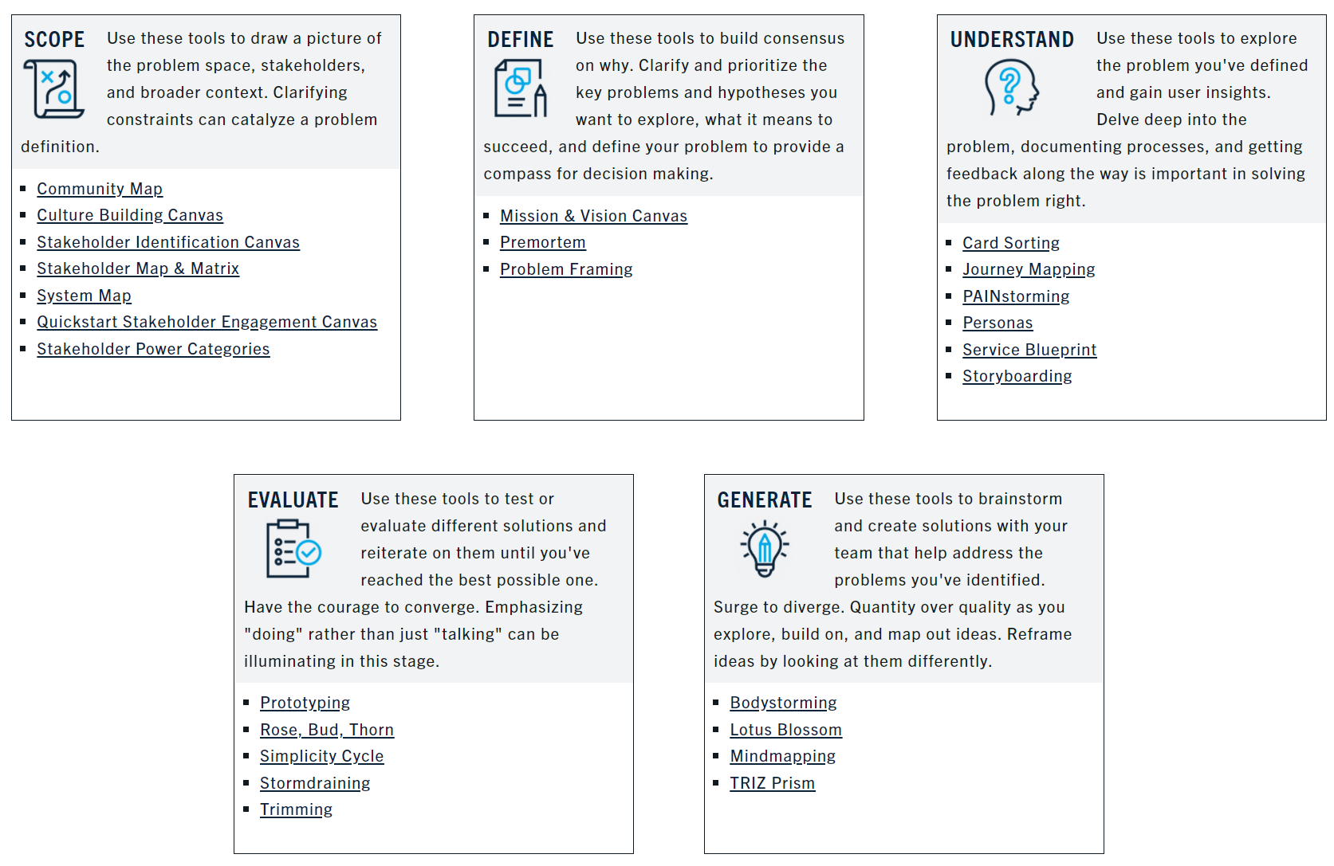
Notes:
Lynne
We put the tools into 6 categories – ideation, strategy, understand users, reduce complexity…

Slide 6
How Do You Pick One?
Notes:
Lynne
OK, so there are two dozen of these… where do you start?
The video on the homepage provides some tips – spoiler alert, start with the Problem Framing tool.
But like any navigation challenge, it helps to have a guide who knows the territory.

Slide 7





MITRE Innovation Toolkit
SCOPE
Community Map
Culture Building Canvas
Stakeholder Identification Canvas
Stakeholder Map & Matrix
System Map
Quickstart Stakeholder Engagement Canvas
Stakeholder Power Categories
DEFINE
Mission & Vision Canvas
Premortem
Problem Framing
Card Sorting
Journey Mapping
PAINstorming
Personas
Service Blueprint
Storyboarding
Value Proposition
UNDERSTAND
EVALUATE
Prototyping
Rose, Bud, Thorn
Simplicity Cycle
Stormdraining
Trimming
GENERATE
Bodystorming
Lotus Blossom
Mindmapping
TRIZ Prism
Notes:
Lynne
I circled a few that are particularly relevant for starting out– but really, I could have circled the whole set (and nearly did!).
But if you’re working on a requirement, then the three in DEFINE are a good place to start.
Any time you think you want to do some brainstorming/idea generation, try LB instead.
The other categories are pretty self explanatory – understand user, develop plan, etc. You probably have a sense of what you’re trying to do. And it’s actually more art than science, you can’t really go wrong. The key is to start somewhere…

Slide 8
MITRE Innovation Toolkit
SCOPE
Community Map
Culture Building Canvas
Stakeholder Identification Canvas
Stakeholder Map & Matrix
System Map
Quickstart Stakeholder Engagement Canvas
Stakeholder Power Categories
DEFINE
Mission & Vision Canvas
Premortem
Problem Framing
UNDERSTAND
Card Sorting
Journey Mapping
PAINstorming
Personas
Service Blueprint
Storyboarding
EVALUATE
Prototyping
Rose, Bud, Thorn
Simplicity Cycle
Stormdraining
Trimming
GENERATE
Bodystorming
Lotus Blossom
Mindmapping
TRIZ Prism
Notes:
Lynne
Today we’re going to try out two of them

Slide 9
 |  |  |  | Topic/ Question
https://itk.mitre.org/toolkit-tools/
lotus-blossom/
Notes:
Dan
Lotus Blossom - Innovation Toolkit (mitre.org)
Focus the power of brainstorming using a structured, visual representation of ideas—pushing you to fill out every box with new ideas.
Use Lotus Blossom when you need to quickly produce a large quantity of ideas or are exploring a range of facets of a problem, solution, or topic.
Help develop many ideas with a focus on quantity. This structured ideation method helps accelerate the process of coming up with ideas, and also makes the next step (sorting, assessing, filtering, etc) faster because the Lotus Blossom is a structured artifact where the ideas are already binned and organized. This tool also helps unlock creativity by encouraging users to go beyond the obvious “first thought” ideas and to instead come up with eight items for each blossom. We find that the 6th, 7th, and 8th idea tend to be the most creative. As a collaboration tool, this helps ensure the entire group is able to contribute and participate, with no judgment or unnecessary barriers.
Eight 3-by-3-inch squares are arranged around a center blossom. The center square of each blossom contains a concept or problem related to the other squares of the blossom.
STEP 1: Enter a problem to be solved, an item to be improved, or a theme to be examined in the center box (Box I in the example).
STEP 2: Brainstorm related components, solutions, or themes and put them in the boxes
immediately surrounding the center box (Boxes A-H).
STEP 3: Use the values from those boxes as the center of the eight lotus blossoms on the outer edges of the sheet. (You’re propagating ideas.)
STEP 4: Brainstorm related components, solutions, or themes, and enter these in the eight boxes surrounding each of the new center seeds for each outer lotus blossom. Try your best to complete all the blossoms to maximize ideas.
STEP 5: When the exercise is complete, you will have at least 64 new ideas to explore related to the original problem or theme.

Slide 10
 |  |  |  | Topic/ Question
Notes:
Focus the power of brainstorming using a structured, visual representation of ideas—pushing you to fill out every box with new ideas.
Use Lotus Blossom when you need to quickly produce a large quantity of ideas or are exploring a range of facets of a problem, solution, or topic.
Help develop many ideas with a focus on quantity. This structured ideation method helps accelerate the process of coming up with ideas, and also makes the next step (sorting, assessing, filtering, etc) faster because the Lotus Blossom is a structured artifact where the ideas are already binned and organized. This tool also helps unlock creativity by encouraging users to go beyond the obvious “first thought” ideas and to instead come up with eight items for each blossom. We find that the 6th, 7th, and 8th idea tend to be the most creative. As a collaboration tool, this helps ensure the entire group is able to contribute and participate, with no judgment or unnecessary barriers.
Eight 3-by-3-inch squares are arranged around a center blossom. The center square of each blossom contains a concept or problem related to the other squares of the blossom.
STEP 1: Enter a problem to be solved, an item to be improved, or a theme to be examined in the center box (Box I in the example).
STEP 2: Brainstorm related components, solutions, or themes and put them in the boxes
immediately surrounding the center box (Boxes A-H).
STEP 3: Use the values from those boxes as the center of the eight lotus blossoms on the outer edges of the sheet. (You’re propagating ideas.)
STEP 4: Brainstorm related components, solutions, or themes, and enter these in the eight boxes surrounding each of the new center seeds for each outer lotus blossom. Try your best to complete all the blossoms to maximize ideas.
STEP 5: When the exercise is complete, you will have at least 64 new ideas to explore related to the original problem or theme.

Slide 11
 |  |  | idea A | idea B | idea C
 |  |  | idea D | Topic/ Question | idea E
 |  |  | idea F | idea G | Idea H
Notes:
Ideas A – H can reflect various facets or aspects of the topic you’re exploring or the question you’re aiming to answer.

Slide 12
Idea A-1 | Idea A-2 | Idea A-3
Idea A-4 | A | Idea A-5 |  | B |  |  | C
Idea A-6 | Idea A-7 | Idea A-8
 |  |  | idea A | idea B | idea C
 | D |  | idea D | Topic/ Question | idea E |  | D
 |  |  | idea F | idea G | Idea H
 | F |  |  | G |  |  | H
Notes:
One potential twist – you may occasionally find an idea in one of these blossoms that you want to expand on further…

Slide 13
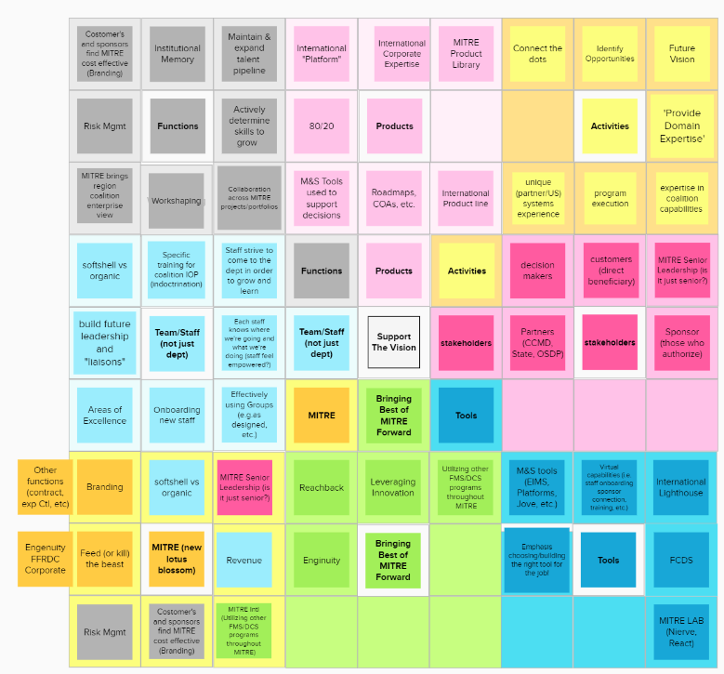
Notes:
When you’re finished, it might end up looking something like this… and you don’t need to read any of these words, just see that we’ve come up with a lot of ideas, they’re binned & categorized & organized.
In particular, notice the lower left corner – that blossom has lots of different colors in it, because we had ideas start in one blossomg (blue, green, grey, etc) and then moved them down to their own blossom

Slide 14
Exercise – Lotus Blossom Practice!
Let’s brainstorm a couple of topics!
Break into two groups

Slide 15

Problem Framing 101
Get clarity and consensus about the problem to be solved
Notes:
Lynne

Slide 16


“If you can’t define the problem…
you shouldn’t design the solution.”
- Sarah Doody
Notes:
Lynne
If we skip this first step (defining the problem), we may end up building something that does NOT solve the problem, or solves the wrong problem…
And we’re likely to have a difficult time coordinating our efforts within the team.
Can you think of a time when you have done or seen this done? What is the outcome?

Slide 17
Add text here…
Add text here…
https://itk.mitre.org/toolkit-tools/
problem-framing/
Add text here…
Notes:
Dan
Problem Framing - Innovation Toolkit (mitre.org)

Slide 18
Notes:
Dan

Slide 19
Notes:
Dan

Slide 20
Notes:
Dan

Slide 21
Notes:
Dan

Slide 22
Notes:
Dan

Slide 23
Exercise: Problem Framing Practice!
Think of a current situation where you have a problem that needs defining
Using the canvas on the table, answer as many questions as you can (try not to overthink!)
Go back to your novelty with impact card for inspiration!
Notes:
Lynne

Slide 24
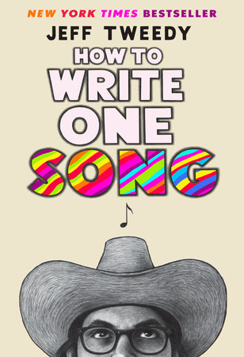
THE
SONGWRITING
EXERCISE
Notes:
Lynne
You may be wondering why we’re going to spend the next hour doing an exercise in songwriting…
Show of hands: Has anyone ever written a song before?

Slide 25
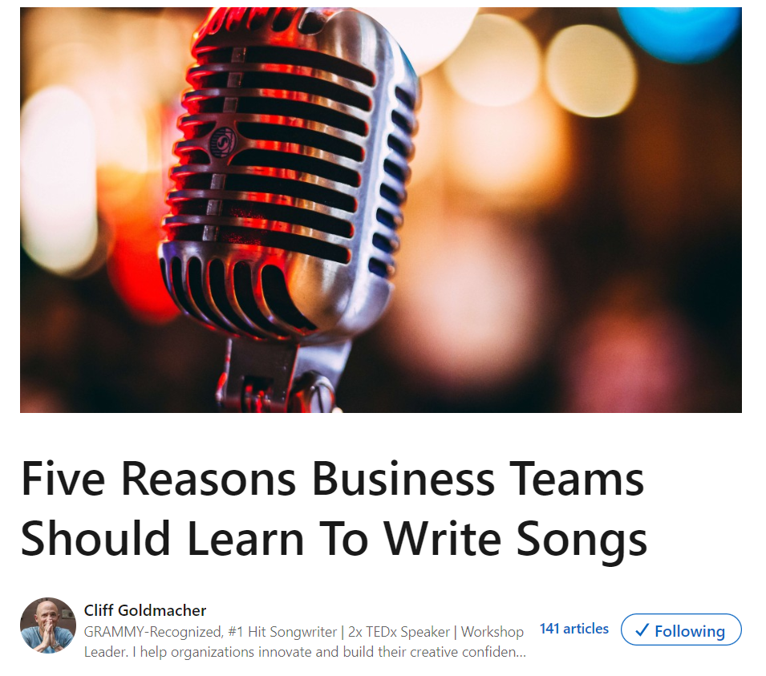

Five Reasons To Write Songs by Cliff Goldmacher
Makes you think differently
Take you out of your comfort zone
Shows you can do the “impossible”
Improves your ability to communicate
Brings teams together
https://www.linkedin.com/pulse/five-reasons-business-teams-should-learn-write-songs-cliff-goldmacher/
Notes:
Lynne
Cliff Goldmacher is a musician and consultant, he wrote an article about why business teams should learn to write songs.
From a MITRE perspective, do you think it’s helpful or important to do these five things?
Learning to write songs makes you think differently
I’ll begin by saying I’m a big fan of the Abraham Maslow quote, “if the only tool you have is a hammer, then every problem looks like a nail.” Consider exploring your ideas and objectives through the lens of songwriting as a new “tool” in your problem-solving toolkit. By examining ideas through metaphor and the emotion-rich language of lyrics, you’re opening up a new way of approaching old or persistent work challenges which will lead to novel and innovative solutions.
2. Learning to write songs takes you out of your comfort zone
As human beings we naturally lean towards preserving the status quo. It’s comfortable and gives us the illusion of control. The reality, however, is that the “safety” of the status quo is anything but safe. We may not want to change but the world will change around us no matter what we want. Leaving your comfort zone in pursuit of a new way to solve problems and examine ideas is a good reminder that the real rewards and solutions exist in leaving the tried and true behind. On top of that, songwriting as a high challenge, high skill and clear objective practice helps business teams achieve a flow state which is, in and of itself, highly satisfying and profoundly motivating.
3. Writing a song shows you that you can do something “impossible”
For most people, the idea of writing a song can seem more like a magic trick or an impossible dream. But my favorite part of what I do with business teams is that I take smart people who don’t consider themselves to be creative and I give them the tools to explore and enhance their creativity. By breaking down the process of songwriting into its component parts, I show the team that songwriting is a craft that can be learned. When a team “does the impossible” and writes a song, there’s a tangible boost of confidence that carries forward and helps the team tackle other seemingly “impossible” issues.
4. Learning to write songs improves your ability to communicate
The beauty of the lyric writing is how it requires us to communicate only the most critical parts of our ideas and say them in a way that is both clear and memorable. While the verses of songs improve our ability to use image-rich language in the service of telling a story, it’s the chorus that teaches us the skill of distilling a message so that it not only makes a clear point but also does it in a way that people will want to hear. If communication is a muscle, then writing song lyrics is a serious workout.
5. Writing songs brings teams together around a common cause
There’s nothing quite like a challenge with a clear goal to bring a team together. Above and beyond exploring ideas and objectives, learning to write songs bonds teams around learning a new way to express themselves. The finished song (and every team I’ve ever worked with finishes their song) serves as tangible - and singable - proof that the team has rallied and done something they weren’t sure that they could do. It’s like a shot of jet fuel for team bonding.

Slide 26
Five Six MORE Reasons To Write Songs by Cliff Goldmacher
Demonstrates that we are all creative
Methodically access our creativity
Helps get over a generalized fear of failure
A shortcut to the emotional crux of any issue
Takes us back to a beginner’s mindset
BONUS REASON: It’s Fun!!
https://www.linkedin.com/pulse/five-more-reasons-business-teams-should-learn-write-songs-goldmacher/
Notes:
Lynne
He wrote a second article that had five – or six – more reasons.
How about this list? Anything here seem valuable or important for your work at MITRE? What stands out?
Beginner’s mindset…that experimentation that we bring to things we are just starting.
Conclusion
It is highly likely that becoming a songwriter isn’t the reason you joined MITRE.
Regardless, using songwriting as a new way to explore ideas and improve your team’s creativity and communication will make you and your team better equipped to handle the challenges you face on a daily basis.

Slide 27
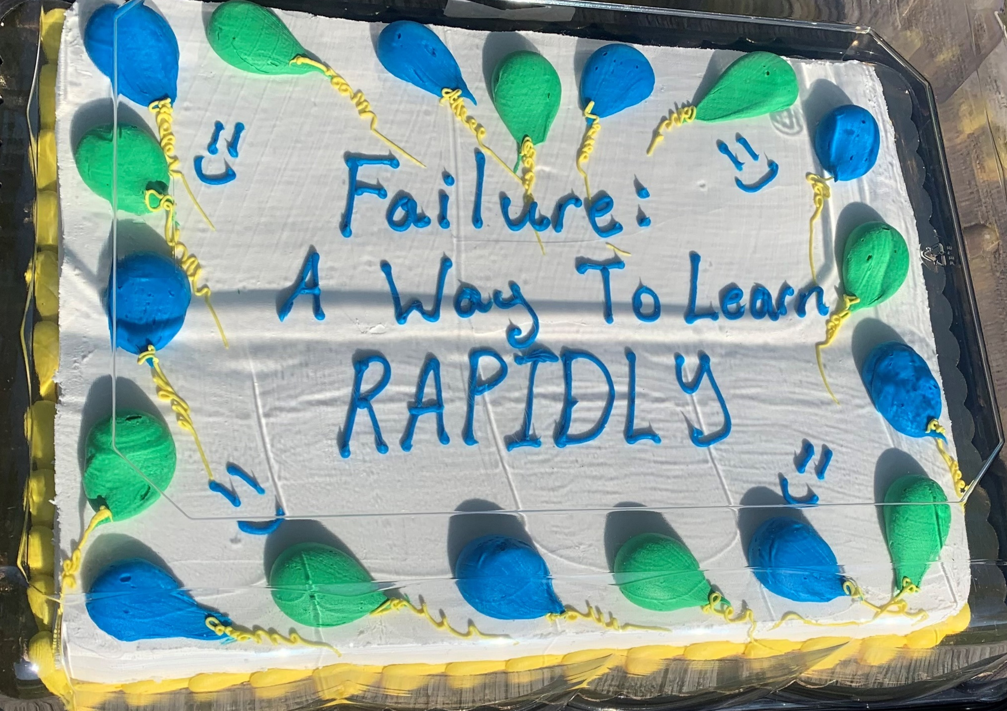
Here’s A Cake
You did your best
You took your shot
You gave it everything you’ve got
But sometimes things
Just don’t turn out
We hoped for rain
Then got a drought
So here’s a cake
I made for you
Have some cake
I’ll have some too
We’ll share this cake
With everyone
And turn our failures
Into fun
Forget the rain
Enjoy the sun
We made our plans
We dreamed real big
We took that shovel
And started to dig
But there’s no gold
Down in that mine
And everything
Didn’t turn out fine
Here’s a song Dan wrote…
Notes:
Lynne/Dan
And just to put our money where our mouth is, here’s a song Dan wrote about ITK’s failure cake practice… and then Niall White put some music to it and ended up performing it at a conference at the Kennedy Center last fall.
To be clear, this was not my first draft… what I wrote was different from what Niall sang at Poptech
But the point is it’s not all fun and games, except it is!

Slide 28
We’re ONLY going to do the HARDEST part…
Notes:
Lynne
OK, hopefully you’re convinced that there’s a good reason to write songs, and that even at MITRE it’s something we can and should do.
Good news / bad news – Today, we’re only going to do the hardest part of writing songs.
Well, YOU are going to do the hardest part, and we’ll help…
Anyone want to guess what that is?

Slide 29

Notes:
OK, all due respect to Tom Petty, but the hardest part is actually… getting started.
Once you do that, the rest is easier…

Slide 30
EXERCISE #1: SEE SONG STRUCTURE
Notes:
Dan
Alright, let’s get started. This is something I did as I prepared to write lyrics for the Failure Cake song.
Think of a song you like. Any song. Write down the lyrics by hand (you can google them if you need to)
Then we want you to notice where the beats & rhymes occur (hint – not always where you might think!)

Slide 31
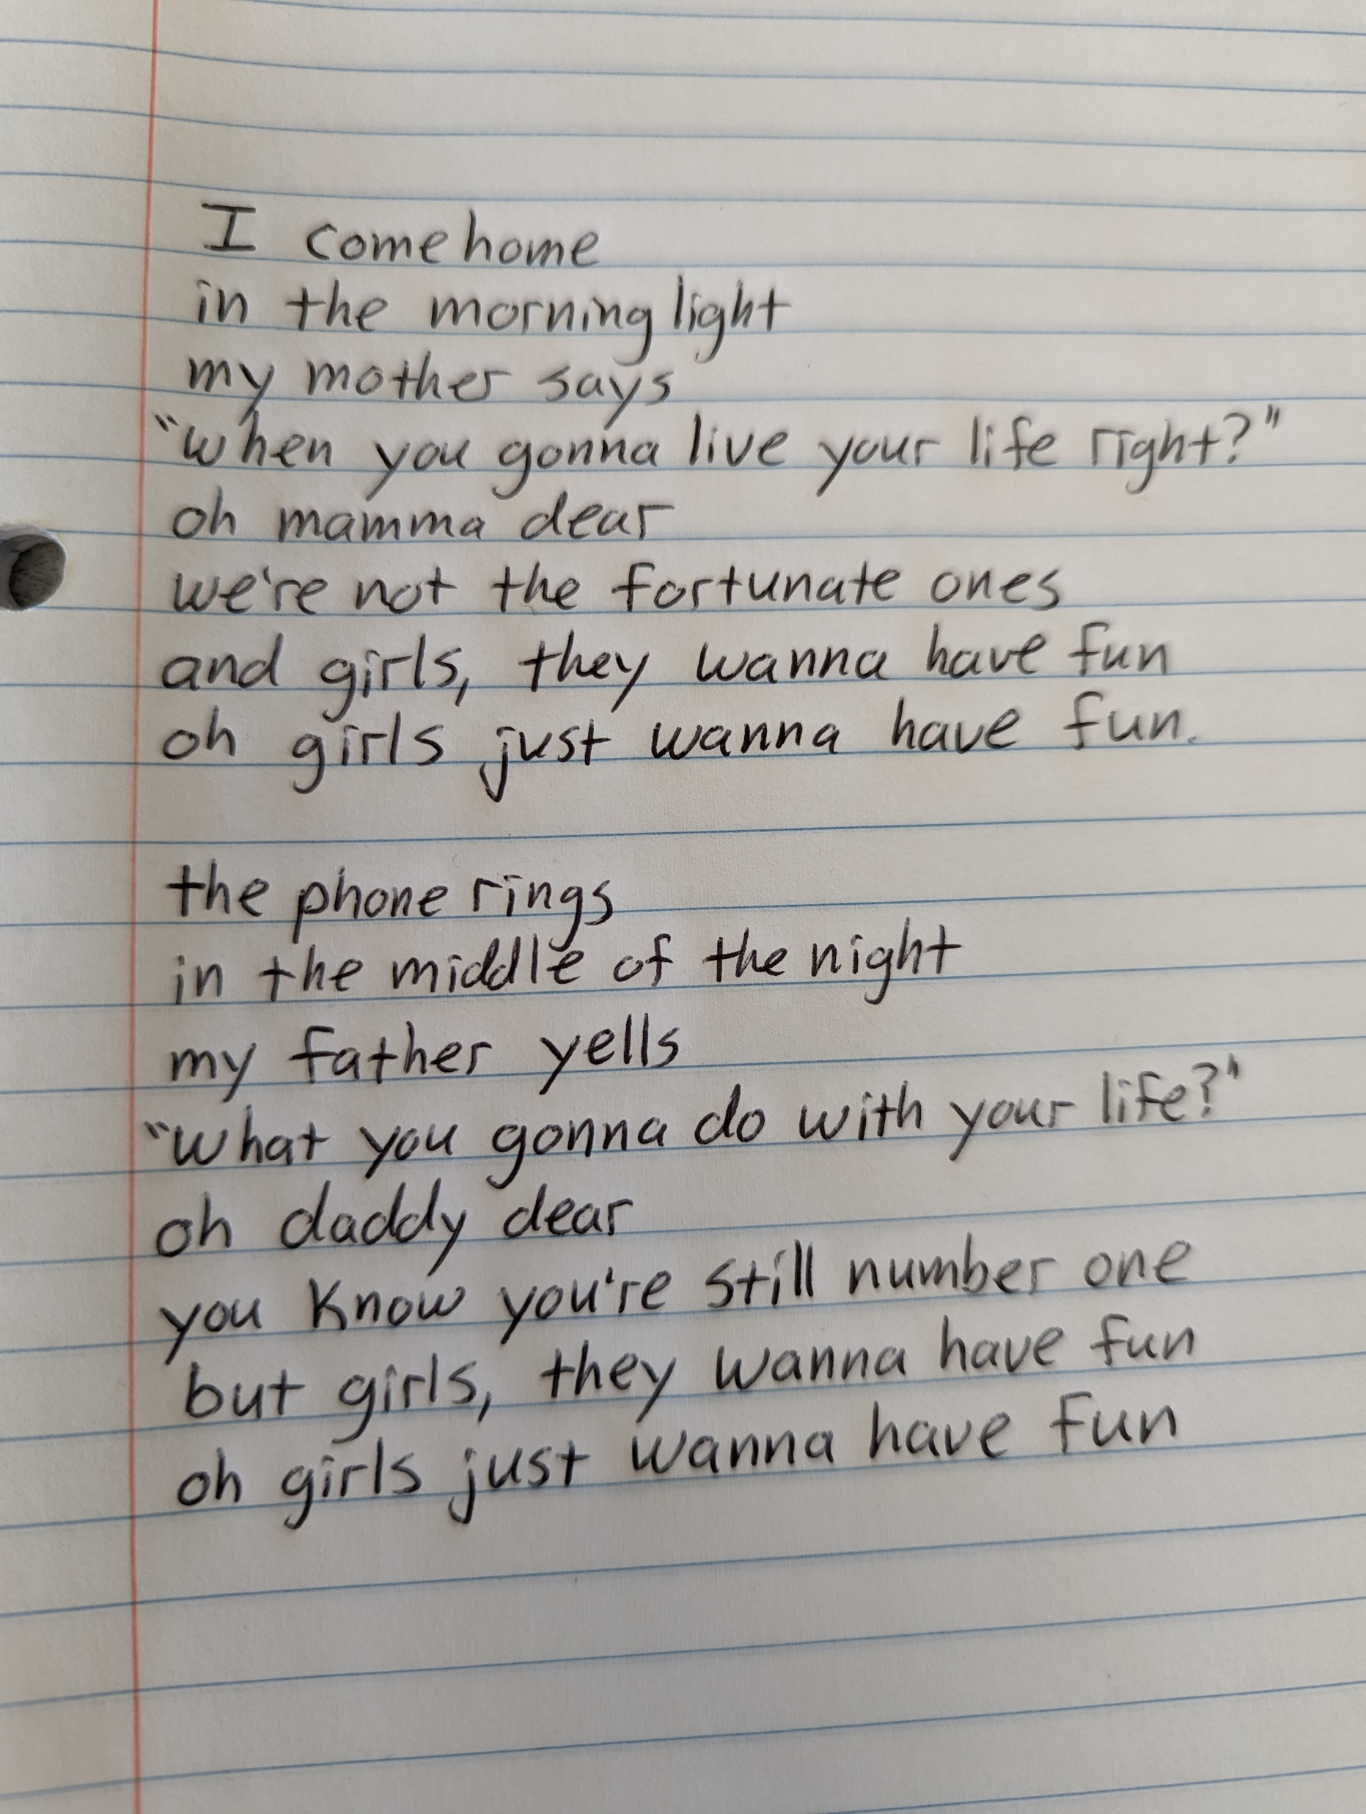
Notes:
Dan
We picked this set of lyrics from a song you’ve probably heard, and I wrote them out in a notebook.
Why it’s important to write it out by hand…get a feel for the physiciality of it all. Requires you to engage with the words differently – stretches a muscle that we don’t use that often any more

Slide 32
Notes:
Dan
Put those two stanzas side-by-side, and you can really see the pattern here.
Notice the rhymes: light / right / night, and she even rhymes “ones” with “fun” – it’s NOT a perfect rhyme, but it’s a perfect lyric.
And then we see the opposites within that same repeated pattern:
morning light / middle of the night
Mother says / father yells
So quickly google the lyrics to a song you like (if you need to look them up) and write them out by hand… doesn’t have to be the whole song, but at least two stanzas (and maybe a refrain?)

Slide 33
EXERCISE #1: SEE SONG STRUCTURE
Step 1: Pick a song you like
Step 2: Copy out the lyrics out by hand (look ‘em up if you need to)
Step 3: Notice the rhymes, beats, patterns, etc
Notes:
Here it is in 3 easy steps. Pick, copy, notice

Slide 34
EXERCISE #2: WORD LADDER
Notes:
Lynne This is an exercise from Jeff Tweedy’s book – write two columns…

Slide 35
10 verbs associated with a physician
10 nouns in your field of view
Examine
Thump
Prescribe
Listen
Write
Scan
Touch
Wait
Charge
Heal
Cushion
Guitar
Wall
Turntable
Sunlight
Window
Carpet
Drum
Microphone
Lightbulb
Notes:
Lynne
The Word Ladder exercise starts by quickly writing down two columns – verbs on one side, nouns on the other.
In this case, we went with verbs associated with doctors and nouns of things we can see

Slide 36
10 verbs associated with a physician
10 nouns in your field of view
Examine
Thump
Prescribe
Listen
Write
Scan
Touch
Wait
Charge
Heal
Cushion
Guitar
Wall
Turntable
Sunlight
Window
Carpet
Drum
Microphone
Lightbulb
The drum is waiting
By the window listening
Where the sunlight writes
On the cushions
Prescribed
Thump the microphone
The guitar is healing
Notes:
Lynne
Now, connect nouns and verbs that don’t normally go together. Jeff Tweedy explains it in his book – he says it’s “…not so much to generate a set of lyrics to but to remind myself of how much fun I can have with words when I’m not concerning myself with meaning or judging my poetic abilities…”
Here’s part of what Jeff Tweedy came up with. It’s not brilliant, but it’s not the worst.
And remember, we’re only doing the hardest part. We’re just getting started.
The next step is to toss out the rules we just followed and make something that makes more sense, more song-like. Not obligated to use every word…

Slide 37
the drum is waiting by the windowsill
where the sunlight writes its will on the rug
my guitar is healed
by the amp plug charging the wall
and that’s not all
I’m always in love
The drum is waiting
By the window listening
Where the sunlight writes
On the cushions
Prescribed
Thump the microphone
The guitar is healing
“That’s still a bit awkward but it’s definitely enough to jump-start my brain…”
- Jeff Tweedy
Notes:
Lynne
So here’s the example from his book, which ends up following a melody from a Wilco song…
And again, THIS IS NOT A GREAT SONG. It is a START and an IMPROVEMENT over the blank page and over the first sketch…

Slide 38
YOUR WORD LADDER
STEP 1
10 verbs associated with your team
Or your project
Or your sponsor
Or being a leader
STEP 2
10 nouns you might find in a coffee shop
Or a waiting room
Or a military base
Or a forest
STEP 3
Make pairs that don’t normally go together

Slide 39
EXERCISE #3: STEAL WORDS
Step 1: Flip to a random page
Step 2: Pick a word or phrase that catches your attention
Step 3: Copy it onto your paper
Step 4: Shuffle the phrase around,
Notes:
Dan
Here’s our next exercise in four easy steps.
We’re going pass out some newspapers / books and have you look for “found poetry” or just bits & phrases that have a rhythm, a vibe, or a message you like.
Look for an anchor word (Tweedy talks about finding the word catastrophe). Keep in mind, when we’re talking about lyrics, we’re talking about WORDS. Words have sounds and feelings as well as meanings. Words have length and syllables, they rhyme with other words (or don’t)
Then shuffle the words around, rearrange and play…

Slide 40
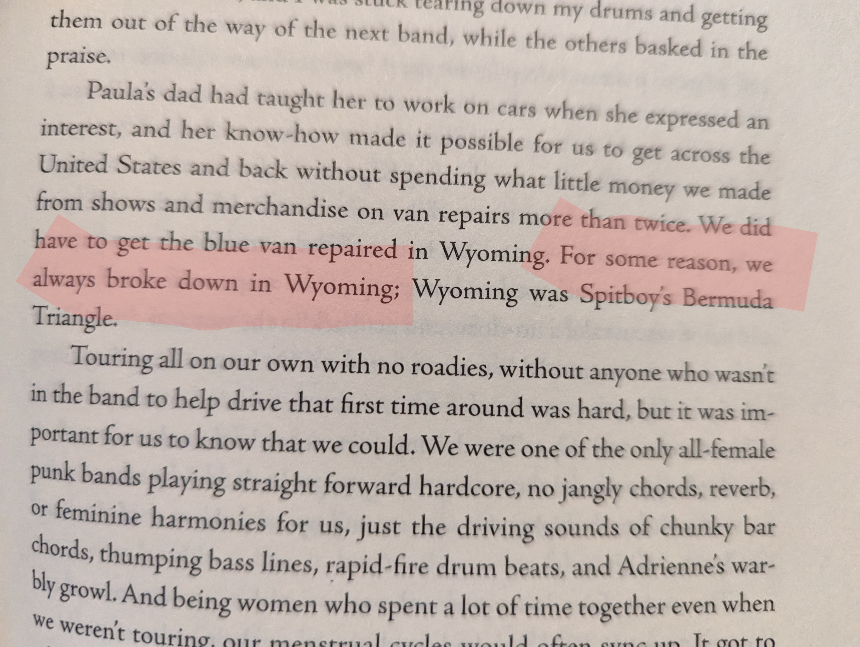
Notes:
Dan
Here’s an example of what this exercise might look like: I opened this book to a random page and my eyes caught on the phrase “for some reason…”
That sounded like a lyric to me – can’t you imagine a song titled For Some Reason?
Then I kept reading and the line “for some reason, we always broke down in Wyoming” just seemed like a perfect anchor for the kind of song I like.
The word “always” kinda killed me. It sort of begs the question “Why do we always break down in Wyoming?”
When I asked myself that question, I noticed the Why in Wyoming… and then I pivoted a little and thought “Why do we always go to Wyoming if we always break down there?”
That got me thinking about how “going to Wyoming” (do you hear the rhyme & rhythm of that phrase?) could be a metaphor for all kinds of breakdowns and counterproductive behaviors, all kinds of losses

Slide 41
EXERCISE #3: STEAL WORDS
Step 1: Flip to a random page
Step 2: Pick a word or phrase that catches your attention
Step 3: Copy it onto your paper
Step 4: Shuffle the phrase around,
Notes:
Dan
We’ll put 5 minutes on the clock for you to go steal some words

Slide 42
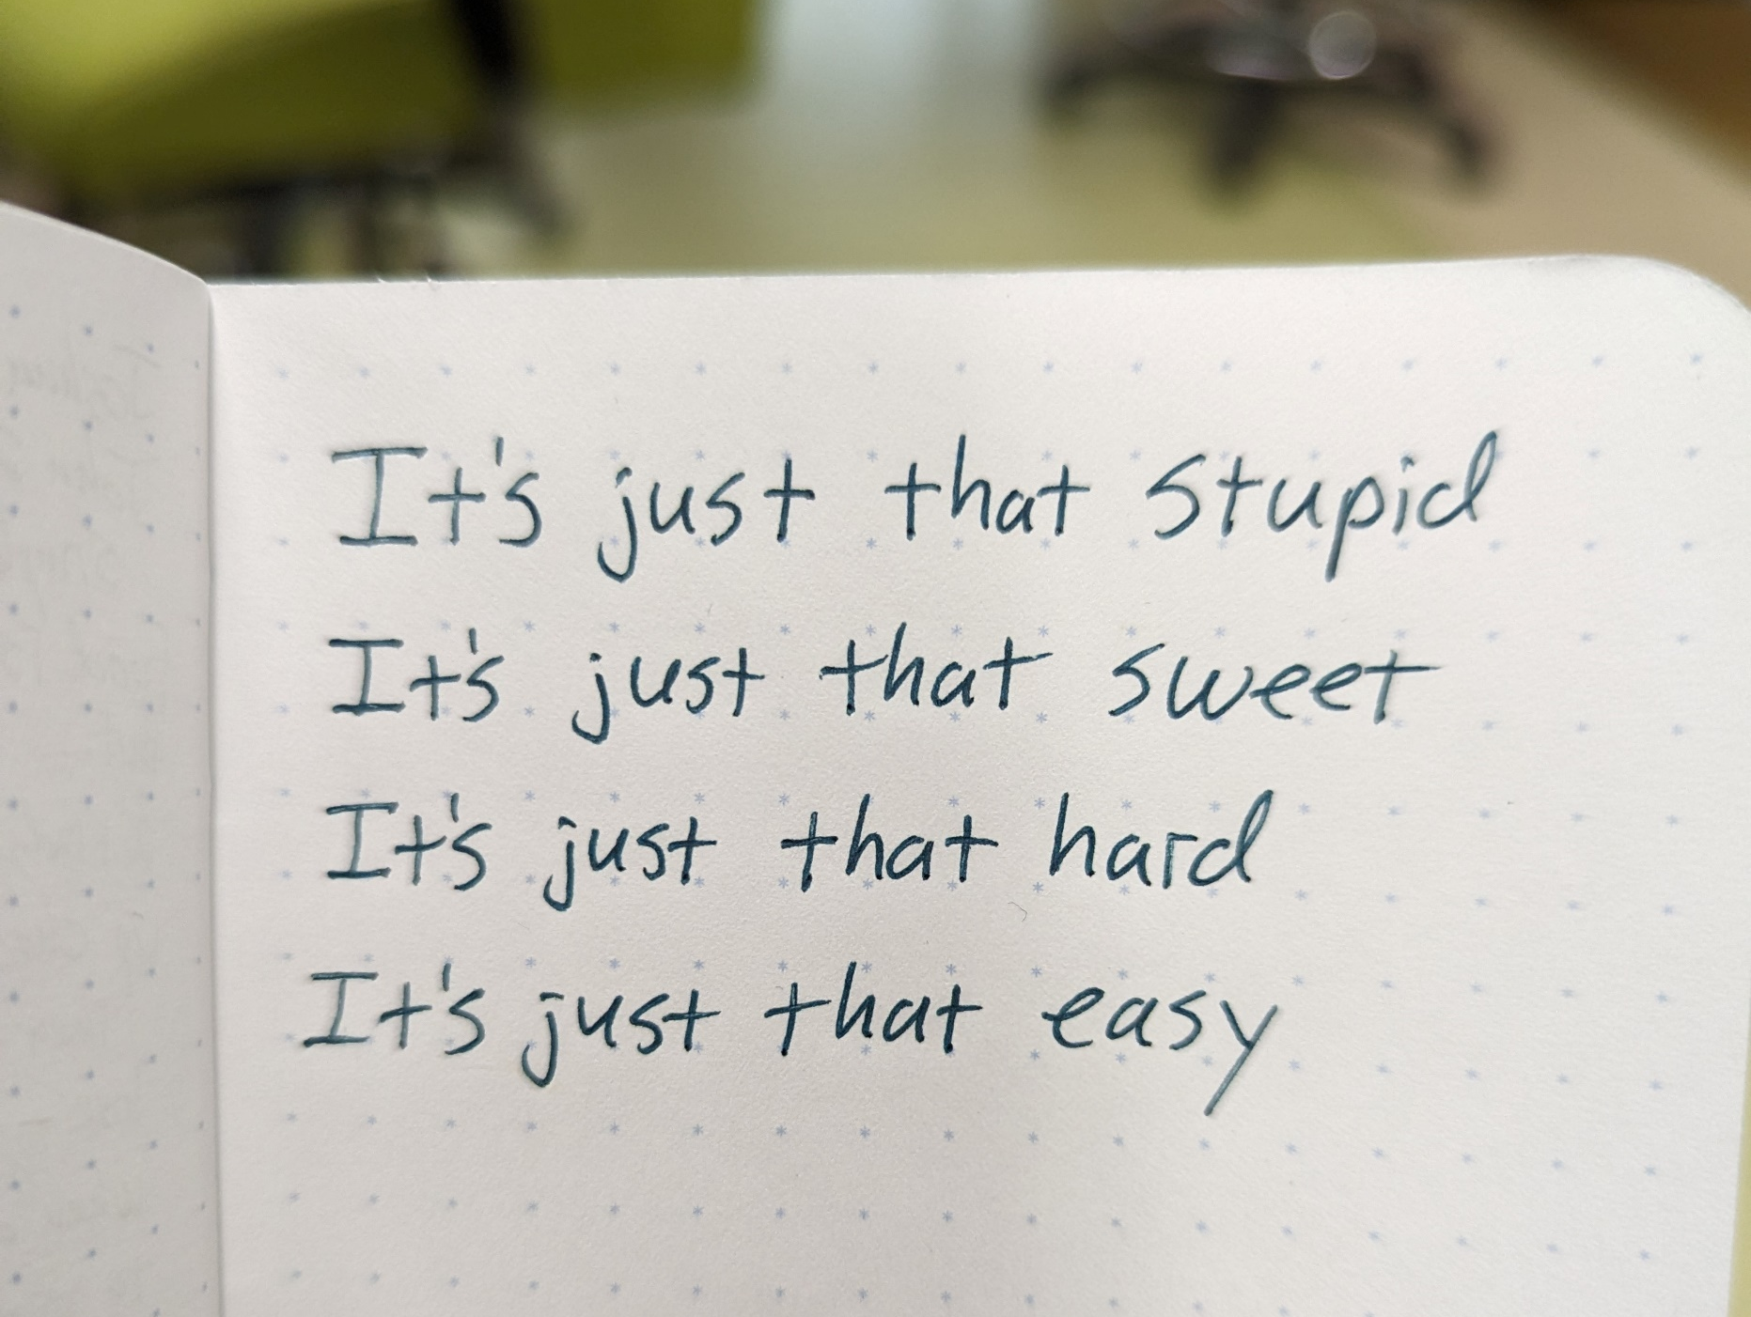
Notes:
Dan
Here’s a little snippet I wrote in my notebook as I thought about this songwriting exercise – it doesn’t use ANY of the first three exercises… and that’s sort of the point too. These exercises are supposed to unlock and enable and inspire – but feel free to go offroading and just write some stuff down.
This isn’t a final lyric, it doesn’t rhyme, the rhythm isn’t there yet, I’m not sure they’re in the right order… I want to put “sweet” in the fourth line… but I can imagine taking something like this and working on it, rearranging it, finding a rhythm to it…
I can imagine going back to the song structure exercise with this in hand… or blending this with some pairs from the word ladder… you get the picture.

Slide 43

Lynne & Dan’s Joint Song
The weight of race is heavy on my soul
I listen, listen, listen but I just don’t know
How to hide my surprise
When you say, “we’ve come a long way in the last 10 years”
It all feels like so many lies
A whole lot of things have to happen
And I wonder how deep we should go?
Independently or together?
The way ahead we simply don’t know.

Slide 44
WRITE THAT FIRST DRAFT*
*your first incomplete, partial, sketchy draft
Notes:
Dan
Again, we’re ONLY doing the hard part – getting started.
Take the words from exercises 2 & 3 – your word ladder and your stolen words – and start putting them into a structure that looks something like what you saw in exercise #1
You don’t have to use it all. Throwing away some pieces is just as important as finding some pieces.
You’ve got 5 minutes…

Slide 45

Share Your Draft
Share your draft with two other people. Sing it if you want!
This Photo by Unknown Author is licensed under CC BY-NC-ND

Slide 46
Five Reasons To Write Songs by Cliff Goldmacher
Makes you think differently
Take you out of your comfort zone
Shows you can do the “impossible”
Improves your ability to communicate
Brings teams together
Notes:
Remember these reasons from an hour ago? How does this line up with your experience from the past hour?
Do any of these sound familiar? Did writing a song do any of this for you?

Slide 47
Five Six MORE Reasons To Write Songs by Cliff Goldmacher
Demonstrates that we are all creative
Methodically access our creativity
Helps get over a generalized fear of failure
A shortcut to the emotional crux of any issue
Takes us back to a beginner’s mindset
BONUS REASON: It’s Fun!!
Notes:
How about this list?

Slide 48


What was AWESOME about the class?
What would make it MORE AWESOME?
Notes:
Two quick feedback questions – and keep in mind, that “nothing” is a valid answer to either of these questions

Slide 49
Thank you!
Let’s keep in touch!
Dan: dward@mitre.org
Lynne: lcuppernull@mitre.org
Notes:
Lynne
Intro selves, etc
Introduce each other at table groups
We’ll take breaks regularly – feel free to step out as needed

