Slide 1
Making Comics 101
Starring
Janet & Morgan
©2024 The MITRE Corporation. ALL RIGHTS RESERVED
Approved for public release. Distribution unlimited 24-02352-6
This work is licensed under CC BY-SA 4.0.
Notes:
In this interactive workshop, participants are invited to make their own comics as a way to explore different ways to communicate.

Slide 2
OUR AGENDA*
WHY COMICS? (with examples!)
TYPES OF COMICS! (mOaR eXaMpLeS!)
MECHANICS OF MAKING COMICS
Characters
Storyboarding
Working with Artists
Doing Your Own Art
* This is the ONLY time it’s ok to use Comic Sans, ‘cause I’m doing it ironically.
Notes:
We'll talk about WHY to make comics, look at a few examples of different types of comics, and then dive into the mechanics of HOW to do it.

Slide 3
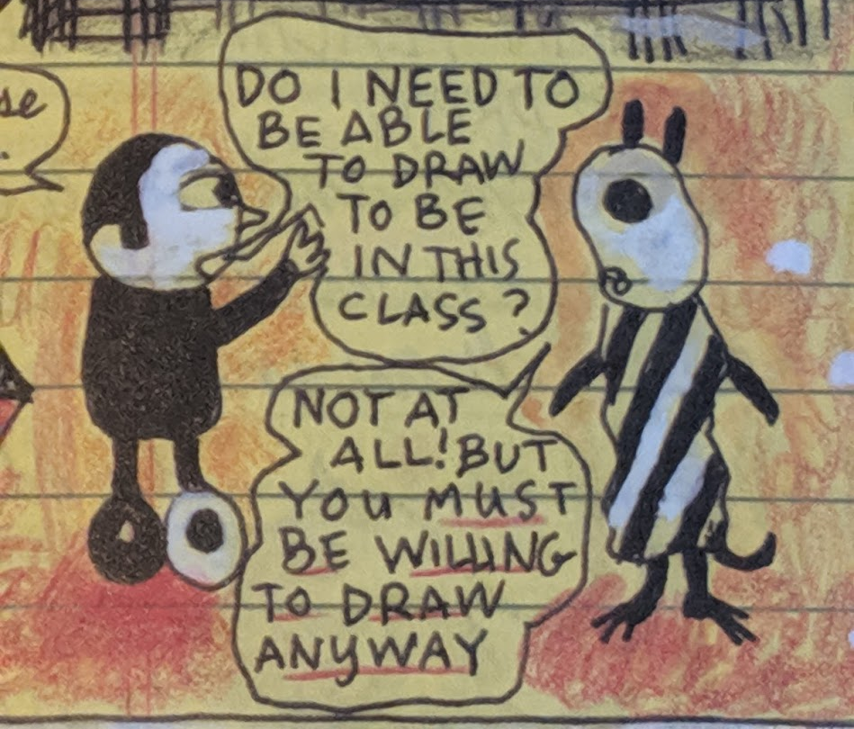
We love this panel from Lynda Barry’s book Syllabus. It applies to this class perfectly.
Notes:
And let's start with this super important concept about "skill."
If you can’t be willing and able, at least be willing…

Slide 4
Hey Morgan, why should people make comics?
Well Janet, there are lots of reasons! Let’s check out a few!
REASONS TO MAKE COMICS
Engage readers!
Enhance learning!
Memorable messaging!
Attention-getting!
Fun to make!
Become a billionaire!*
*You could be the very first comic-making billionaire!
Notes:
Let’s start with why we might want to make comics…

Slide 5
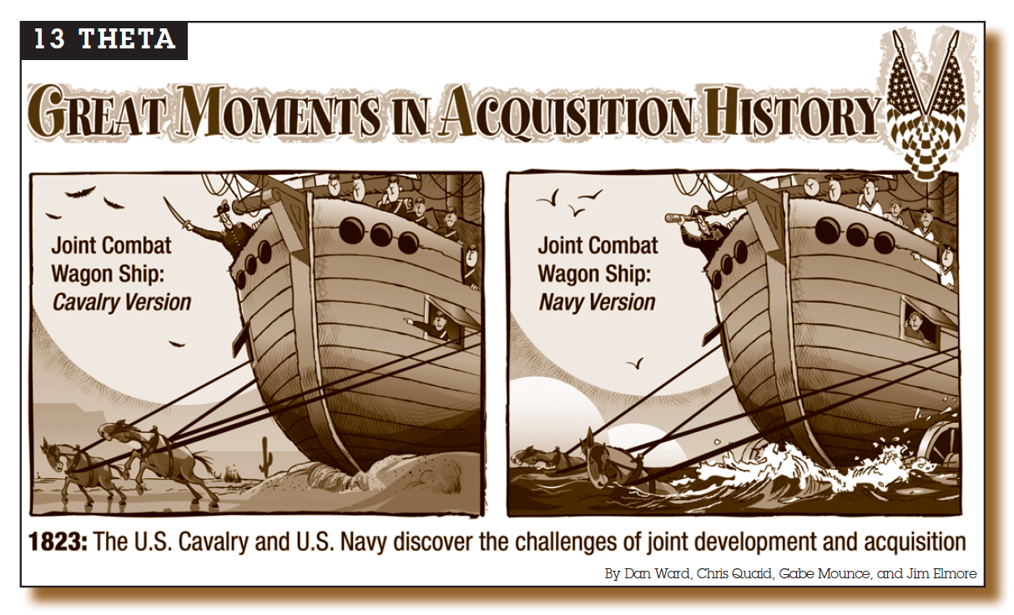
The Far Side™ style single-panel comic can be satirical…*
*Yes, this is about the F-35
Notes:
Comics come in a lot of different formats. My friends and I did several dozen of these single-panel comics for DAU’s magazine, for a few years.
We use this format to convey a single concept in each comic, to make a memorable point about something, and to move readers into a playful, open stance as they considered the idea.
This one was totally making fun of the F-35 (yes it was!) without actually mentioning the F-35. It’s still one of my favorites.
Let's take a moment to look it over – notice that the Cavalry version is pulled by horses, but it's still a ship! And the Navy version is ALSO pulled by horses, AND it has wheels... which would of course be unnecessary on a ship.

Slide 6
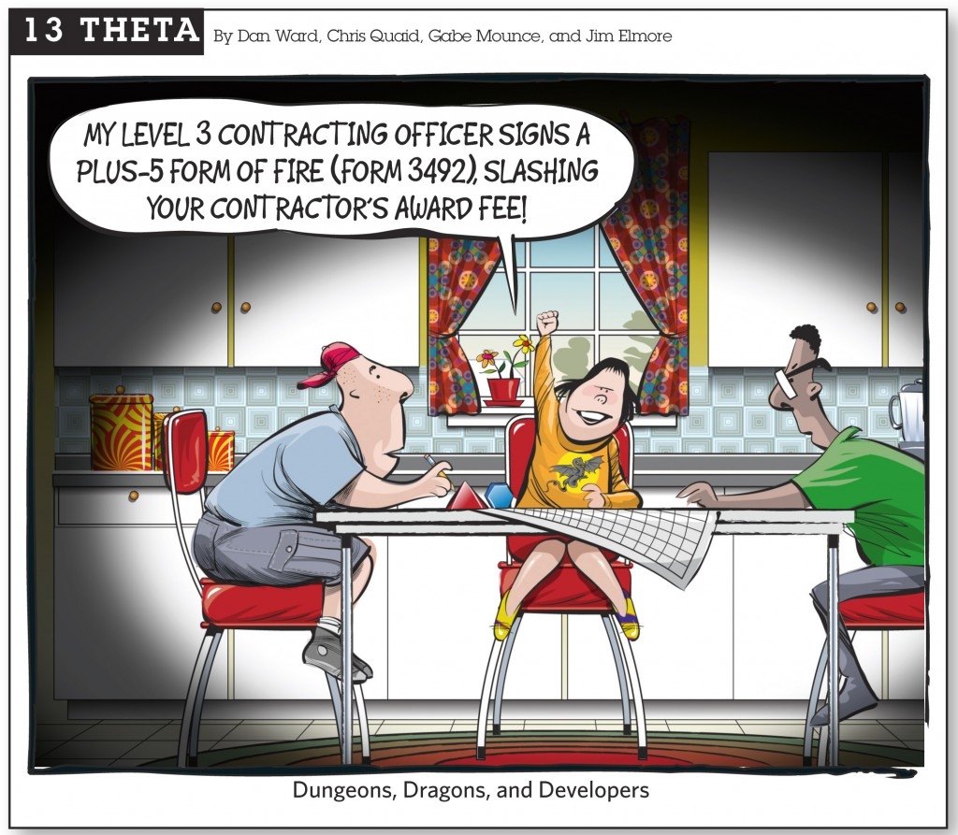
Or just silly!*
* If your comics aren’t playful, you’re doing it wrong.
Notes:
This format also creates something that people can cut out and hang on their wall, or use in social media as a way of developing brand.
This helped establish my personal brand as a super nerd among nerds. This comic doesn't have a specific point or lesson, it's not about a specific problem or system. It's just kinda silly. It's intended to make people smile or chuckle.
And let me be clear – it’s OK to be silly and playful.

Slide 7
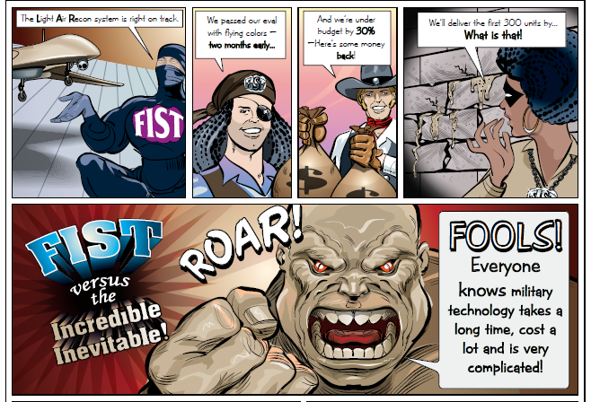
Working with an artist can be lots of fun!
Obviously, Dan does not always* work with an artist.
*Don’t let your lack of artistic ability hold you back
Notes:
But single-panel comics aren't the only option. This excerpt is from the third in a series of 2-page comics we did in DAU’s magazine – I’ll give you a minute to scan through it.
These comics basically aimed to make the case for rapid acquisitions – the acronym FIST stood for Fast, Inexpensive, Simple, and Tiny (which eventually became the acronym FIRE, in Dan's first book). We aimed to visually show the principles in a format that aimed to attract people who might not read a whole article. We were expanding our readership base.
There were four of us doing this – two buddies and I did the storyboard, then Jim our artist friend did the artwork.
We created the characters, laid out the storyboard, then handed it over to Jim to make it like this.

Slide 8
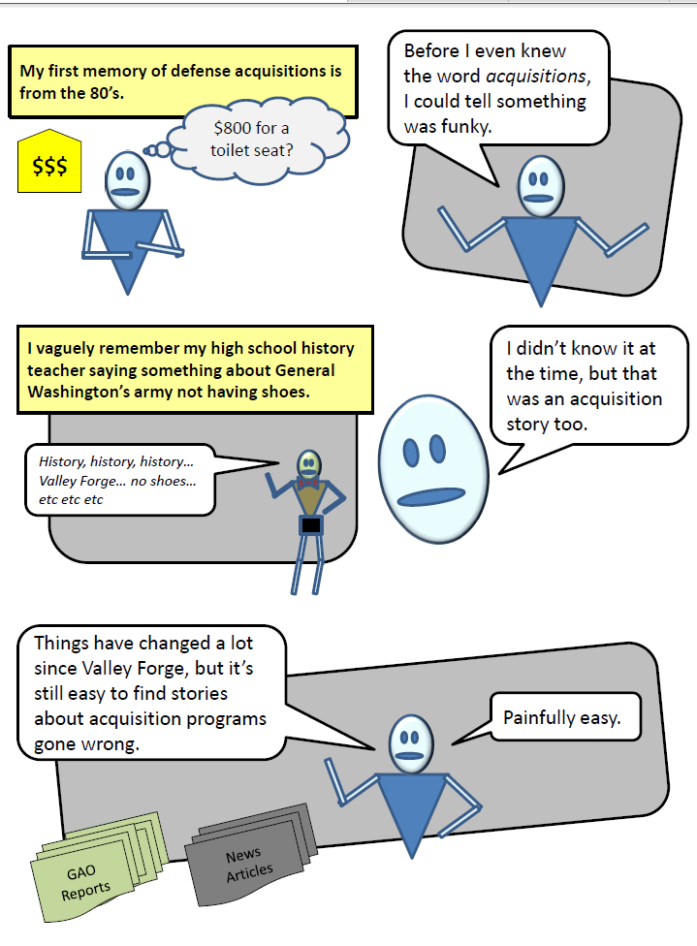
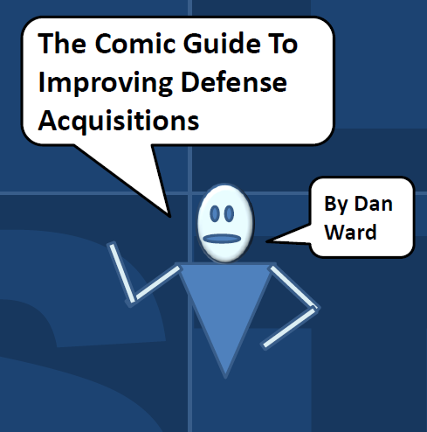
Notes:
Here's an example of my first real attempt at making my own complete comic, from scratch.
The main character was kinda flat and boring- but it’s not a bad place to start. I was just using shapes and bubbles in PowerPoint to tell a story.

Slide 9


https://www.newamerica.org/cybersecurity-initiative/policy-papers/the-graphic-guide-to-cybersecurity-and-simplicity/
Sometimes the artist’s version isn’t that different than mine!
Notes:
I did a pair of these “Graphic Guides” with New America – I did the layout & storyboard, they had an artist do the final version.
Unlike the previous one, this Comic Guide was pretty heavy on text (see more later).
This is a good approach for lightening up dense material (instead of dragging down light material – don’t do that)

Slide 10
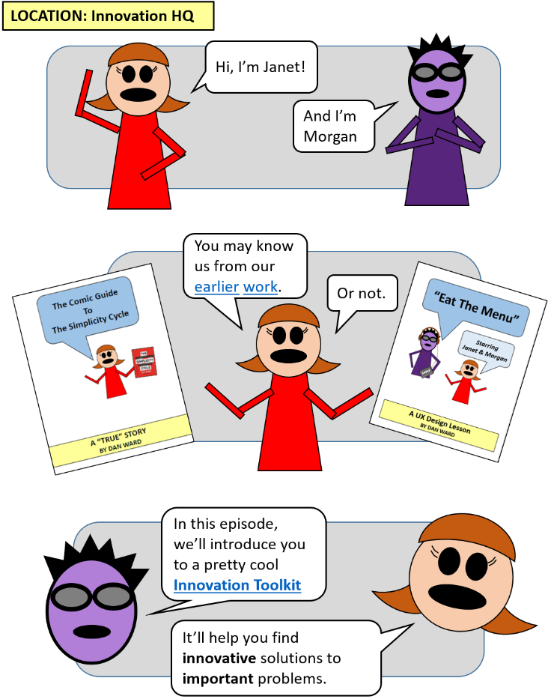
We’re Dan’s favorites*…
*True!
Notes:
But my favorite comics are the series using Janet & Morgan.
Why do I like them?
More personality than the earlier versio, more colorful, funnier
Creating a duo creates opportunity for dialog and telling a more engaging story!

Slide 11
CHARACTERS
Eyelashes are on point
Cool shades
Spiky hair
Long hair
JANET
Young
Enthusiastic
Gets it wrong
Asks lots of questions
Funny
MORGAN
Older
Patient
Wise
Provides explanations
Dry wit
Notes:
The thing that was missing in my first comic was any sort of personality in the character. I didn’t even give him a name – I guess it was supposed to be me, sort of?
Then I came up with Janet & Morgan. I thought long and hard about what they were like and how I would represent them, both visually and verbally.
The first J&M comic was about my simplicity cycle book, so I wanted to keep them both simple. No legs, hands or feet, pretty basic eyes… but a few little improvements over my original (unnamed) guy.
For example, they have names & backstories. Eyelashes. A sense of style, colors

Slide 12
!
!
!
Wait, brainstorming is not the only way to innovate?
Mind. Blown.
Tell me more!
Notes:
This is a single panel from the third J&M comic, let’s take a closer look at what’s going on here.
Janet is learning something. She’s expressing her reaction to the learning. She’s also teaching the reader. And she’s setting up the next point in the following panels with her “tell me more.”
She’s demonstrating her personality – her enthusiasm, curiosity, youth, and openness. The "Mind. Blown." Phrase shows a lot of personality. That’s a lot going on in one very simple panel – it’s one of my favorites.
And I really like her pose and the !!! above her head.
It’s a really simple panel – YOU CAN DO THIS – but it also shows a lot of deliberate decisions that I had to make.

Slide 13
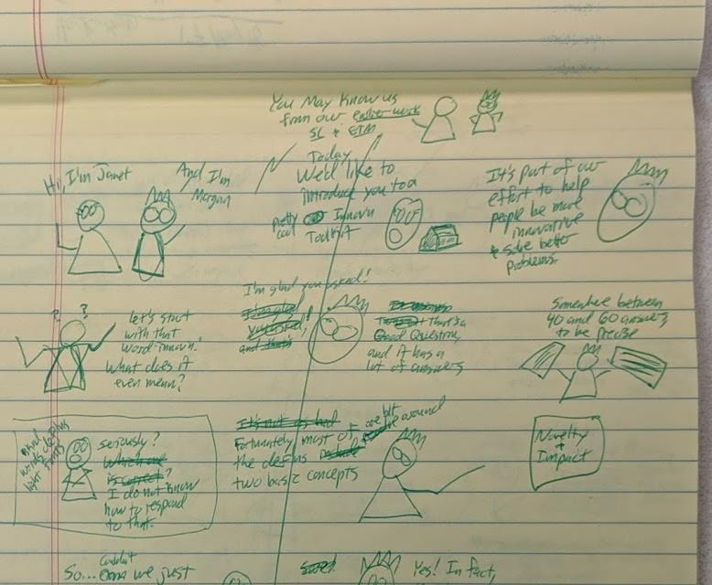
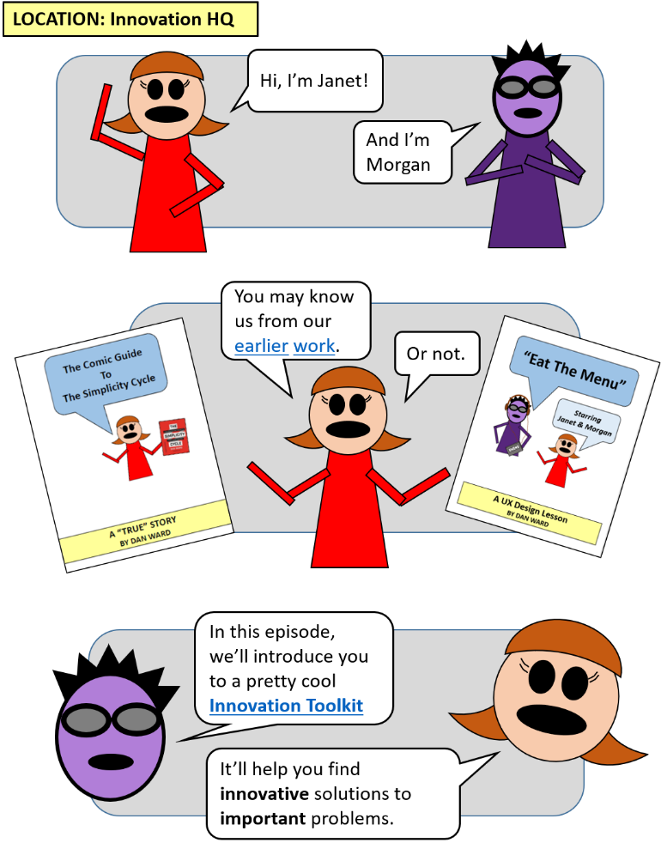
FIRST DRAFT
FINAL DRAFT
Notes:
OK, now let’s talk about mechanics.
I like to start with paper – sketching out the storyboard roughly – before I get into pixels on a screen
I think this is important because it creates space to be playful, to make crappy first drafts, and to be focused on the message or concept without getting distracted by colors and layouts.

Slide 14
Notes:
When it’s time to do it in PPT, I have a whole sheet of different poses for each character. I just copy & paste them into the scene as necessary.

Slide 15
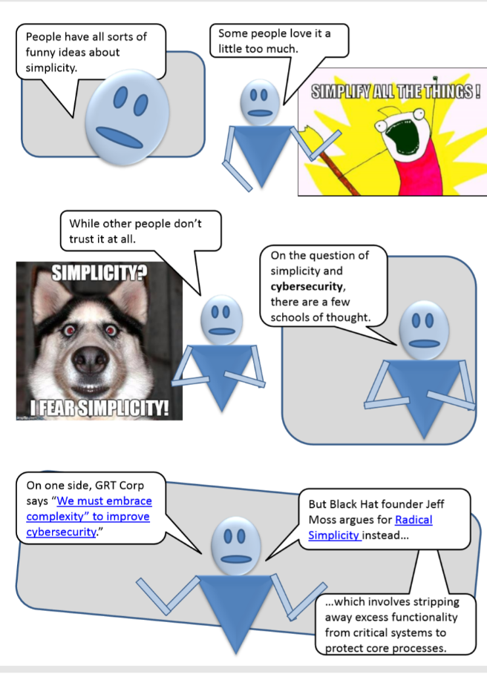
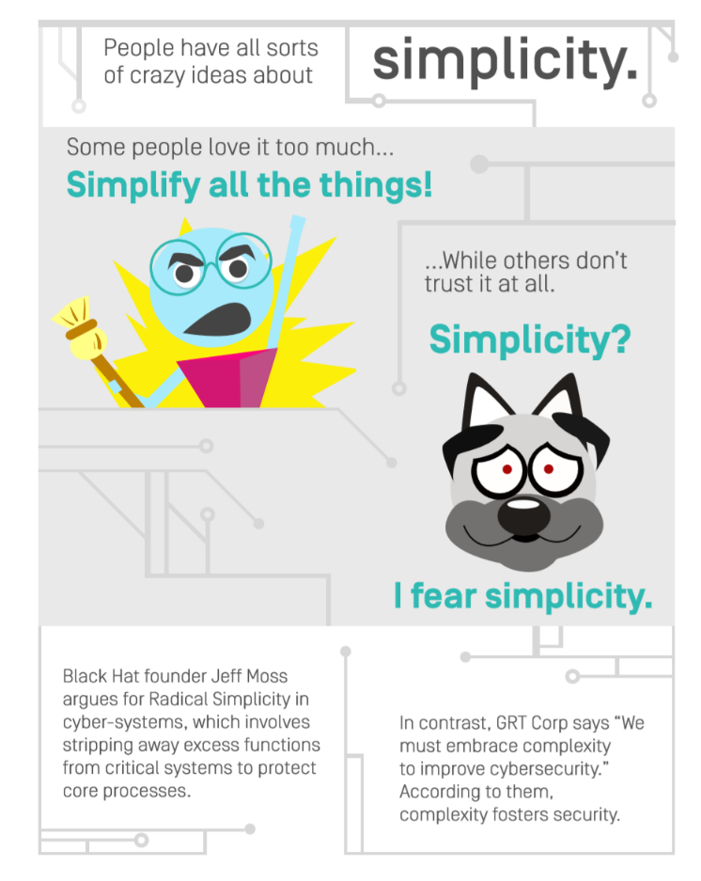
Here’s the sketch Dan submitted…
…alongside the final version.*
DRAFT
FINAL
*I kinda liked the original sketch better…
Notes:
Let’s talk about the mechanics of working with an artist. Here’s the draft I sent to the artist, alongside the final version. You might recognize that blue guy from my original comic
I kinda liked mine better, tbh, because the memes lost something in translation.

Slide 16
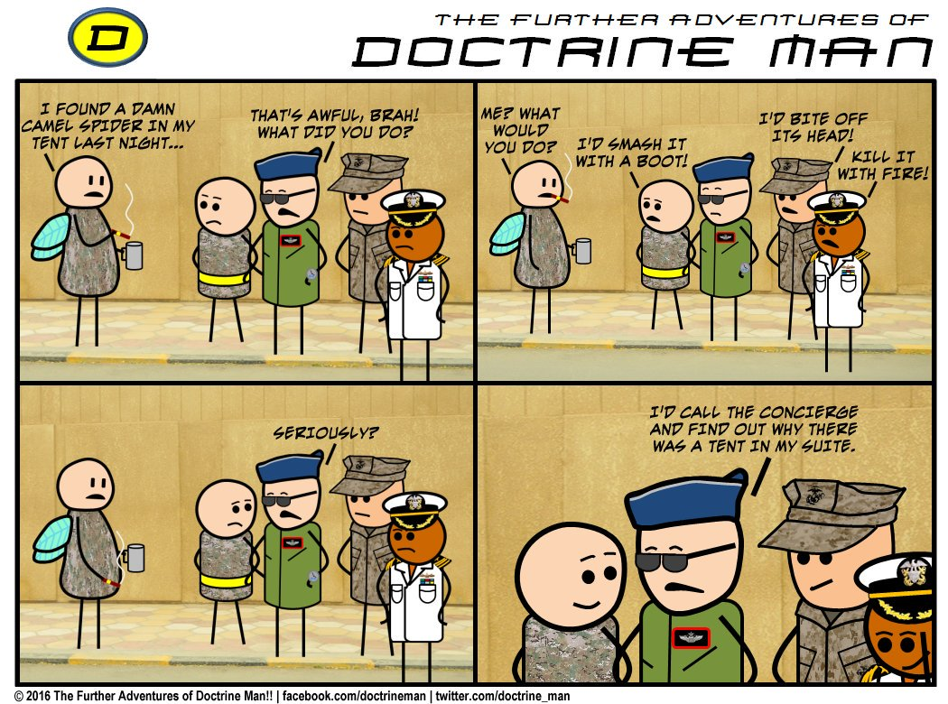
Notes:
Doctrine Man is the master of this genre – study his approach.
Note – NOT a master at drawing. Or is he?!?!?!?

Slide 17
Do you see what he’s doing here?
SAME CHARACTER
ZOOMED
IN
Notes:
See what he’s doing here? The EXACT same character, same pose, shows up in multiple panels.
Still keeps it interesting by changing up the characters around the unchanged ones, while making it fast and easy to create new panels.
The photo background gives a sense of reality. And the four panel divisions provides the story flow.

Slide 18
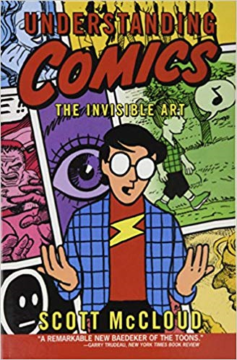
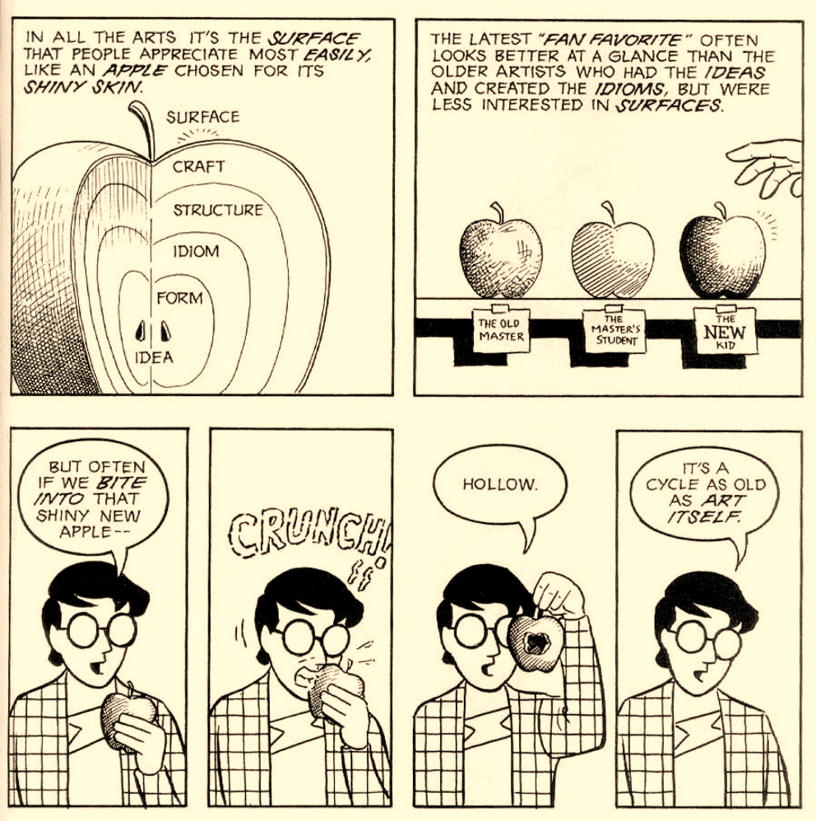
You should read his book!
Scott McCloud is the master of this topic
Notes:
If you're interested in going deeper, check out Scott McCloud's book
Or don't – it's ok to just play around with this stuff too.

Slide 19
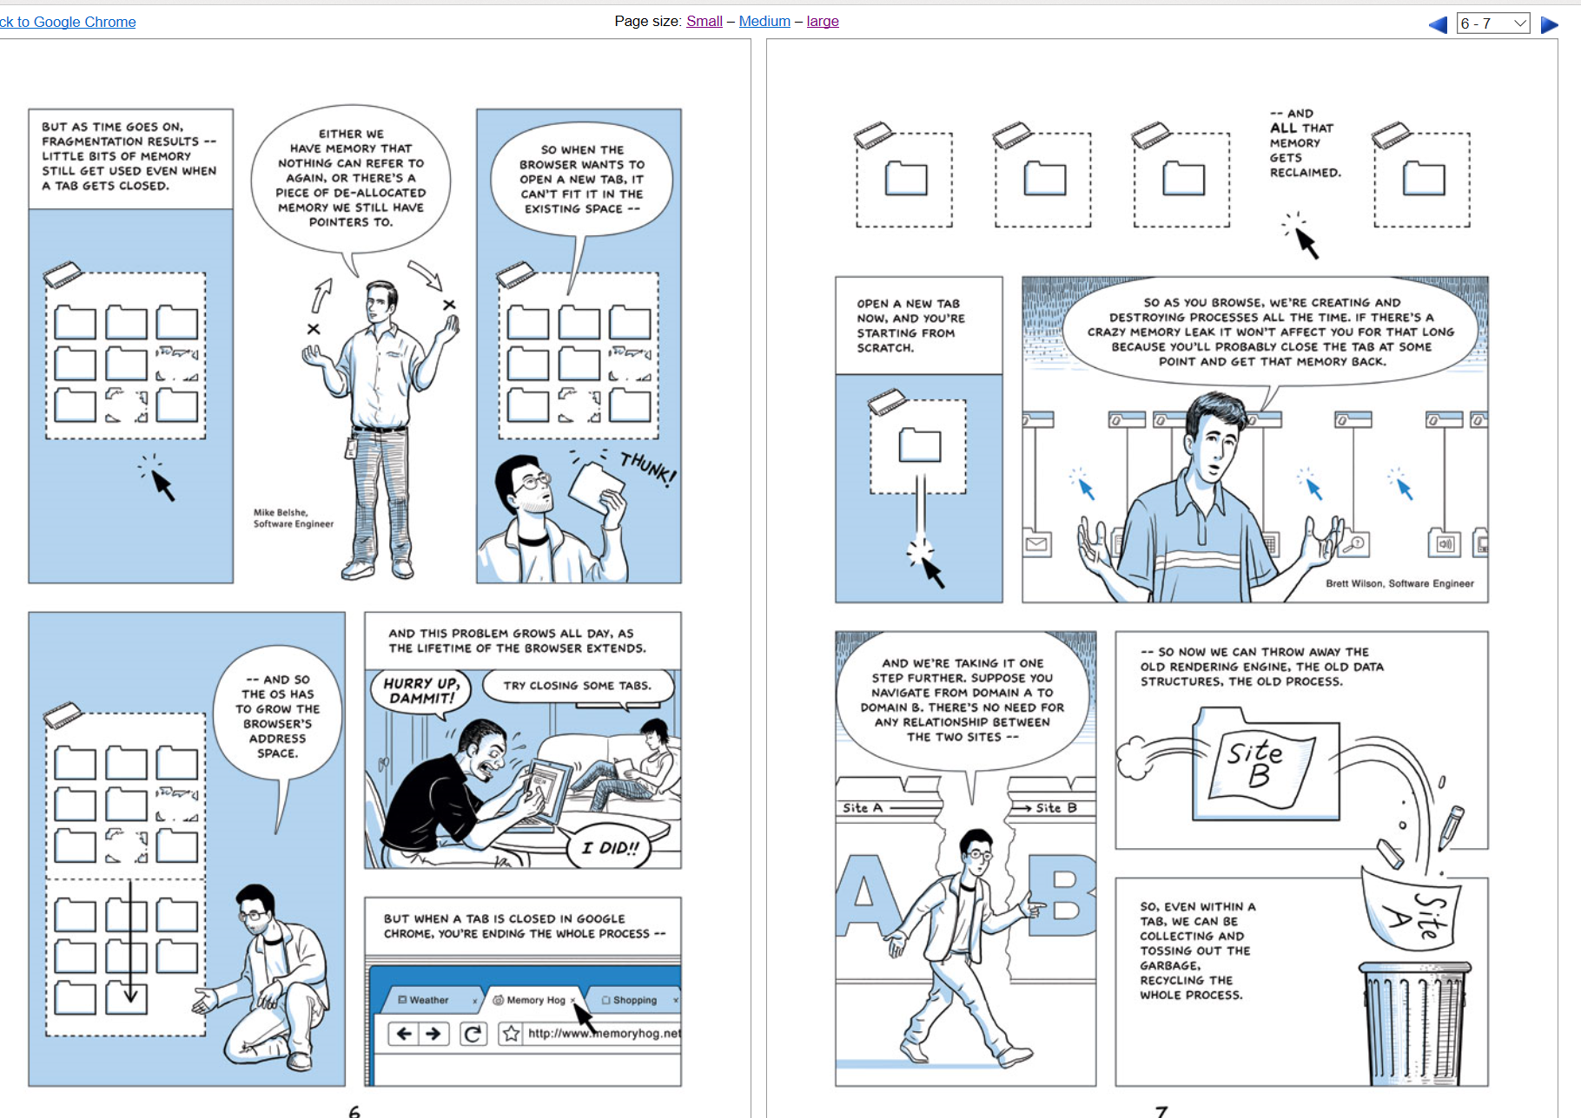
He also did a pretty cool comic about Google Chrome in 2008…
https://www.google.com/googlebooks/chrome/big_00.html
Notes:
In 2008, Scott McCloud did this comic for a new browser called Google Chrome – you might have heard of it.
It’s brilliant & I recommend reading it. A great example of a technical tutorial written for a general audience, very engaging & easy to read, terrific tone

Slide 20
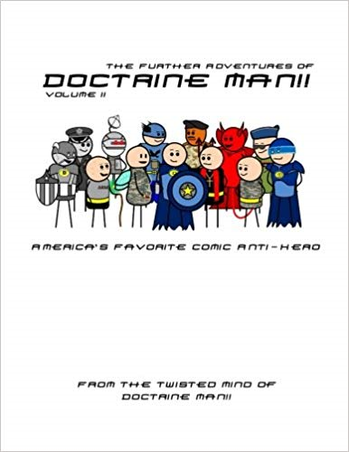

“The best cartoons are drawn from real life experiences.”
Notes:
Where do we get ideas from? Studying the masters, of course, but also from real life (yours and others).
When I asked Steve Leonard (aka Doctrine Man!) for a tip to share with you today, here’s what he said.

Slide 21

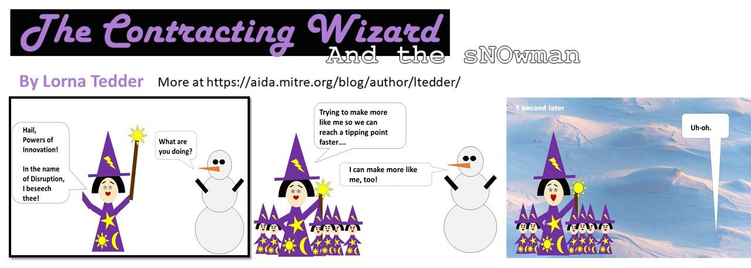
Notes:
Here’s an example of a great comic series that my friend Lorna created

Slide 22
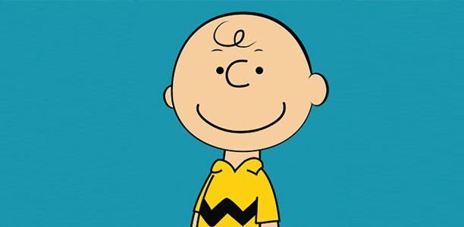
How much technical art ability does it take to draw him?
Have you ever really looked at Charlie Brown?
Notes:
One more comment about the “I can’t draw” mentality…

Slide 23
MESSAGE
What do you want to say?
VOICE
How do you want to sound?
Find your…
Who do you want to reach?
AUDIENCE
Where will you go?
OUTLET
Notes:
OK, so let’s do this… but where do you start? Consider these four questions
The top 2 questions are: What do you want to say? What do you want to sound like? The only way to answer those is to write.
Then who are you writing for and where will you find them? Who’s head are you trying to get into, and what stuff do they already read? (make sure you’re reading it too)
I don’t necessarily recommend sitting down and filling in these four quadrants. Instead, I recommend sitting down writing something, making a comic… and having these questions in mind as you do so.

Slide 24

MESSAGE
VOICE
Introducing people to rapid innovation practices & ideas
Personal, practical, funny, engaging
AUDIENCE
OUTLET
Defense acquisition professionals
ITK Blog, LinkedIn, Twitter, Uxmag.com
Notes:
Here are my answers to those 4 questions…

Slide 25

Let’s try an exercise inspired by Lynda Barry’s book Syllabus

Slide 26
Draw Batman’s head… in 15 seconds.

Slide 27
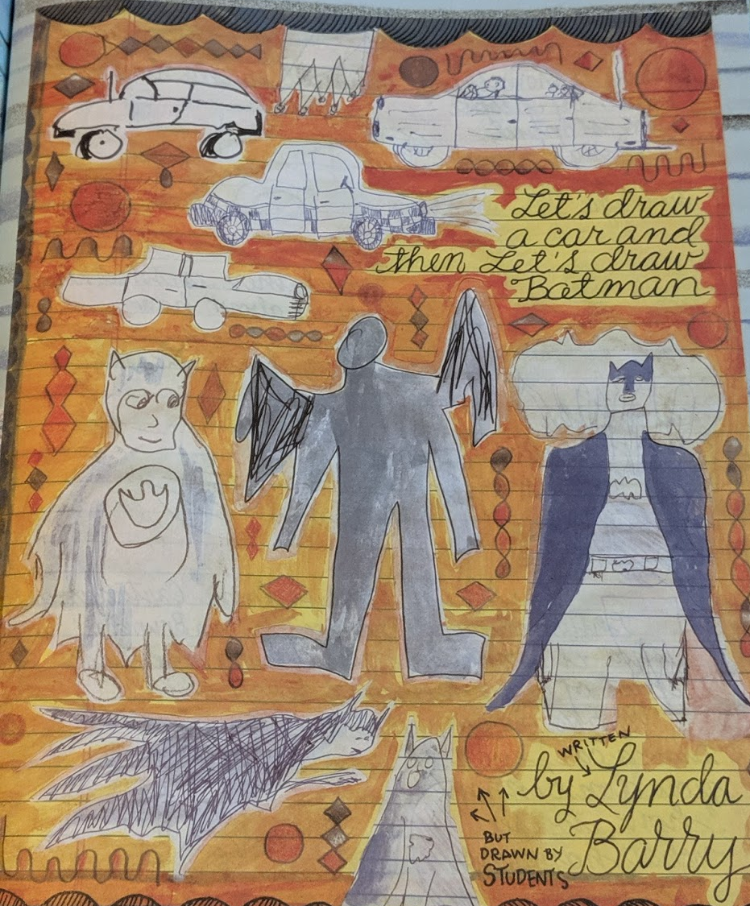
This is what some of Lynda Barry’s students came up with!*
*She also had them draw cars…

Slide 28

And now it’s time to draw!
YAY! I love drawing!
Notes:
OK, let’s get started!
Sketch a character – I like going on paper, but you can start digital if you want.
Sketch a pair of characters.
Think about how you want to sound, what you want to say, whose head you’re trying to get into…
Keep those four questions in mind...

