Slide 1
TRIMMING FLOWCHART
START
REMOVE
ONE
PIECE
Y
Y
TRY
AGAIN?
DISCARD
PIECE
DOES
SYSTEM
WORK?
REPLACE
PIECE
TRY
AGAIN?
Y
N
N
N
FINAL
DESIGN

Slide 2
1)
2)
3)
4)
5)
LIST THE PIECES
START
REMOVE
ONE
PIECE
Y
Y
TRY
AGAIN?
DISCARD
PIECE
DOES
SYSTEM
WORK?
REPLACE
PIECE
TRY
AGAIN?
Y
N
N
N
FINAL
DESIGN

Slide 3
1) THRESHOLD
2) TIMEBOX
3) THOROUGH
4) OTHER
DEFINE STOP
STRATEGY
START
REMOVE
ONE
PIECE
Y
Y
TRY
AGAIN?
DISCARD
PIECE
DOES
SYSTEM
WORK?
REPLACE
PIECE
TRY
AGAIN?
Y
N
N
N
FINAL
DESIGN

Slide 4
START
REMOVE
ONE
PIECE
1) Obviously extraneous
2) Threshold busters
3) Speedy
4) Accelerator
5) Random
6) Obviously necessary
Y
Y
TRY
AGAIN?
DISCARD
PIECE
DOES
SYSTEM
WORK?
REPLACE
PIECE
TRY
AGAIN?
Y
N
N
N
FINAL
DESIGN

Slide 5
START
REMOVE
ONE
PIECE
Delete – Remove entire piece
Trim – Remove portion of piece
Integrate – Combine multiple pieces
Shrink – Replace piece with smaller version
Remove Copy – Reduce redundancy
Trust – Remove a check function
Polish – Remove friction/delay between pieces
Y
Y
TRY
AGAIN?
DISCARD
PIECE
DOES
SYSTEM
WORK?
REPLACE
PIECE
TRY
AGAIN?
Y
N
N
N
FINAL
DESIGN

Slide 7
START
REMOVE
ONE
PIECE
Y
Y
TRY
AGAIN?
DISCARD
PIECE
DOES
SYSTEM
WORK?
REPLACE
PIECE
TRY
AGAIN?
Y
N
N
Create an experiment.
Collect data.
Analyze data.
Draw conclusion.
N
FINAL
DESIGN

Slide 8
START
REMOVE
ONE
PIECE
Y
Y
TRY
AGAIN?
DISCARD
PIECE
DOES
SYSTEM
WORK?
REPLACE
PIECE
TRY
AGAIN?
Y
N
N
Discard / Replace entire piece.
Discard / replace part of piece.
Replace alternative piece.
N
FINAL
DESIGN

Slide 9
1) THRESHOLD
2) TIMEBOX
3) THOROUGH
4) OTHER
APPLY STOP
STRATEGY
START
REMOVE
ONE
PIECE
Y
Y
TRY
AGAIN?
DISCARD
PIECE
DOES
SYSTEM
WORK?
REPLACE
PIECE
TRY
AGAIN?
Y
N
N
N
FINAL
DESIGN

Slide 10
START
REMOVE
ONE
PIECE
Y
Y
TRY
AGAIN?
DISCARD
PIECE
DOES
SYSTEM
WORK?
REPLACE
PIECE
TRY
AGAIN?
Y
N
N
N
FINAL
DESIGN

Slide 11
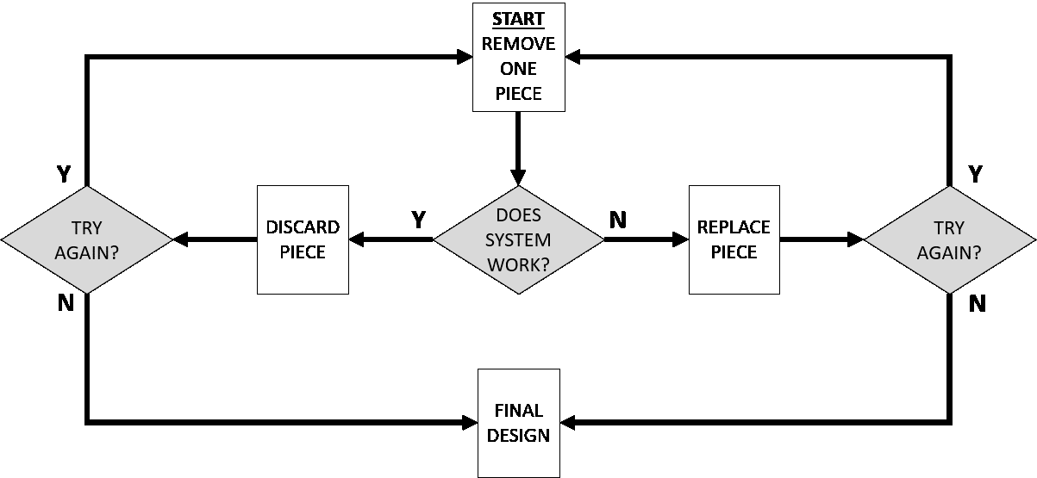
TRIMMING CANVAS
Project Name:
Date_____________
HYPOTHESIS
When Will We Stop?
How Do We Pick Which Pieces To Remove?
If we trim __________________________
out of _____________________________
we can_____________________________.
Meet Threshold / Goal
At a Certain Time
After checking Every Piece
Other
Obviously Extraneous
Threshold Busters
Speedy Trim
Acceleration Trim
Random
Obviously Necessary
Other
I am using the Trimming canvas in order to___________________
I can tell it is time to stop trimming when______________________
What Are The Pieces
(List and Categorize)
How Do We Remove Pieces?
Delete – Remove entire piece
Trim - Remove portion of piece
Integrate - Combine multiple pieces
Shrink – Replace with smaller piece
UnCopy – Remove redundant piece
Trust – Remove a check function
Polish – Remove friction between pieces
Relocate – Move piece elsewhere
Other
Does The System Work?
How will you confirm the core function?
Describe an experiment & data collection plan
How might we _______________________________________
(PERFORM KEY FUNCTION)
in the absence of ____________________________________
(PIECE BEING REMOVED)
without causing harm to_______________________________.
(STAKEHOLDERS / ENVIRONMENT / GOALS)
Discard/Replace Mechanism(s)
Discard / Replace entire piece
Discard / Replace part of piece
Introduce alternative piece

